Slide 1
Traditional vs.
Activity-Based Costing (ABC)
International Management Accounting
Prof. Dr. Marc Beutner
TH Köln
4th Lecture
SoSe 2023

Slide 2
What are we going to do?
Methods of
assigning overheads
ABC steps and
cost drivers,
product and
period costs
value chain analysis
Finishing the rest of lecture 3
Activity-Based Costing (ABC)
Planning & controlling
Flexible budget,
variance and controlling
Budgeting techniques
and processes
Cash flow budgets
and company valuation
Standard costing method
Budgetary control systems -
Standard costing and variance
Bowhill Ch. 7-9

Slide 3
Step 1:
finishing the rest of lecture 3
Activity-Based Costing (ABC)
Methods of
assigning overheads
ABC steps and
cost drivers,
product and
period costs
value chain analysis

Slide 4
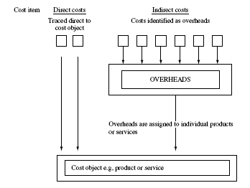
Full or total costing –
Costing of products and services
Graphic according to Bohill
2008 John Wiley & Sons Ltd.
www.wileyeurope.com/college/bowhill

Slide 5
Methods of assigning overheads
Identifying overheads to be assigned using
    Blanket overhead rate, or
    Different cost recovery rate for different areas of organization
Methods of "blanket overhead" cost recovery to product and services
    Cost per unit
    Cost per labour hour
    Cost per $ / £ / € of labour
    Cost per machine hour

Slide 6
Methods of assigning overheads
4 steps to overhead cost allocations across departments
Graphic according to Bohill
2008 John Wiley & Sons Ltd.
www.wileyeurope.com/college/bowhill

Slide 7
Methods of assigning overheads
Step 1: Calculating departmental overhead rate
Graphic according to Bohill
2008 John Wiley & Sons Ltd.
www.wileyeurope.com/college/bowhill
Cost | Basis of apportioning costs to cost centres
Canteen costs | Number of employees
Rent /Heating and lighting | Floor area
Insurance | Cost of assets in the department

Slide 8
Methods of assigning overheads – Steps 2 to 4
Step 2: Costs of service departments´ needs to be reallocated
to ´production´ departments
Step 3: Calculate separate overhead rate for each
´production´ department
  e.g. labour hour rate = Overhead/budgeted labour hours =
  $10000/1000 = $10/hour
Step 4: Assign overhead rate to each product or service
    e.g. 1,5 hours at $10/hour = $15

Slide 9
Overhead allocation by department
Example: Milton Ltd.s two distinct bicycle frames
  "Alto" requires 1,5 hours in the machine shop and 2 hours in the welding department
  "Special" requires 2 hours machine shop and 3 hours in welding

Slide 10
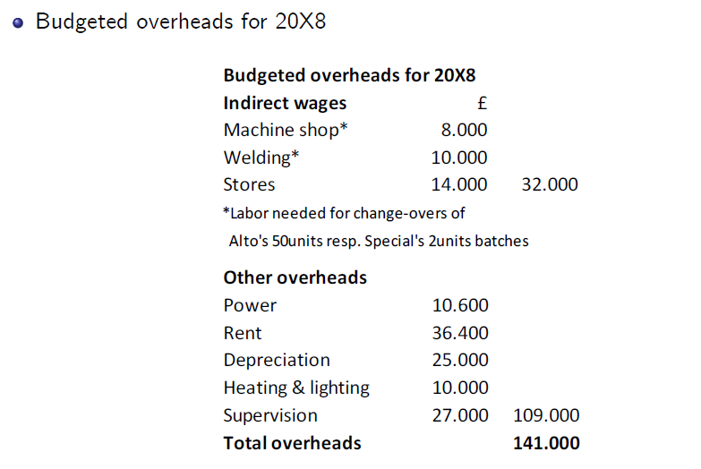
Methods of assigning overheads – Example

Slide 11
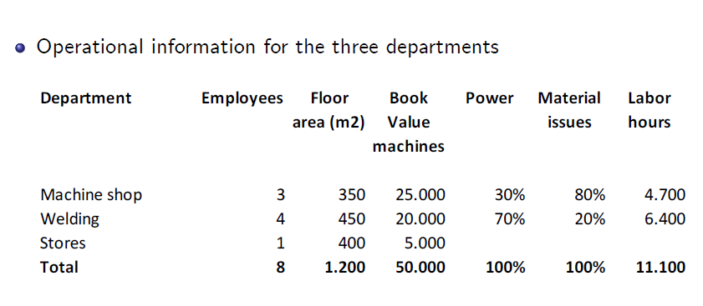
Methods of assigning overheads – Example

Slide 12
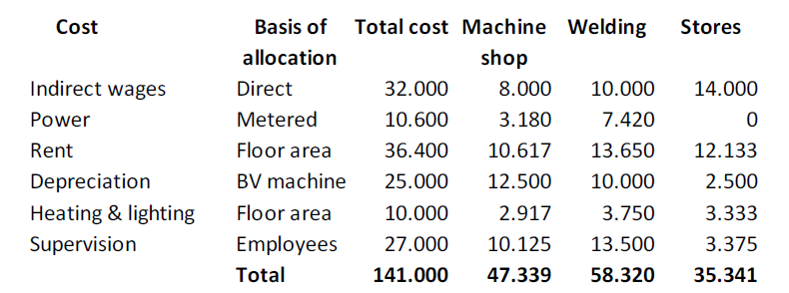
Methods of assigning overheads – Example Step 1
Step 1: Overhead costs identified by department

Slide 13
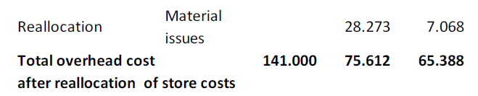
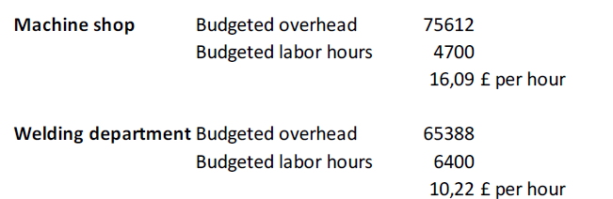
Methods of assigning overheads – Example Step 2 and 3
Step 2: Cost of support departments allocated to
productive cost centres
Step 3: Calculate rate for each cost centre for assigning
overheads to products
80%
20%
35.341 from Stores
!
Labour hours Slide 11!
Labour hours Slide 11!

Slide 14
Methods of assigning overheads – Example Step 4
Step 4: Assign cost centre costs to individual products
Average full cost to make 1 Alto:
Machine shop labor 1,5 hrs @ £6 per hour 9,00
Welding cost centre labor 2 hrs @ £8 per hour 16,00
Materials 50,00
Direct costs 75,00
1.5 hrs in machine shop @ 16,09 per hour 24,03
2 hrs in welding department @ 10,22 per hour 20,44
Overhead cost 44,47
Total cost 119,47

Slide 15
Methods of assigning overheads – Example Step 4
Step 4: Assign cost centre costs to individual products
Average full cost to make 1 Special:
Machine shop labor 2 hrs @ £6 per hour 12,00
Welding cost centre labor 3 hrs @ £8 per hour 24,00
Materials 60,00
Direct costs 96,00
2 hrs in machine shop @ 16,09 per hour 32,18
3 hrs in welding department @ 10,22 per hour 30,66
Overhead cost 62,84
Total cost 158,84

Slide 16
ABC Costing
Again we will have a look at
Milton Ltd.
And the bicycle frames / producs Alto and Special
But now, we are using a different approach:
ABC Costing

Slide 17
ABC Steps
Step 1
Identify activities
Step 2
Assign costs to activities
Step 3
Identify cost drivers and respective cost-driver rates
Step 4
Compute the cost per unit product or service

Slide 18
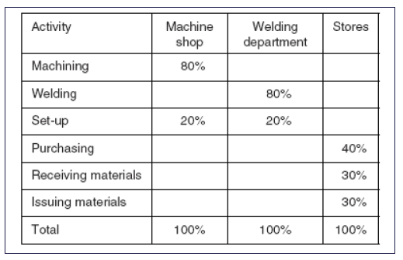
ABC Costing – Example Step 1
ABC Step 1: Identify activities

Slide 19
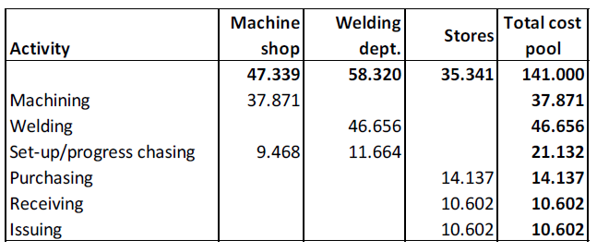
ABC Costing – Example Step 2
ABC Step 2: Assigning costs to activities

Slide 20
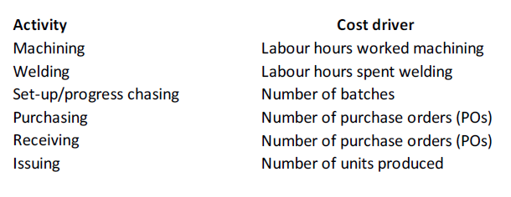
ABC Costing – Example Step 3
ABC Step 3: Identify cost drivers for each activity and their respective
cost-driver rates

Slide 21
ABC Costing – Example Step 3
ABC Step 3: Identify cost drivers for each activity and their respective
cost-driver rates

Slide 22
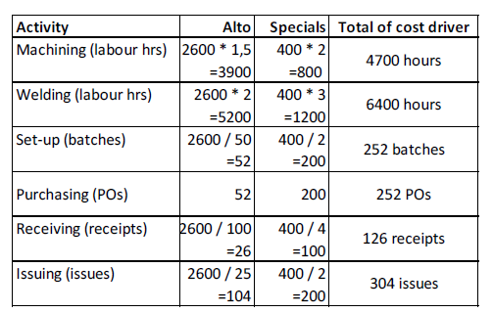
ABC Costing – Example Step 3
ABC Step 3: Identify cost drivers for each activity and their respective
cost-driver rates
Cost-driver usage given 2600 units of product A (Alto) and 400 units of product B (Specials)

Slide 23
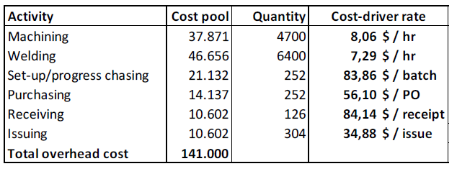
ABC Costing – Example Step 3
ABC Step 3: Activity Cost driver rate

Slide 24
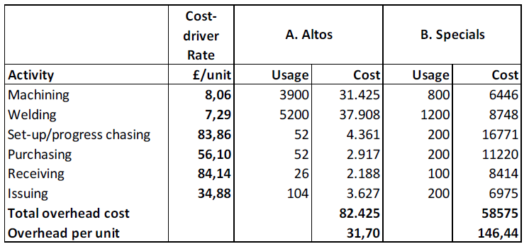
ABC Costing – Example Step 4
ABC Step 4: Identify cost per unit product/service
2600 units of product A (Alto) and 400 units of product B (Specials) – slide 22

Slide 25
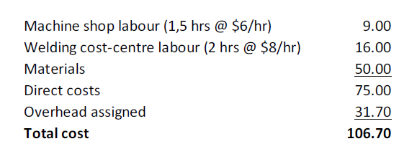
ABC Costing – Example Step 4
Therefore Alto´s total ABC-calculated unit cost
Question 1:
What about for the bicycle frame Special?
Question 2:
How do the results of ABC analysis differ from traditional full-costing?
Please, explain.

Slide 26
Ideal scenarios for ABC application
Proportionally high indirect costs and majority fixed i.e. do not increase directly with volumes
Diverse range of products, consuming resources in different proportions
Intense competition necessitates more accurate costing
Lastly, ABC is extremely useful for
  Analyzing profitability and identifying cost-saving opportunities
  For entire company and for separate cost objects e.g. customer account profitability

Slide 27
Costing methods differ by industry
Job costing:
each unit of product or service is unique
(HW1 Mr Jones, the painter)
Batch costing:
a finite amount of units is produced for each unique product
(e.g. furniture production)
Contract costing:
A system of job costing used for long-term contracts
(e.g. shipbuilding)
Process costing:
when a continuous stream of identical units are produced through the same stages (e.g. oil refineries)

Slide 28
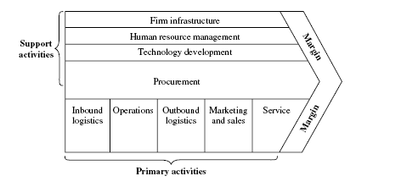
Value-chain analysis
Graphic according to Bohill
2008 John Wiley & Sons Ltd.
www.wileyeurope.com/college/bowhill
Primary activities:
Inbound logistics, operations, outbound logistics, marketing & sales, service
Secondary activities: Firm infrastructure, human resource mgt, (HRM), procurement, technology/product/service development

Slide 29
Cost behaviour and value-chain activities
Cost structure of businesses and industries evolved over last few decades
Proportion of direct manufacturing an operational costs decreased
Increasing importance of indirect costs e.g. research and development (R&D), information technology (IT) to distribution, marketing and customer service
With the advent of internet and media-oriented activities many costs do not necessarily change in proportion to volume of products or services produced

Slide 30
Competitive benchmarking and cost cutting:
People Express
Cost per seat mile was $1.35 less than United Airlines due to strategic decisions in the following .ve areas:
Pre-arrival and airport operations (ticket counter, gate operations, baggage handling) ($0.42 per seat mile)
Costs associated with aircraft ($0.18 per seat mile)
Flight operations (pilots and .ight crew) ($0.40 per seat mile)
Cabin operations ($0.32 per seat mile)
Marketing and sales ($0.03 per seat mile)
=) Could they have achieved this with traditional full costing?

Slide 31
What are we going to do?
Budgetary control systems -
Standard costing and variance
Planning & controlling
Flexible budget,
variance and controlling
Budgeting techniques
and processes
Cash flow budgets
and company valuation
Standard costing method
Bowhill Ch. 7-9

Slide 32
Definition:
„A budget is a quantification of a plan, for a defined period of time“
Bohill, page 155

Slide 33
Planning and Controlling

Slide 34
Learning Outcomes
Understand the objectives of budgeting and controlling
Describe and derive various budgeting techniques
Calculate and interpret flexible budgets and variances based on standard costs
Describe various production processes and
controlling approaches

Slide 35
Planning and controlling - I
Graphic according to Bohill
2008 John Wiley & Sons Ltd.
www.wileyeurope.com/college/bowhill
Long-term planning
1. Where is the business today?
2. Establish objectives
3. Search for alternative ways ("strategies") to
achieve objectives
4. Evaluate options and select appropriate or
optimal one
5. Prepare long-term (multi-year) business plan

Slide 36
Planning and controlling - I
Graphic according to Bohill
2008 John Wiley & Sons Ltd.
www.wileyeurope.com/college/bowhill
Long-term planning
t₀
t₁
t₂
t₃
t₄
t₅
t_{n}

Slide 37
Planning and controlling - II
Graphic according to Bohill
2008 John Wiley & Sons Ltd.
www.wileyeurope.com/college/bowhill
Annual planning and controlling
1. Prepare annual plans and
performance targets
2. Quantify plans in form of budgets
3. Monitor actual results and identify variances
4. Respond to variances and
adjust course of action

Slide 38
Planning and controlling - II
Graphic according to Bohill
2008 John Wiley & Sons Ltd.
www.wileyeurope.com/college/bowhill
Annual planning
and controlling
…
t₀
t₁
t₂
t₃
t₄
t₅
t_{n}

Slide 39
Budget reviews:
„On a regular basis (probably every three months) most organisations review the actual oucome for the year to date and the budget for the remainder of the financial year in order to identify if the original budget will be achieved.
If it is not likely to be achieved then corrections may be taken.
This is know as forward control.“
Bohill, page 156

Slide 40
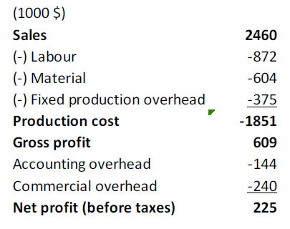
Example:
Budget P&L for Dundee Bicycles division for period April 20X8 to Mar 20X9
Information according to Bohill
2008 John Wiley & Sons Ltd.
www.wileyeurope.com/college/bowhill
= 1851 production cost

Slide 41
Potential benefits of budgeting
Improved planning
Improved coordination and communication
Improved control of the actions of organizations
Improved evaluation of the performance of managers
Higher motivation of staff¤

Slide 42
Recall the conditions in which ABC may be appropriate
Information according to Bohill
2008 John Wiley & Sons Ltd.
www.wileyeurope.com/college/bowhill
  Indirect costs are a high proportion of total costs.
  There is a diverse range of products or services provided.
  There is competition and accurate costing is needed for pricing and in order to eliminate non-value-adding activities
  Activity-Based Costing (ABC)

Slide 43
Administration of a budget
Information according to Bohill
2008 John Wiley & Sons Ltd.
www.wileyeurope.com/college/bowhill
Responsibility accounting
Responsibility centres
  Profit
  Cost
  Revenue
  Investment

Slide 44
Flexible Budget
A flexible budget is the original budget adjusted for the change in the actual level of activity.

Slide 45
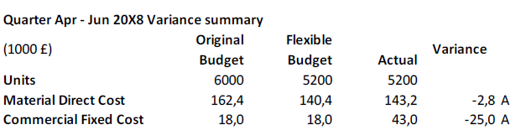
Original vs. flexible budget
Note:
To follow Bowhill.s terminology, define variances as
(-) when they reduce profits
(Adverse Variance i.e. when revenue decrease or costs increase)
versus
(+) when they increase profits
(Favorable variance i.e. when revenue increase or costs decrease)

Slide 46
Adverse and favourable variance
If actual revenue is less than budget then this is an adverse variance.
If actual revenue is greater than budget then this is a favourable variance.
If actual cost is greater than budget then this is an adverse.
If actual cost is less than budget then this is a favourable variance.
(Bohill, p. 160)

Slide 47
Just a short own calculation example –
Calculate the variance
Quarter Jul Sep 2012 Variance summary
Original Flexible
(1000£) Budget Budget Actual Variance
Units 6500 5800 5800
Material Direct Cost 164,2 148,2 152,1 ? A
Commercial Fixed Cost 20,4 20,4 37,2 ? A

Slide 48
Just a short own calculation example –
Please, check the variance: +? -?
Quarter Jul Sep 2012 Variance summary
Original Flexible
(1000£) Budget Budget Actual Variance
Units 6500 5800 5800
Material Direct Cost 164,2 148,2 147,1 +1,1 A
Commercial Fixed Cost 20,4 20,4 37,2 -16,8 A

