Slide 1
Traditional vs.
Activity-Based Costing (ABC)
International Management Accounting
Prof. Dr. Marc Beutner
TH Köln
3rd Lecture
SoSe 2024

Slide 2
What are we going to do?
Demand-based pricing
and
Strategy
Finishing the rest of lecture 2
  Market-based pricing
  Richmont PLC
Lecture 3: Traditional vs. Activity-Based Costing (ABC)
Methods of
assigning overheads
ABC steps and
cost drivers,
product and
period costs
value chain analysis

Slide 3
Step 1:
Demand-based pricing
and
Strategy
Finishing the rest of lecture 2
  Market-based pricing
  Richmont PLC

Slide 4
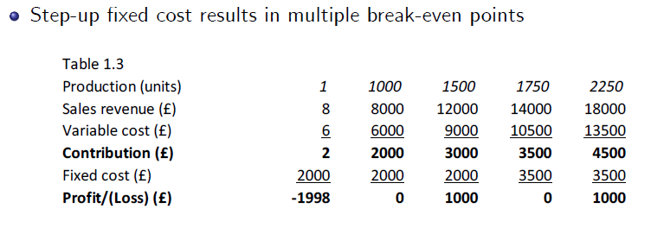
Looking Back: Multiple break-even points
Graphic according to Bohill
2008 John Wiley & Sons Ltd.
www.wileyeurope.com/college/bowhill

Slide 5
Exercise: Calculate multiple break-even points
Graphic according to Bohill
2008 John Wiley & Sons Ltd.
www.wileyeurope.com/college/bowhill
  Units 1 1,000 1,500 2,000 2,500
£ £ £ £ £
Total sales revenue 10
Variable cost 8
Fixed cost until 1499 = 2,500 £ over 1500 unit = 3,500 £
Calculate profit and loss and find the multiple BEPs!

Slide 6
Solution: Calculate multiple break-even points
Graphic according to Bohill
2008 John Wiley & Sons Ltd.
www.wileyeurope.com/college/bowhill
  Units 1 1,000 1,500 2,000 2,500
£ £ £ £ £
Total sales revenue 10 10,000 15,000 20,000 25,000
Variable cost 8 8,000 12,000 16,000 20,000
Fixed cost 2,500 2,500 3,500 3,500 3,500
Total cost 2,508 10,500 15,500 19,500 23,500
Profit/ (loss) (2,498) (500) (500) 500 1,500
BEP 1:
2500
2
= 1250 units
BEP 2:
3500
2
= 1750 units

Slide 7
Market-based pricing –
Overview on approaches to pricing

Slide 8
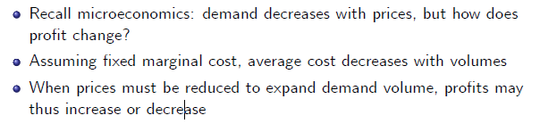
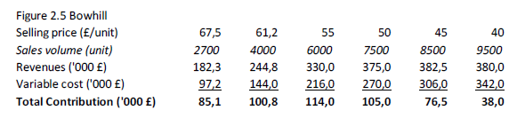
Market-based pricing –
Demand-based pricing

Slide 9
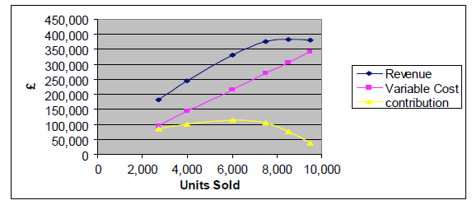
Market-based pricing –
Demand-based pricing
In this example, contribution declines at higher volumes
because price (must) decline faster at higher volumes

Slide 10
Market-based pricing –
Demand-based pricing
Product Y, expected sales volume of 4000 and 6000 units per month for £ 40 respectively £ 35 selling prices
Variable cost is £ 28 per unit
Questions:
Calculate total contribution at each price and choose the contribution-maximizing price
Is this result always correct and justifiable?
What if management had to hire an additional supervisor at a cost of £ 2000/month, as soon as sales and production volume exceeds 5000 units/month?

Slide 11
Answer
40 – 28 = 12 £ Contribution at 4,000 units
35 – 28 = 7 £ Contribution at 6,000 units
4,000 * 12 = 48.000 £
6,000 * 7 = 42.000 £
- 2000 £ fix
= 40,000 £

Slide 12
Target pricing and Target costing –
Comparison with traditional costing

Slide 13
Target pricing and Target costing
Target costing
  Company XY wishes to sell a new product
  Competing or substitute products selling at £ 50
  XY estimates it can sell 10K units at £ 50, but not at higher prices
  XY targets profit to sales ratio of 20%
Thus target cost is target revenue £ 500K –
target profit £ 100K equalling £ 400K (20%)
If actual cost estimation is higher than this level, XY must find
cost saving potential
  Tear-down analysis: of competitor products
  Value engineering:
  component-level analysis to reduce cost at minimum functionality

Slide 14
Strategic pricing considerations
Price leader, possible when a product is superior in terms of quality,
features or cost of production
Price taker, usually the case in competitive markets with many companies producing similar or identical products ("commodity")
Predatory pricing, where price is lowered to undercut competitors in order to gain market share
  Used to gain market share and generate future profit
  (esp. when key competitors exit the market)
  To deter new entrants in the market
  Typically not allowed due to anti-trust considerations and abuse of market power
Tying and bundling
  Promote sales of one product by selling it only together with another complementary product
  Microsoft Windows and Internet Explorer, Windows Media Player

Slide 15
Strategic pricing considerations
New products pricing
Price skimming when new product is superior and no major competitors have entered (requires innovation and differentiation), usually dynamic as prices decrease over time
Penetration pricing for new products also undercuts rivals to gain market share
(parallels predatory pricing for existing products)

Slide 16
Discussion: A self-employed painter
Mr Jones is a painter and decorator. His overheads are $200 a week and he expects to work on average 40 hours a week.
He has been asked to quote for a job which he estimates will take him 20 hours to complete. The material cost for the job will be $100. Assume he includes a pay rate of $10 an hour for himself and builds in a 20% profit margin on full cost.
Question:
Calculate the price for the job that Mr Jones should quote to his customer.

Slide 17
Calculation: A self-employed painter
General: overheads are $200 a week - work on average 40 hours a week.
40 hours a week - 200 $ overheads
Job: 20 hours to complete - 100 $ overheads
Material cost: 100 $
Pay rate: $10 an hour * 20 hours = 200 $
Full cost 400 $
20% profit margin 80 $
Price 480 $

Slide 18
Cost-Volume-Profit decisions
Approach
  Identify objectives, alternative options, evaluate alternatives
Short-term decisions to evaluate alternatives
  Identify relevant revenues and costs that change with alternative choices
  Evaluate these changes, identify non-financial or qualitative factors and constraints
Typical short-term questions
  Whether to withdraw a product/service or close-down a business unit
  Choice of pro.t-maximizing sales plan
  Make-or-buy decisions for selected components
  Choice of optimal sales and production plan as function of resource (e.g. labor, materials, machine) shortage and resource constraints

Slide 19
Discussion: Richmond Plc I
Budgeted Profit and Loss (P&L) account for 20X0
  Revenue of £ 1.581.500 minus total costs £ 1.487.750
  yields profit £ 93.750
  Total cost incl. fixed cost of £ 247.250
Fixed overhead per unit
  Budgeted fixed overhead £ 247.250
  Budgeted output 21.500 units (6500 X, 8000 Y, 7000 Z)
  Assuming identical overhead allocation across product lines, fixed overhead is £ 11,50/unit

Slide 20
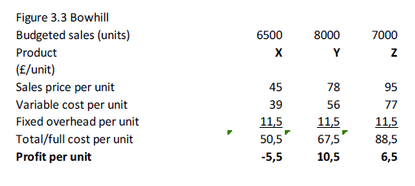
Discussion: Richmond Plc II
Profit per unit
Thus product X seems unprofitable

Slide 21
Discussion: Richmond Plc III
Q1:
Should Richmond Plc stop sales and production of product X?
Product X.s contribution is 6500 x £ 6/unit equalling £ 39.000
Thus X makes positive contribution to helping cover fixed overhead
Without other information, the answer may be negative,
i.e. it is preferable to maintain X in operation

Slide 22
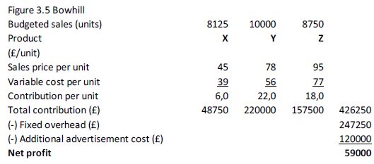
Discussion: Richmond Plc IV
Q2:
Should Richmond Plc pursue a different marketing strategy?
Marketing director suggests an additional £ 120.000 campaign to increase sales of all products by 25%
Profit thus declines from £ 93.750 to £ 59.000
New marketing strategy is rejected

Slide 23
Discussion: Richmond Plc V
Q3:
Should product Z be outsourced i.e. bought for £ 87 instead of made?
  Variable cost is £ 77, lower than outside purchase
  However, must consider qualitative factors
    Quality, on-time delivery, maintaining core competences

Slide 24
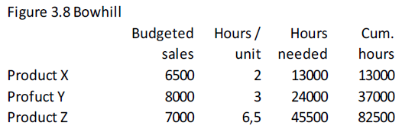
Discussion: Richmond Plc VI
Q4:
What is optimum product or service mix given resource constraint of 70,000 labor hours?
Step 1, identify constraint
Thus total cumulative labor hours needed is higher than the available constrained resource

Slide 25
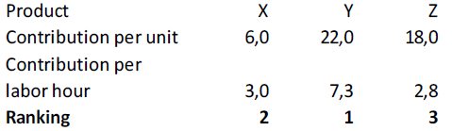
Discussion: Richmond Plc VII
The contribution per labor hour can also be calculated
Therefore, more of product Y and X must be produced than Z

Slide 26
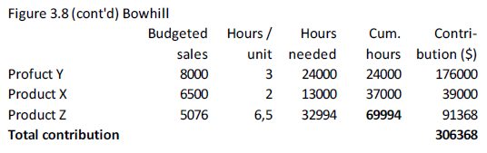
Discussion: Richmond Plc VIII
Step 2, determine optimum pro.t-maximizing production plan

Slide 27
Discussion: Richmond Plc IX
Given limitation on labour hours, only 5076 units of the least profitable product Z can be made
Considering the labour hour constraint, total profit declines to
£ 59.118 (=£ 306.368 - fixed overhead of £ 247.250)
Step 3, identify other constraints,
e.g. bundled customer preferences
Question:
What if product X price were to decrease to £ 42?

Slide 28
Price of X is decreasing to 42
Budgeted Sales 8125 (?) Demand-based?
Product x
Sales price per unit 42 £
Variable cost per unit 39 £
Fixed overhead per unit 11,5 £
Contribution per unit 3,0 £
Profit per unit -8,5 £
Total Contribution 3£*8125 = 24375 £

Slide 29
Cost definitions
Incremental costs:
change as a result of a decision and incl. identifiable fixed costs
Relevant costs:
change as a result of a decision (example replacement cost or resale cost)
Irrelevant costs:
fixed general overhead and other costs
Sunk costs:
already spent or committed to be spent (no matter what),
irrelevant for decision-making
Opportunity cost:
value lost or sacrificed when an opportunity is foregone
Avoidable costs:
similar to relevant costs, depend on decision made
Unavoidable costs:
are irrelevant and sunk

Slide 30
Step 2:
Methods of
assigning overheads
ABC steps and
cost drivers,
product and
period costs
value chain analysis
Lecture 3: Traditional vs. Activity-Based Costing (ABC)
Bowhill Ch. 5-6

Slide 31
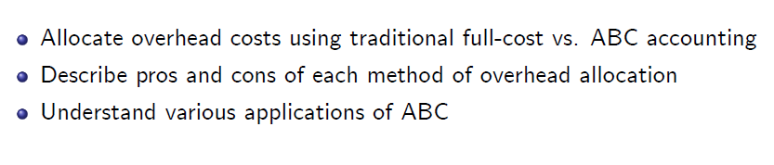
Learning Outcomes

Slide 32
Cost classification
Direct costs can be exclusively identified with a particular cost object
Cost object is any activity requiring separate measurement of cost
Indirect costs or overheads cannot be exclusively identified with a cost object

Slide 33
Full or total costing
Calculate full-cost of single product or service
  Identify direct costs
  Assign part of indirect costs to each product or service
Purpose
  Profit determination
  Pricing
  Inventory valuation
  (at lower of full manufacturing cost and net sales value)

Slide 34
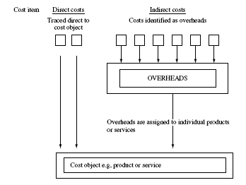
Full or total costing –
Costing of products and services
Graphic according to Bohill
2008 John Wiley & Sons Ltd.
www.wileyeurope.com/college/bowhill

Slide 35
Methods of assigning overheads
Identifying overheads to be assigned using
    Blanket overhead rate, or
    Different cost recovery rate for different areas of organization
Methods of "blanket overhead" cost recovery to product and services
    Cost per unit
    Cost per labour hour
    Cost per $ / £ / € of labour
    Cost per machine hour

Slide 36
Methods of assigning overheads
4 steps to overhead cost allocations across departments
Graphic according to Bohill
2008 John Wiley & Sons Ltd.
www.wileyeurope.com/college/bowhill

Slide 37
Methods of assigning overheads
Step 1: Calculating departmental overhead rate
Graphic according to Bohill
2008 John Wiley & Sons Ltd.
www.wileyeurope.com/college/bowhill
Cost | Basis of apportioning costs to cost centres
Canteen costs | Number of employees
Rent /Heating and lighting | Floor area
Insurance | Cost of assets in the department

Slide 38
Methods of assigning overheads – Steps 2 to 4
Step 2: Costs of service departments´ needs to be reallocated
to ´production´ departments
Step 3: Calculate separate overhead rate for each
´production´ department
  e.g. labour hour rate = Overhead/budgeted labour hours =
  $10000/1000 = $10/hour
Step 4: Assign overhead rate to each product or service
    e.g. 1,5 hours at $10/hour = $15

Slide 39
Overhead allocation by department
Example: Milton Ltd.s two distinct bicycle frames
  "Alto" requires 1,5 hours in the machine shop and 2 hours in the welding department
  "Special" requires 2 hours machine shop and 3 hours in welding

Slide 40
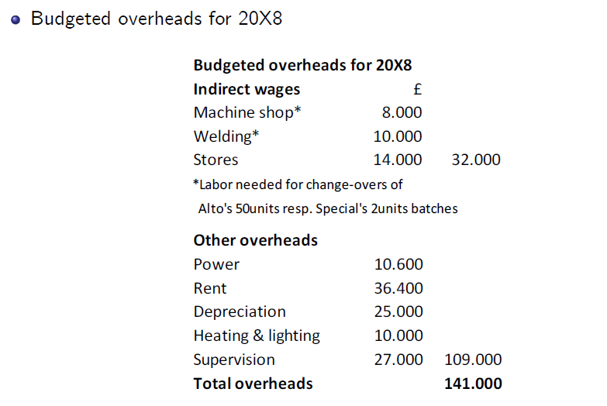
Methods of assigning overheads – Example

Slide 41
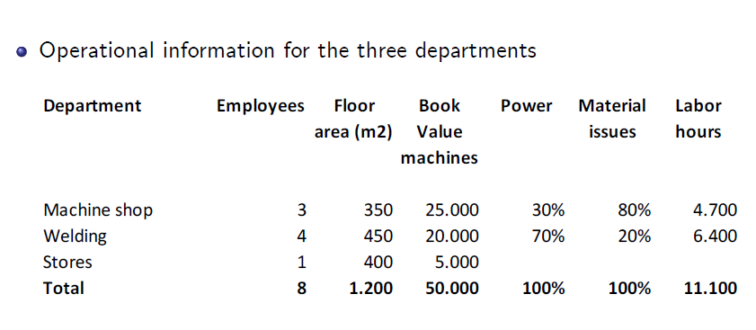
Methods of assigning overheads – Example

Slide 42
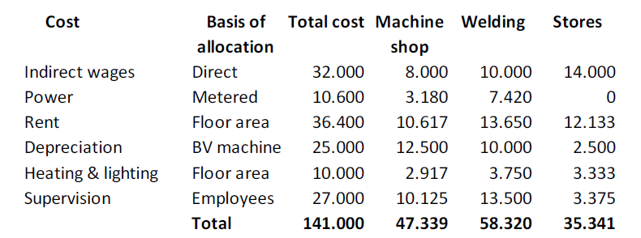
Methods of assigning overheads – Example Step 1
Step 1: Overhead costs identified by department

Slide 43
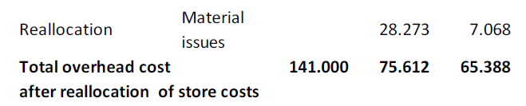
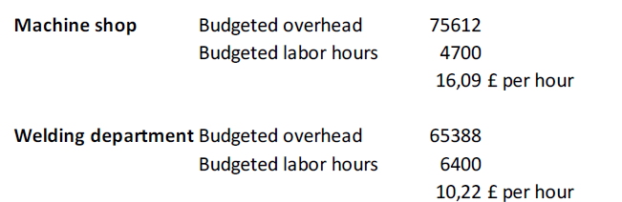
Methods of assigning overheads – Example Step 2 and 3
Step 2: Cost of support departments allocated to
productive cost centres
Step 3: Calculate rate for each cost centre for assigning
overheads to products

Slide 44
Methods of assigning overheads – Example Step 4
Step 4: Assign cost centre costs to individual products
Average full cost to make 1 Alto:
Machine shop labor 1,5 hrs @ £6 per hour 9,00
Welding cost centre labor 2 hrs @ £8 per hour 16,00
Materials 50,00
Direct costs 75,00
1.5 hrs in machine shop @ 16,09 per hour 24,03
2 hrs in welding department @ 10,22 per hour 20,44
Overhead cost 44,47
Total cost 119,47

Slide 45
Methods of assigning overheads – Example Step 4
Step 4: Assign cost centre costs to individual products
Average full cost to make 1 Special:
Machine shop labor 2 hrs @ £6 per hour 12,00
Welding cost centre labor 3 hrs @ £8 per hour 24,00
Materials 60,00
Direct costs 96,00
1.5 hrs in machine shop @ 16,09 per hour 32,18
2 hrs in welding department @ 10,22 per hour 30,66
Overhead cost 62,84
Total cost 158,84

Slide 46
ABC Costing
Again we will have a look at
Milton Ltd.
And the bicycle frames / producs Alto and Special
But now, we are using a different approach:
ABC Costing

Slide 47
ABC Steps
Step 1
Identify activities
Step 2
Assign costs to activities
Step 3
Identify cost drivers and respective cost-driver rates
Step 4
Compute the cost per unit product or service

Slide 48
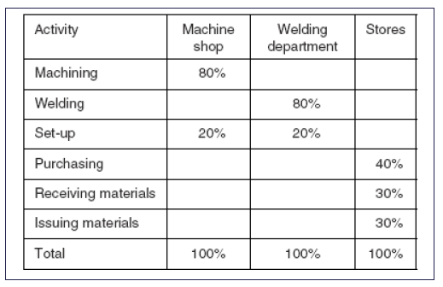
ABC Costing – Example Step 1
ABC Step 1: Identify activities

Slide 49
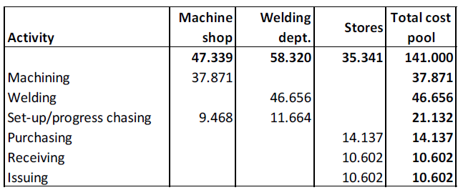
ABC Costing – Example Step 2
ABC Step 2: Assigning costs to activities

Slide 50
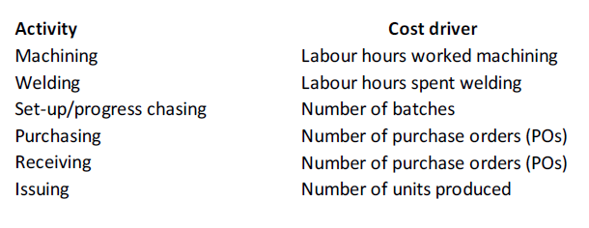
ABC Costing – Example Step 3
ABC Step 3: Identify cost drivers for each activity and their respective
cost-driver rates

Slide 51
ABC Costing – Example Step 3
ABC Step 3: Identify cost drivers for each activity and their respective
cost-driver rates

Slide 52
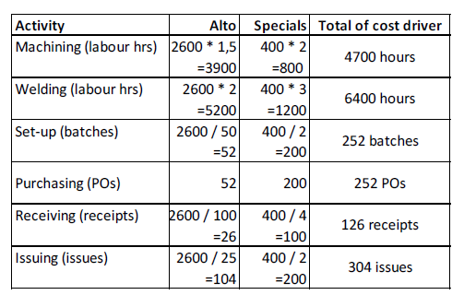
ABC Costing – Example Step 3
ABC Step 3: Identify cost drivers for each activity and their respective
cost-driver rates
Cost-driver usage given 2600 units of product A (Alto) and 400 units of product B (Specials)

Slide 53
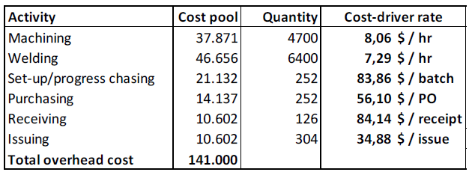
ABC Costing – Example Step 3
ABC Step 3: Activity Cost driver rate

Slide 54
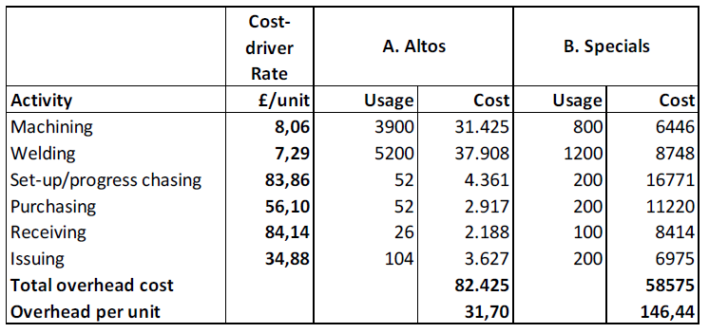
ABC Costing – Example Step 4
ABC Step 4: Identify cost per unit product/service

Slide 55
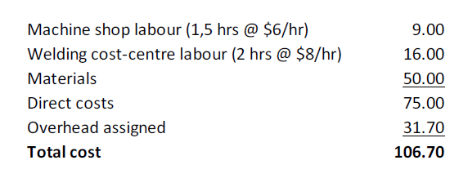
ABC Costing – Example Step 4
Therefore Alto´s total ABC-calculated unit cost
Question 1:
What about for the bicycle frame Special?
Question 2:
How do the results of ABC analysis differ from traditional full-costing?
Please, explain.

Slide 56
Ideal scenarios for ABC application
Proportionally high indirect costs and majority fixed i.e. do not increase directly with volumes
Diverse range of products, consuming resources in different proportions
Intense competition necessitates more accurate costing
Lastly, ABC is extremely useful for
  Analyzing profitability and identifying cost-saving opportunities
  For entire company and for separate cost objects e.g. customer account profitability

Slide 57
Costing methods differ by industry
Job costing:
each unit of product or service is unique
(HW1 Mr Jones, the painter)
Batch costing:
a finite amount of units is produced for each unique product
(e.g. furniture production)
Contract costing:
A system of job costing used for long-term contracts
(e.g. shipbuilding)
Process costing:
when a continuous stream of identical units are produced through the same stages (e.g. oil refineries)

Slide 58
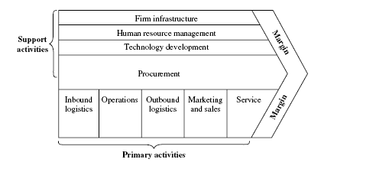
Value-chain analysis
Graphic according to Bohill
2008 John Wiley & Sons Ltd.
www.wileyeurope.com/college/bowhill
Primary activities:
Inbound logistics, operations, outbound logistics, marketing & sales, service
Secondary activities: Firm infrastructure, human resource mgt, (HRM), procurement, technology/product/service development

Slide 59
Cost behaviour and value-chain activities
Cost structure of businesses and industries evolved over last few decades
Proportion of direct manufacturing an operational costs decreased
Increasing importance of indirect costs e.g. research and development (R&D), information technology (IT) to distribution, marketing and customer service
With the advent of internet and media-oriented activities many costs do not necessarily change in proportion to volume of products or services produced

Slide 60
Competitive benchmarking and cost cutting:
People Express
Cost per seat mile was $1.35 less than United Airlines due to strategic decisions in the following .ve areas:
Pre-arrival and airport operations (ticket counter, gate operations, baggage handling) ($0.42 per seat mile)
Costs associated with aircraft ($0.18 per seat mile)
Flight operations (pilots and .ight crew) ($0.40 per seat mile)
Cabin operations ($0.32 per seat mile)
Marketing and sales ($0.03 per seat mile)
=) Could they have achieved this with traditional full costing?

