Slide 1
Cost and Profit Decision-Making
International Management Accounting
Prof. Dr. Marc Beutner
TH Köln
2nd Lecture
SoSe 2024

Slide 2

Prof. Dr. Marc Beutner
Lehrstuhl Wirtschaftspädagogik II
Prof. Dr. Marc Beutner
Lehrstuhl
Wirtschaftspädagogik II -
Wirtschaftspädagogik und Evaluationsforschung
Universität Paderborn
Lehrauftrag an der TH Köln
Email:
Marc.Beutner@uni-paderborn.de

Slide 3
What are we going to do?
Break-even analysis
Finishing the rest of lecture 1
  A fitness centre’s decision
  Break even analysis
Lecture 2: Costs and Profits
Full-cost and
market-based pricing,
demand-based pricing,
target pricing,
pricing strategies,
cost-volume-profit
decisions

Slide 4
Step 1:
Break-even analysis
Finishing the rest of lecture 1
  A fitness centre’s decision
  Break even analysis

Slide 5
Looking back – total costs
Graphic according to Bohill
2008 John Wiley & Sons Ltd.
www.wileyeurope.com/college/bowhill

Slide 6
Looking back - Contribution Statement
  Units 1 500 1,000 1,500
£ £ £ £
Total sales revenue 8 4,000 8,000 12,000
Variable cost 6 3,000 6,000 9,000
Fixed cost 2,000 2,000 2,000 2,000
Total cost 2,006 5,000 8,000 11,000
Profit/ (loss) (1998) (1,000) 0 1,000

Slide 7
Create a Contribution Statement with the following data
  Units 1 1,000 1,500 2,000
£ £ £ £
Total sales revenue 9
Variable per Unit cost 7
Fixed cost 2,100 £

Slide 8
Answer - Contribution Statement
  Units 1 1,000 1,500 2,000
£ £ £ £
Total sales revenue 9 9,000 13,500 18,000
Variable cost 7 7,000 10,500 14,000
Fixed cost 2,100 2,100 2,100 2,100
Total cost 2,107 9,100 12,600 16,100
Profit/ (loss) (2,098) (100) 900 1,900

Slide 9
Looking back – Break-even analysis
Graphic according to Bohill
2008 John Wiley & Sons Ltd.
www.wileyeurope.com/college/bowhill
Graphic according to Bohill
2008 John Wiley & Sons Ltd.
www.wileyeurope.com/college/bowhill

Slide 10
Looking back – Break-even analysis
According to Bohill
2008 John Wiley & Sons Ltd.
www.wileyeurope.com/college/bowhill
Break-even point (BEP)
BEP = Fixed cost = £2,000 = 1,000 units
Contribution per unit £2
BEP (in units of volume) is where profit is exactly zero
Sales to earn £1,000 profit
= Fixed cost + profit = (£2,000 + £1,000) = 1500 units
Contribution per unit £2

Slide 11
Where is the Break-even-point?
  Units 1 1,000 1,500 2,000
£ £ £ £
Total sales revenue 9 9,000 13,500 18,000
Variable cost 7 7,000 10,500 14,000
Fixed cost 2,100 2,100 2,100 2,100
Total cost 2,107 9,100 12,600 16,100
Profit/ (loss) (2,098) (100) 900 1,900

Slide 12
Answer - BEP
BEP = Fixed cost = £2,100 = 1,050 units
Contribution per unit £2
  Units 1 1,000 1,050 1,500 2,000
£ £ £ £ £
Total sales revenue 9 9,000 9,450 13,500 18,000
Variable cost 7 7,000 7,350 10,500 14,000
Fixed cost 2,100 2,100 2,100 2,100 2,100
Total cost 2,107 9,100 9,450 12,600 16,100
Profit/ (loss) (2,098) (100) 0 900 1,900

Slide 13
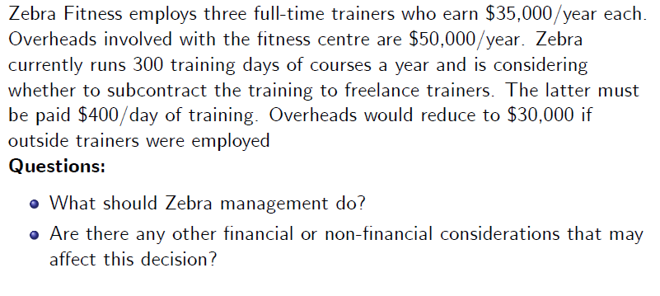
A fitness centre´s decision
Solution discussion

Slide 14
Answer
Internal full-time trainers:
  Variabe cost = 3 x 35,000 € = 105,000 €
  Fix cost = 50,000 €
  Total cost = 155,000 €
External freelance trainers:
  Variable cost = 300 x 400 € = 120,000 €
  Fix cost = 30,000 €
  Total cost = 150,000 €

Slide 15
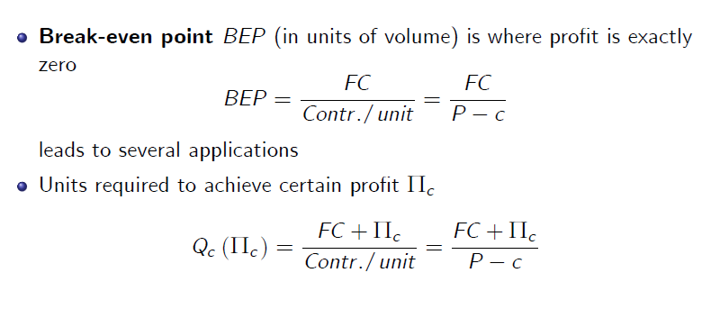
Moving on – Break-even analysis
According to Bohill
2008 John Wiley & Sons Ltd.
www.wileyeurope.com/college/bowhill

Slide 16
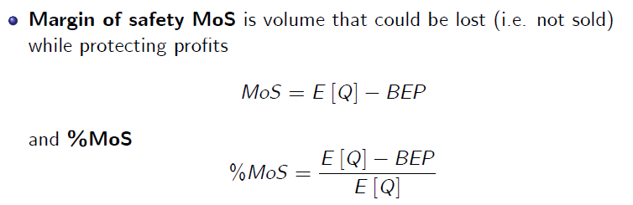
The margin of safetey - Mos
According to Bohill
2008 John Wiley & Sons Ltd.
www.wileyeurope.com/college/bowhill

Slide 17
Looking back – Break-even analysis
Graphic according to Bohill
2008 John Wiley & Sons Ltd.
www.wileyeurope.com/college/bowhill
Graphic according to Bohill
2008 John Wiley & Sons Ltd.
www.wileyeurope.com/college/bowhill

Slide 18
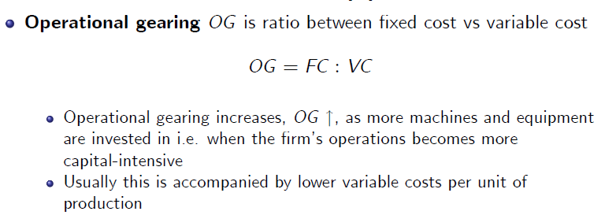
Operational gearing
According to Bohill
2008 John Wiley & Sons Ltd.
www.wileyeurope.com/college/bowhill

Slide 19
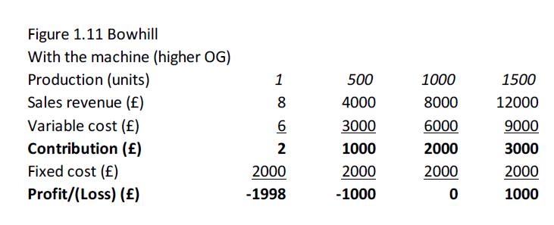
Operational gearing – leasing of machines to manifacture bycylce tubes high operational gearing
Example according to Bohill
2008 John Wiley & Sons Ltd.
www.wileyeurope.com/college/bowhill

Slide 20
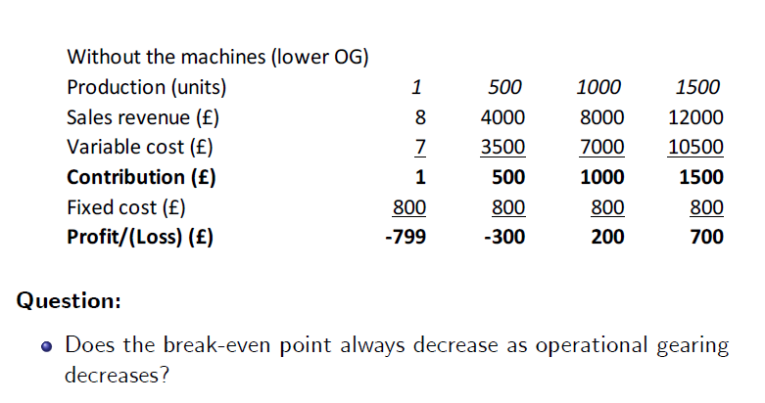
Operational gearing – leasing of machines to manifacture bycylce tubes low operational gearing
Example according to Bohill
2008 John Wiley & Sons Ltd.
www.wileyeurope.com/college/bowhill
BEP = Fixed cost = £800 = 800 units
Contribution per unit £1

Slide 21
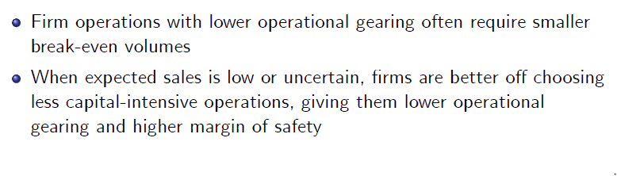
Answer

Slide 22
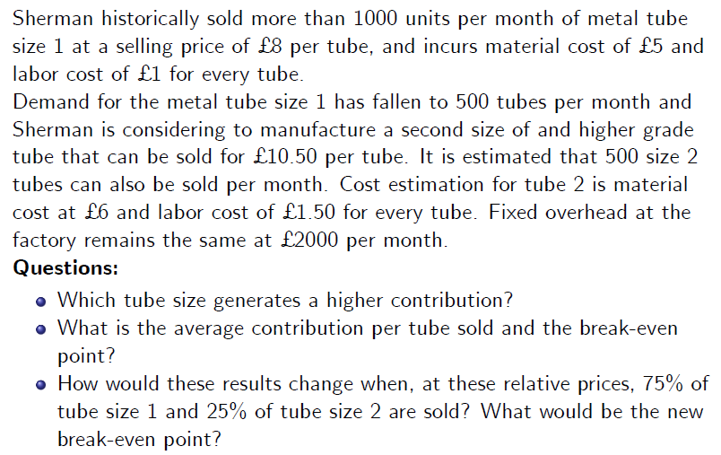
Discussion: Sherman Ltd’s metal tubes manufacturing
- What assumptions are beeing made in this example? -

Slide 23
Discussion: Sherman Ltd’s metal tubes manufacturing
- What assumptions are beeing made in this example? -

Slide 24
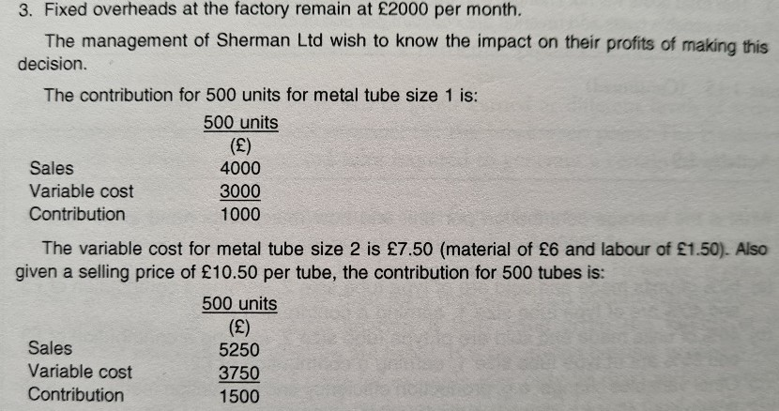
Contribution
Graphic according to Bohill
2008 John Wiley & Sons Ltd.
www.wileyeurope.com/college/bowhill
500*8 = 4,000
500*6= 3,000
500*10.50 = 5,250
500*7.50 = 3,750

Slide 25
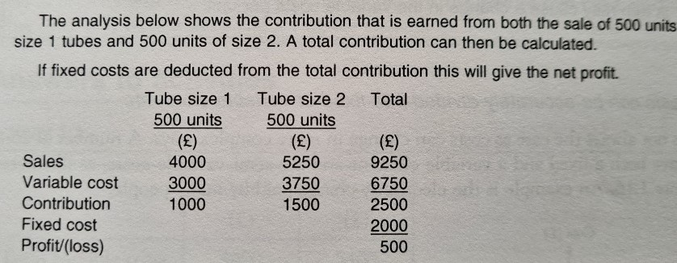
Let´s consider both tubes
Graphic according to Bohill
2008 John Wiley & Sons Ltd.
www.wileyeurope.com/college/bowhill
Contribution of tube size 1 = 2 £ per unit
Contribution of tube size 2 = 3 £ per unit
2 * 50% + 3 * 50% = 2,50 £
50/50
75/25
Contribution of tube size 1 = 2 £ per unit
Contribution of tube size 2 = 3 £ per unit
2 * 75% + 3 * 25% = 2,25 £

Slide 26
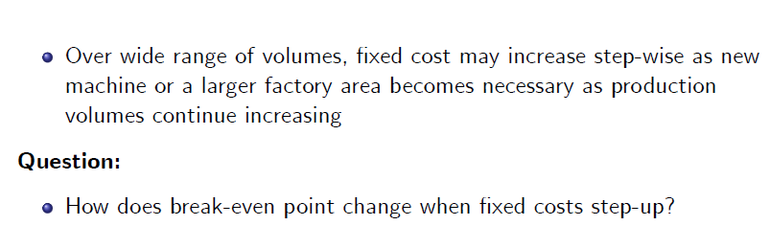
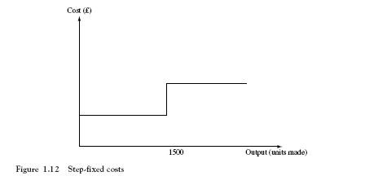
Scenarios that change simple break-even analysis
Graphic according to Bohill
2008 John Wiley & Sons Ltd.
www.wileyeurope.com/college/bowhill

Slide 27
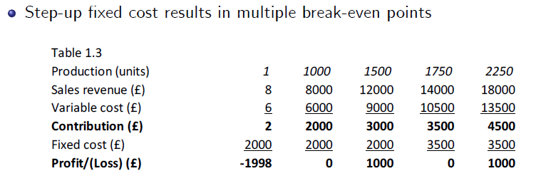
Multiple break-even points
Graphic according to Bohill
2008 John Wiley & Sons Ltd.
www.wileyeurope.com/college/bowhill

Slide 28
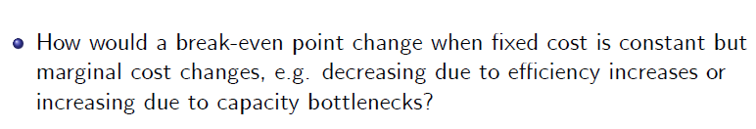
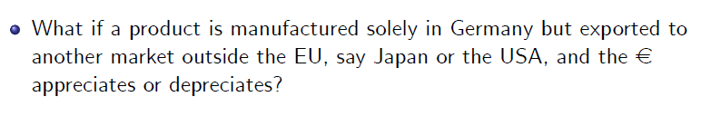
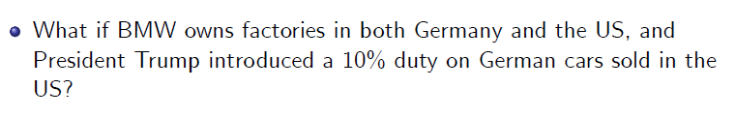
Some questions

Slide 29
Step 2: Bowhill Ch. 2-3
Lecture 2: Costs and Profits
Full-cost and
market-based pricing,
demand-based pricing,
target pricing,
pricing strategies,
cost-volume-profit
decisions

Slide 30
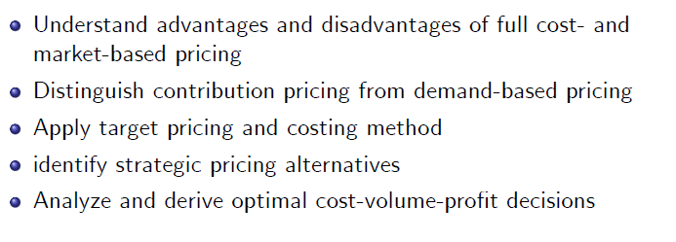
Learning Outcomes

Slide 31
Alternative Approaches
Traditional approach = Full cost plus mark-up.
Approaches to pricing that take into consideration market factors
  Contribution approach
  Demand based approach
  Target pricing and costing
  Pricing strategies e.g. -price skimming- market based pricing

Slide 32
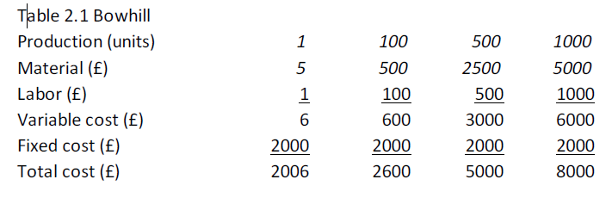
Traditional full-costing
Total cost as function of output volume

Slide 33
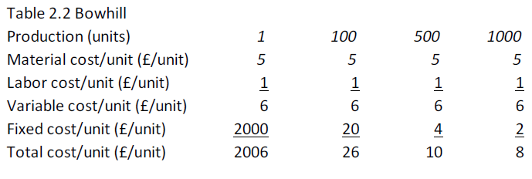
Traditional full-costing
Cost per unit at different levels of activity

Slide 34
Traditional full-costing
Full-costing approach to pricing
Determine variable i.e. direct material and direct labor costs
Estimate fixed overhead, indirect material and indirect labor costs
Calculate full cost per unit based on estimated production volume
(i.e. output)
Add profit markup to determine Selling Price/unit
Question:
Is this a good approach?

Slide 35
Criticisms to full costing approach
Neglects competition thus may result in
uncompetitive price levels
Overhead allocation and apportionment may not
reflect true level of activity
Budgeted production or costs may be outdated or incorrect

Slide 36
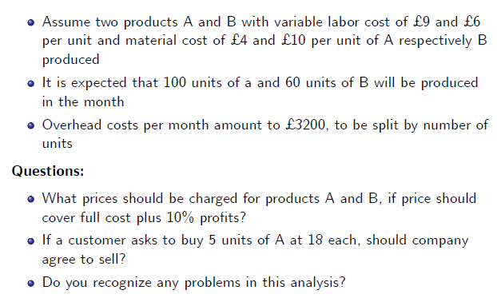
An Example for discussion
A

Slide 37
Answer
Variable cost (£) A B
labour 9 6
material 4 10
= =13 =16
Units 100 60
variable cost (£) 1,300 960
fixed cost (£) 2,000 1,200
= =3,300 =2,160
Profit 10% (£) 330 216
= =3,630 =2,376
Divided by units 36,30 £ 39,60 £
Fixed cost:
3200 : 160 = 20

Slide 38
Market-based pricing –
Overview on approaches to pricing

Slide 39
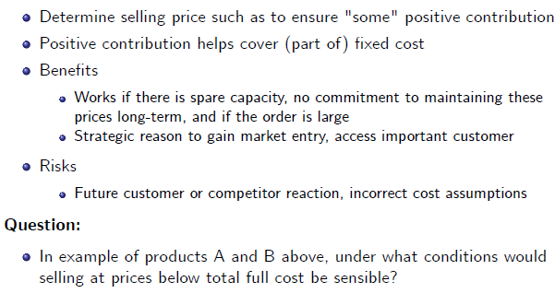
Market-based pricing – Contribution Approach

Slide 40
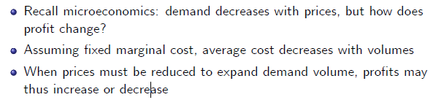
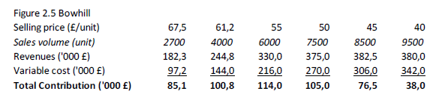
Market-based pricing – Demand-based pricing

Slide 41
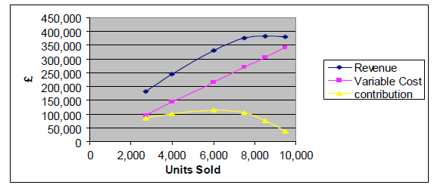
Market-based pricing – Demand-based pricing
In this example, contribution declines at higher volumes
because price (must) decline faster at higher volumes

Slide 42
Market-based pricing – Demand-based pricing
Product Y, expected sales volume of 4000 and 6000 units per month for £ 40 respectively £ 35 selling prices
Variable cost is £ 28 per unit
Questions:
Calculate total contribution at each price and choose the contribution-maximizing price
Is this result always correct and justifiable?
What if management had to hire an additional supervisor at a cost of £ 2000/month, as soon as sales and production volume exceeds 5000 units/month?

Slide 43
Answer
40 – 28 = 12 £ Contribution at 4,000 units
35 – 28 = 7 £ Contribution at 6,000 units
4,000 * 12 = 48.000 £
6,000 * 7 = 42.000 £
- 2000 £ fix
= 40,000 £

Slide 44
Target pricing and Target costing –
Comparison with traditional costing

Slide 45
Target pricing and Target costing
Target costing
  Company XY wishes to sell a new product
  Competing or substitute products selling at £ 50
  XY estimates it can sell 10K units at £ 50, but not at higher prices
  XY targets profit to sales ratio of 20%
Thus target cost is target revenue £ 500K –
target profit £ 100K equalling £ 400K (20%)
If actual cost estimation is higher than this level, XY must find cost saving potential
  Tear-down analysis: of competitor products
  Value engineering:
  component-level analysis to reduce cost at minimum functionality

Slide 46
Strategic pricing considerations
Price leader, possible when a product is superior in terms of quality,
features or cost of production
Price taker, usually the case in competitive markets with many companies producing similar or identical products ("commodity")
Predatory pricing, where price is lowered to undercut competitors in order to gain market share
  Used to gain market share and generate future pro.t (esp. when key competitors exit the market)
  To deter new entrants in the market
  Typically not allowed due to anti-trust considerations and abuse of market power
Tying and bundling
  Promote sales of one product by selling it only together with another complementary product
  Microsoft Windows and Internet Explorer, Windows Media Player

Slide 47
Strategic pricing considerations
New products pricing
Price skimming when new product is superior and no major competitors have entered (requires innovation and differentiation), usually dynamic as prices decrease over time
Penetration pricing for new products also undercuts rivals to gain market share
(parallels predatory pricing for existing products)

Slide 48
Discussion: A self-employed painter
Mr Jones is a painter and decorator. His overheads are $200 a week and he expects to work on average 40 hours a week.
He has been asked to quote for a job which he estimates will take him 20 hours to complete. The material cost for the job will be $100. Assume he includes a pay rate of $10 an hour for himself and builds in a 20% profit margin on full cost.
Question:
Calculate the price for the job that Mr Jones should quote to his customer.

Slide 49
Calculation: A self-employed painter
General: overheads are $200 a week - work on average 40 hours a week.
40 hours a week - 200 $ overheads
Job: 20 hours to complete - 100 $ overheads
Material cost: 100 $
Pay rate: $10 an hour * 20 hours = 200 $
Full cost 400 $
20% profit margin 80 $
Price 480 $

Slide 50
Cost-Volume-Profit decisions
Approach
  Identify objectives, alternative options, evaluate alternatives
Short-term decisions to evaluate alternatives
  Identify relevant revenues and costs that change with alternative choices
  Evaluate these changes, identify non-.nancial or qualitative factors and constraints
Typical short-term questions
  Whether to withdraw a product/service or close-down a business unit
  Choice of pro.t-maximizing sales plan
  Make-or-buy decisions for selected components
  Choice of optimal sales and production plan as function of resource (e.g. labor, materials, machine) shortage and resource constraints

Slide 51
Discussion: Richmond Plc I
Budgeted Profit and Loss (P&L) account for 20X0
  Revenue of £ 1.581.500 minus total costs £ 1.487.750
  yields profit £ 93.750
  Total cost incl. fixed cost of £ 247.250
Fixed overhead per unit
  Budgeted fixed overhead £ 247.250
  Budgeted output 21.500 units (6500 X, 8000 Y, 7000 Z)
  Assuming identical overhead allocation across product lines, fixed overhead is
  £ 11,50/unit

Slide 52
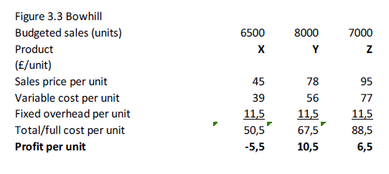
Discussion: Richmond Plc II
Profit per unit
Thus product X seems unprofitable

Slide 53
Discussion: Richmond Plc III
Q1:
Should Richmond Plc stop sales and production of product X?
Product X´s contribution is 6500 x £ 6/unit equalling £ 39.000
Thus X makes positive contribution to helping cover fixed overhead
Without other information, the answer may be negative,
i.e. it is preferable to maintain X in operation

Slide 54
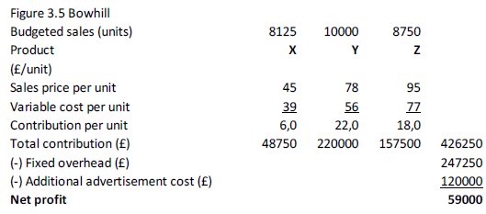
Discussion: Richmond Plc IV
Q2:
Should Richmond Plc pursue a different marketing strategy?
Marketing director suggests an additional £ 120.000 campaign to increase sales of all products by 25%
Profit thus declines from £ 93.750 to £ 59.000
New marketing strategy is rejected

Slide 55
Discussion: Richmond Plc V
Q3:
Should product Z be outsourced i.e. bought for £ 87 instead of made?
  Variable cost is £ 77, lower than outside purchase
  However, must consider qualitative factors
    Quality, on-time delivery, maintaining core competences

Slide 56
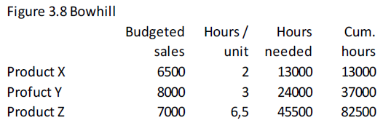
Discussion: Richmond Plc VI
Q4:
What is optimum product or service mix given resource constraint of 70,000 labor hours?
Step 1, identify constraint
Thus total cumulative labor hours needed is higher than the available constrained resource

Slide 57
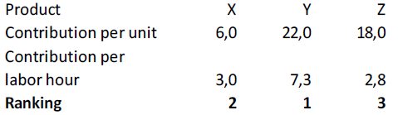
Discussion: Richmond Plc VII
The contribution per labor hour can also be calculated
Therefore, more of product Y and X must be produced than Z

Slide 58
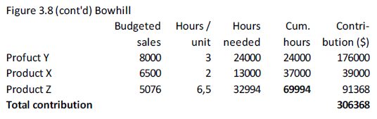
Discussion: Richmond Plc VIII
Step 2, determine optimum profit-maximizing production plan

Slide 59
Discussion: Richmond Plc IX
Given limitation on labour hours, only 5076 units of the least profitable product Z can be made
Considering the labour hour constraint, total profit declines to
£ 59.118 (=£ 306.368 - fixed overhead of £ 247.250)
Step 3, identify other constraints,
e.g. bundled customer preferences
Question:
What if product X price were to decrease to £ 42?

Slide 60
Cost definitions
Incremental costs:
change as a result of a decision and incl. identifiable fixed costs
Relevant costs:
change as a result of a decision (example replacement cost or resale cost)
Irrelevant costs:
fixed general overhead and other costs
Sunk costs:
already spent or committed to be spent (no matter what),
irrelevant for decision-making
Opportunity cost:
value lost or sacrificed when an opportunity is foregone
Avoidable costs:
similar to relevant costs, depend on decision made
Unavoidable costs:
are irrelevant and sunk

