Slide 1
BUSINESS MODELLING FOR CIRCULAR ECONOMY BUSINESSES

Slide 2
02
2.2 BUSINESS MODELS

Slide 3
Main objectives
Developing new circular products or services
Circular supplies
Recycle, reuse and share
Extending products' life
Sharing platforms
Product as a service
Other methodologies (for ex. lean manufacturing)

Slide 4
Circular design strategies
The CE requires systemic adaptations to a firm’s organizational competence not only at the product level, but also in the business model itself.
To innovate along or design more circular and eco-friendly products, a strategy known as Design for Sustainability (DfS) is a transversal, multidisciplinary area of design sciences that contains the methods and strategies to achieve sustainable and circular design of products.

Slide 5
examples of schemes for circularity include (but not limited to):
Design for upgradeability and repair (modularity)
Design long-life products
Design for product-life extension
Design for closing resource loops
Design for technical and biological cycles
Design for disassembly and reassembly

Slide 6
Sustainable product development
New production system definition
Occurs when innovation in the production system is necessary
New product concept definition
An innovation ‘rupture’ (as technical functions to fulfil product functionality are different)
Design sustainability scope
Product redesign
A new product, designed on the basis of an existing product
Product improvement
Progressive and incremental improvement of the product, e.g. through re-styling using fewer materials

Slide 7
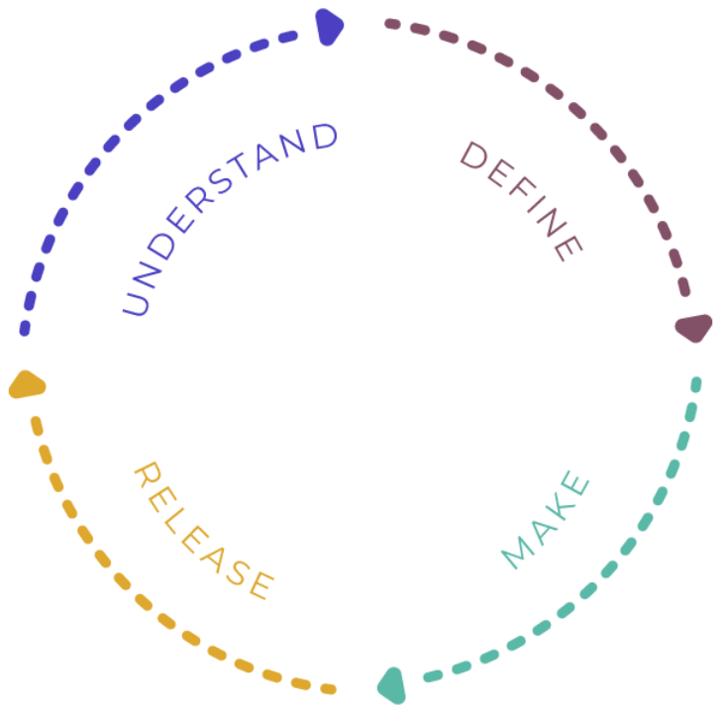
Sustainable product development (CONT.)
Put into words the design challenge and your intention as the designer
Get to know the user and the system
Circular design process
Ideate, design, and prototype as many iterations and versions as you can
Launch your design into the wild and build your narrative - create loyalty in customers and deepen investment from stakeholders by telling a compelling story

Slide 8
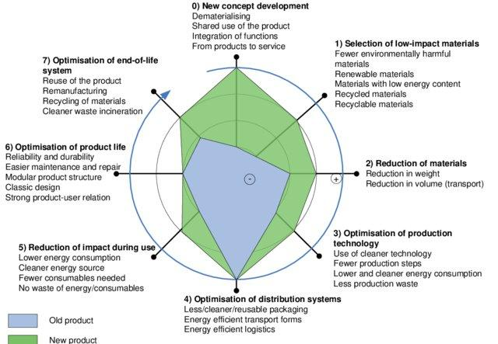
Eco-Design
“…the systematic integration of environmental considerations into product and process design”
Eco-design integrates a life-cycle thinking approach, .ie., considers, in the design stage, all the phases of the product life-cycle (production, use, and end-of-life)
[1] Ecodesign: a promising approach to sustainable production and consumption. ISBN 928071631X 9789280716313

Slide 9
Eco-Design (cont.)
Eco-design
Raw materials extraction and processing
Production
Use
End of Life
Traditional Design
Key Eco-Design strategies
to use materials with low environmental impact
choosing clean production processes
avoiding hazardous and toxic materials
maximising the efficiency of the energy used for production and for the product in use
designing for waste management and recycling

Slide 10
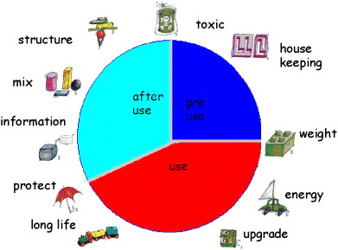
Eco-Design TOOLS
At European level, the Ecodesign Directive provides consistent EU-wide rules to improve the environmental performance of products, such as household appliances, information and communication technologies or engineering.
Types of tools
1st | Checklists
2nd | Guidelines
3rd | MET matrix
4th | Environmental effect analysis
5th | Eco-ideas maps
6th | Environmental Impact assessment
7th | House of environmental quality
8th | LiDS wheel
9th | Life cycle assessment
*Click here* for a comprehensive review on ecodesign tools
[2] C. Luttropp, J. Lagerstedt, EcoDesign and The Ten Golden Rules: generic advice for merging environmental aspects into product development, J. Clean. Prod. 14 (2006) 1396–1408. https://doi.org/10.1016/j.jclepro.2005.11.022.

Slide 11
Challenges
The operationalization of ecodesign practices is not always able to incorporate some important environmental considerations.
A more holistic approach is needed for product development and to innovate not only the product itself, but also the business model associated to it
beco sem saída by sergnewa in https://br.freepik.com/vetores-premium/conceito-de-beco-sem-saida-a-empresaria-esta-a-caminho-do-beco-sem-saida_31585740.htm

Slide 12
Circular supplies
We already learnt that the choice of materials is not the only task in product development that can lead to more greener and circular routes, but it is in fact an important component of product design. Now we’ll have a closer look at what are considered circular supplies is undertaken and how can we really take advantage of them to improve the circularity and sustainability of the products.

Slide 13
Circular and Sustainable design – Key Facts
A good designer and/or engineer must be able to continuously look for new products where new materials and production methods can be used together with a sustainable design.
Context is changing and new products are continuously offered and demanded.
Companies are more likely to engage in sustainable activities as the acknowledgment of benefits such as better reputation and better economy from the use of recycled materials.
The availability of new raw materials is decreasing
Material selection has a predominant role in Sustainable Product Development
Increased consumer demand for (more) sustainable and circular products
Life-cycle thinking approach serves as a basis to assess the sustainability of a product

Slide 14
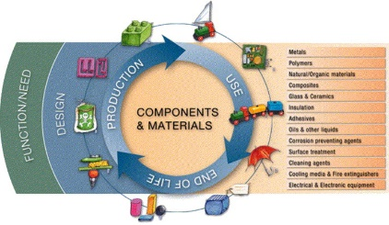
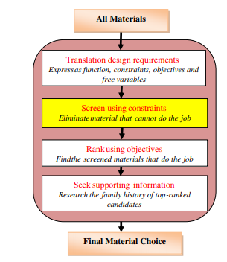
Material selection
One of the main phases in product design process
Impacts
Sustainability
Traditional view
Eco-design view
A snapshot of the Design for Environment Guidelines in Engineering Book of Knowledge [1]
Technical and physical properties such as price, strength, temperature stability, density, hardness, etc.
Production methods.
Function and structural demands.
Market or user demands.
Design.
Price.
Environmental impact.
Lifetime.
[1] C. Luttropp, J. Lagerstedt, EcoDesign and The Ten Golden Rules: generic advice for merging environmental aspects into product development, J. Clean. Prod. 14 (2006) 1396–1408. https://doi.org/10.1016/j.jclepro.2005.11.022.
[2] M. Ashby, K. Johnson, Materials and Design: The Art and Science of Material Selection in Product Design, 2014.
Material Selection phases [2]

Slide 15
Material selection general framework
Avoid toxic or harmful materials for product components
Avoid materials that emit toxic or harmful substances during pre-production
Avoid additives that emit toxic or harmful substances
Avoid toxic or harmful surface treatments – Avoid materials that emit toxic or harmful substances during usage
Avoid materials that emit toxic or harmful substances during disposal
Avoid toxic substances, but use closed loops when necessary to do so
Avoid exhaustive materials
Rejection
Two pathways
Use renewable materials
Use residual materials from production processes
Use retrieved components from disposed products
Use recycled materials, alone or combined with primary materials
Use biodegradable materials
Use non hazardous recyclable materials
Use few, simple, unblended materials.
Use materials with low energy consumption in extraction and transportation.
Acceptance

Slide 16
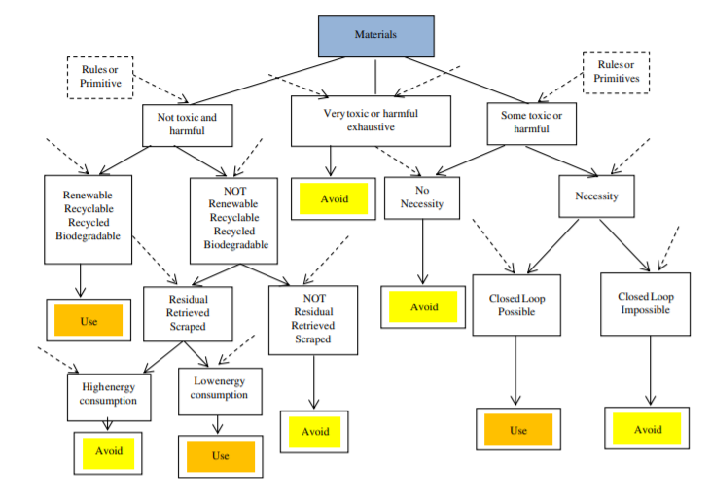
Material selection general framework
Evaluation indicators of sustainable material selection
Social
Environmental
Economic
Welfare
Equity
Human-health
Poverty
…
Pollution
Energy consumption
Eco-toxicity
Recyclability
…
Purchase cost
Process cost
Transport cost
Disposal Cost
…
M.H.F. Zarandi, S. Mansour, S.A. Hosseinijou, M. Avazbeigi, A material selection methodology and expert system for sustainable product design, Int. J. Adv. Manuf. Technol. 57 (2011) 885–903. https://doi.org/10.1007/s00170-011-3362-y.
Indicators for sustainable material selection (social, environmental, and economic) (adapted)

Slide 17
Best practices
Use of databases for evaluation of environmental load and materials selection
Use of local materials
Use of Life-cycle Assessment methodology
Incorporate sustainability concerns in the material selection process

Slide 18
Recycle, reuse, and share
Next slides focus on the circular opportunities aiming on the recycling, reuse, and sharing strategies in the operational part of a business. It starts by examining whether what was traditionally considered production waste is really waste and proceeds with the idea that through recycling, reusing and sharing, optimal resource utilization and waste elimination can be achieved. The benefits of adopting such a strategy both for the SME and the environment are explained by looking at case studies.

Slide 19
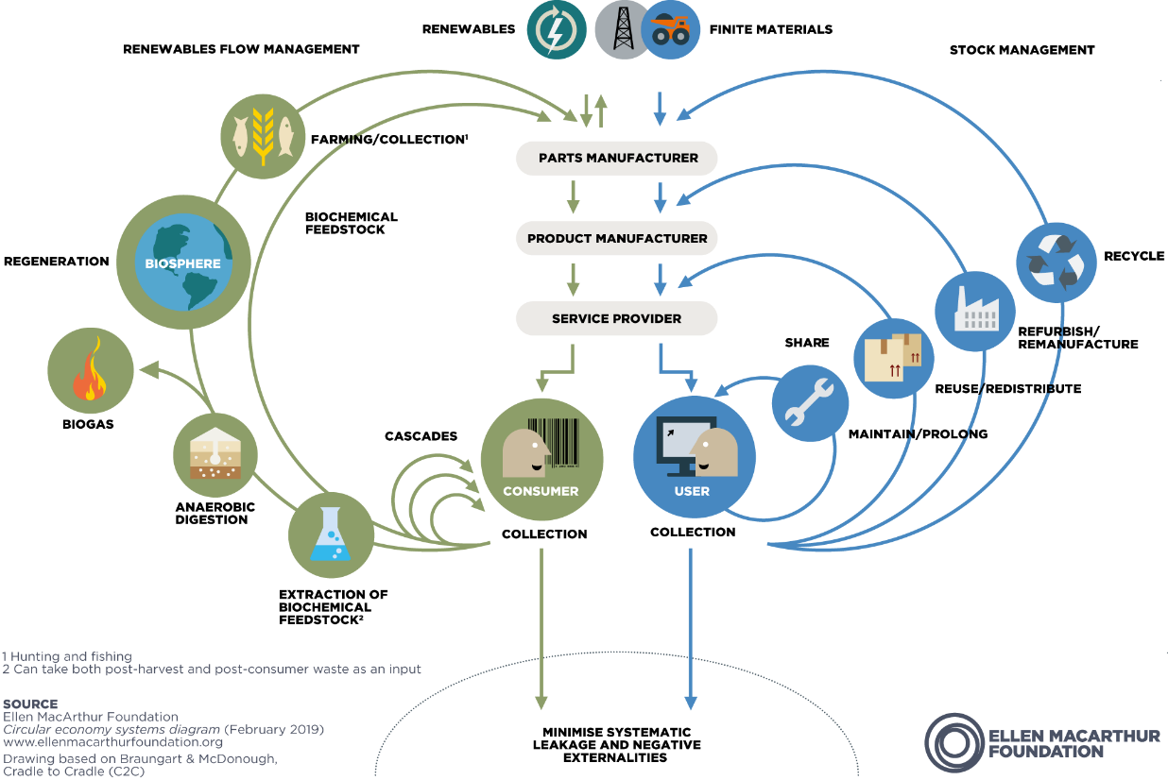
Value in the Loops
Redefining what is considered waste is key to a
Circular Economy!
Value
Sharing
Reuse
Recycling
Disposal/Elimination

Slide 20
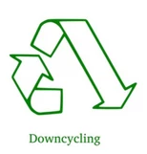
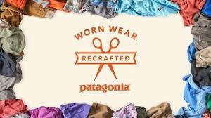
Recycle
“…the processing of mixed streams of post-consumer products or post-consumer waste streams, including shredding, melting and other processes to capture (nearly) pure materials.”
Recycling
Downcycling
Upcycling
Conversion of waste into a product with lower value than the original material.
Presupposes a material quality degradation
Conversion of waste into a new high quality product
Source: Patagonia

Slide 21
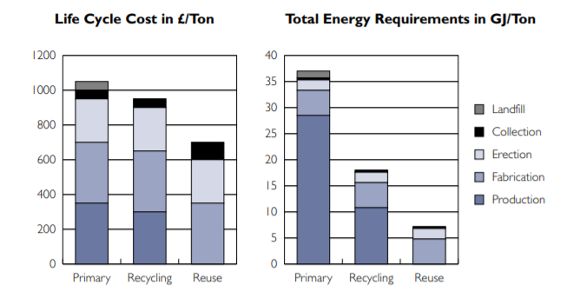
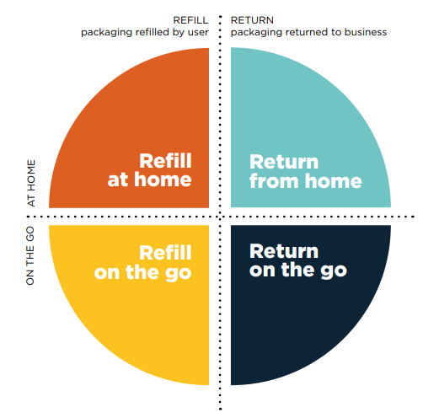
Reuse
“…represents the ability to give a second consumer, a product that hardly needs any adaptation and works as good as new”
Reuse models for packaging and food containers
Refill at home – users refill their reusable container at home (e.g., with refills delivered through a subscription service)
Refill on the go – users refill their reusable container away from home (e.g., at an in-store dispensing system)
Return from home – packaging is picked up from home by a pick-up service (e.g., by a third party logistics or outsourced company)
Return on the go – users return the packaging at store or drop-off point (e.g., in a deposit return machine or mailbox)
Total life cycle cost and total energy requirements between primary in the three scenarios, primary, recycling and reuse [1]
Reuse is the preferred alternative over traditional recycling routes
[1] R. Geyer, T. Jackson, Supply Loops and Their Constraints: The Industrial Ecology of Recycling and Reuse, Calif. Manage. Rev. 46 (2004) 55–73. https://doi.org/10.2307/41166210.

Slide 22
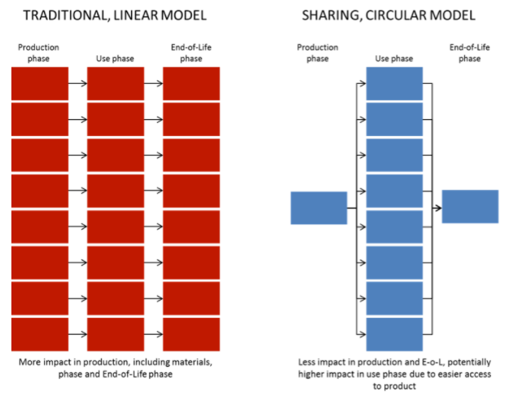
Sharing
Sharing business models is a way of re-capturing value from under-utilized assets and capabilities.
Product that can serve multiple consumers
Reduces material consumption and waste generation
Use phase is intensified
Examples
Collaboration platforms
Uber
AirBnB
Couchsurfing
Impact distribution between the traditional linear model and the sharing economy, along the life-cycle [2]
[2] E. Mieras, 5 roads to a circular economy – Part IV: sharing, (2016). Available at: https://pre-sustainability.com/articles/5-roads-to-a-circular-economy-part-iv-sharing/

Slide 23
Extending products' life
Unlike linear business models that may depend on planned obsolescence to achieve growth, CE aims to extend the service-life of their products. The main objectives of it are clear-mitigate the requirement for additional raw materials in order to create a new product that serves a particular purpose and reduce the rate that products are disposed to the landfills. Next, is described how the CMC industry can extend their products’ life by presenting case studies of successful implementation.

Slide 24
Extending products' life
• The “Product life extension” concept describes how long a product can be used for, with the main purpose of maximizing the product’s “utilization” rate and duration. With a product end of life, we are generally losing all of the energy and resources used in its production.
• Product life extension is one of several circular business model strategies, where we can include others, such as Cycling, Intensifying and Dematerialising.
• Circular business models are crucial for companies to embrace the circular economy and should align circular value creation activities with opportunities to capture economic value.
This business model main goals can be defined as:
Extended use period of existing products;
Reduced flow of constituent materials through the economy;
Reduced rate of resource extraction and waste generation.

Slide 25
Extending products' life (cont.)
General advantages of product life extension
Does not require a relevant change to a company’s current business model
By engaging people to extend the use of products, companies can create additional contact points with their clients
Favourable public opinion and consumer attitude
Use of new technologies (suitable materials, less material use, lower power consumption)
Reduced legislative pressure (“closed cycle and substances closed act”)
New marketing possibilities
Cost savings

Slide 26
Extending products' life (cont.)
The companies main organizational challenge to implement this business model, particularly with low-value products, is to choose the right format and scope for establishing an internal exploratory venture. Implementing a Product Use Extension model frequently means acquiring new capabilities, changes to product design (e.g., increased modularity to allow for feature upgrades), and changes to financial models.
CHALLENGE
thoughtful asian businessman pointing by creativeart in https://www.freepik.com/premium-photo/composite-image-thoughtful-asian-businessman-pointing_35247927.htm#page=2&query=direction%20sign&position=9&from_view=search&track=ais

Slide 27
Extending products' life (cont.)
Methods for extending products’ life
Extending the products life, seeks the goal of keeping the product in use to the highest extent possible and can be achieved with several actions and capabilities:
• A product’s use can be extended through repairing, component reconditioning, refurbishing, upgrading and new design, to trading in and reselling, some of which can be business models by its own;
• Extention of the respective resource loops which implies that the use phase of the product is extended, through long-lasting and timeless design, marketing that encourages long use phases, maintenance, and repair;
• Implementing a Product Use Extension model frequently means acquiring new capabilities, changes to product design (e.g., increased modularity to allow for feature upgrades), and changes to financial models.

Slide 28
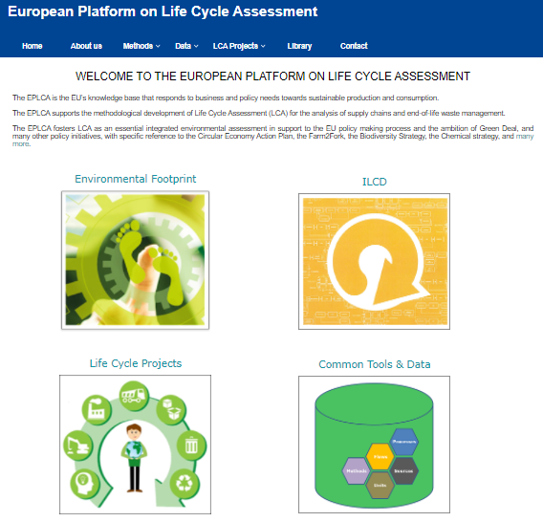
Extending products' life (cont.)
Products’ life in own products
It is important to match the product lifespan with the customer needs, and extending the life of the products is an effective direction for a circular business model design.
To understand the product lifespan, it can be followed an assessment methodology like LCA.
The life-cycle approach is already used by many companies in the framework of sustainability to help reduce the overall environmental burdens across the whole life cycle of goods and services. LCA is also used to improve the competitiveness of the company’s products and in decision making as a tool to improve product design, in the choice of materials, the selection of technologies, specific design criteria and when considering recycling.
[1] European Platform on Life Cycle Assessment (LCA). European Commission. Web: https://ec.europa.eu/environment/ipp/lca.htm

Slide 29
Sharing Platforms
In several cases, it has been proven that Circular platforms and knowledge networks accelerate the promotion of the circular economy by sharing knowledge, highlighting case studies and promote collaboration.
The literature suggest that one of the main contributions of these platforms is that they mitigate the market failure since through these exchanges, effectiveness and efficiency for the economic and environmental perspectives can be evaluated.

Slide 30
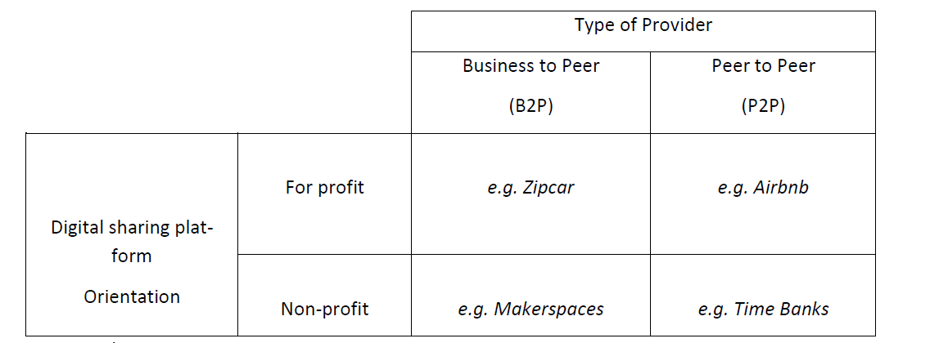
The concept of sharing Economy Platforms
The sharing platforms are separated into Business to Peer (B2P) and Peer to Peer (P2P) business models. Another distinction is regarding the orientation, the platforms can be oriented for-profit and non-profit, referring to whether or not the transaction generates any monetary benefit.
[1] Schor, J. Debating the Sharing Economy. J. Self-Governance Manag. Econ. 2014.
Digital sharing platforms examples [1]

Slide 31
Examples of sharing platforms
Airbnb: In this platform people make their housing space available to others for a short period of time and are paid a certain amount of money, billed via the digital sharing platform which keeps a percentage of the rent, thus financially participating in the realized swap. (P2P for profit).
Zip Car: Is an international car-sharing provider which, after online registration, allows for the flexible use of cars by way of a card. Utilization is billed on a daily, hour or minute basis. Provider of the fleet is a commercial enterprise. (B2P for profit).
Time Banks: This service is about people making their own leisure time available to other people. Neither these private persons nor the brokering digital sharing platform make profit from their activities. (P2P nonprofit).
Makerspace: This market collects digital sharing platforms supposed to support DIY, for instance, craftwork at workshops. For this purpose, experienced craftspeople share their knowledge and skills for free. (B2P nonprofit) .

Slide 32
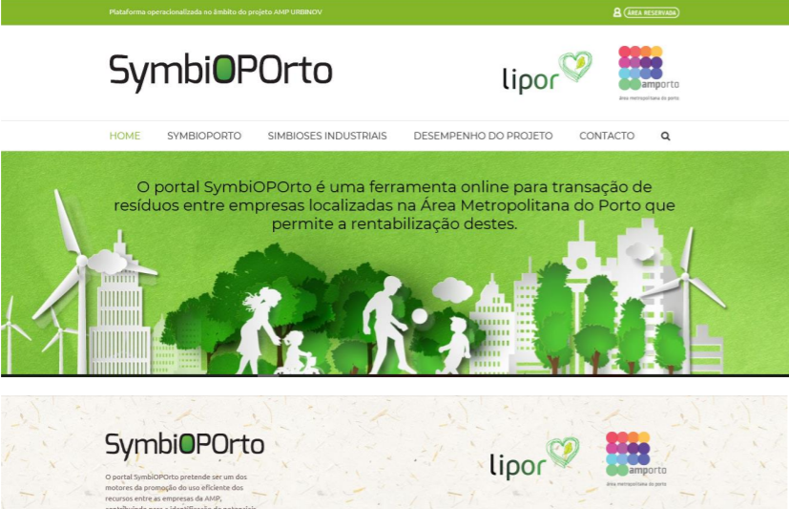
Sharing platforms for Circular economy (Business to Peer platforms)
The SymbiOPorto portal is an online tool promoted by LIPOR and AMP (Porto Metropolitan Area) that promotes the transaction of waste between companies located in the Porto Metropolitan Area through the implementation of a platform that includes a database of the companies' waste.
Outline of SymbiOPorto Platform [2]
[2] LIPOR Portal SymbiOPorto Available online: https://symbioporto.org/ .

Slide 33
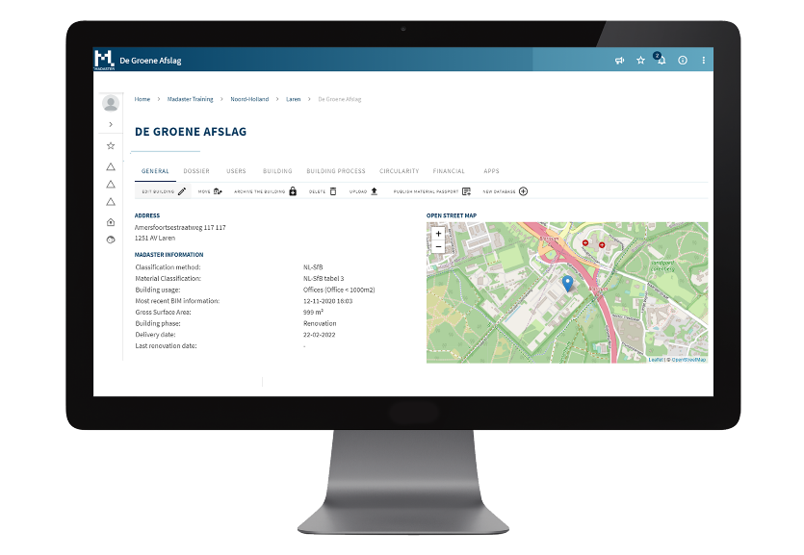
Sharing platforms for Circular economy (Peer to Peer platforms)
Madaster is an independent platform for individuals, companies and governments with the aim of creating a materials cadastre. The company states that if raw materials are well documented, they remain available without limit. With the help of so-called material passports, materials are given an identity, so that they no longer disappear into anonymity as waste.
[3] Madaster Foundation Madaster Platform Available online: https://madaster.com/ .
Outline of Madaster Platform [3]

Slide 34
Product as a service
Converting a product into a service allows customers to hire or lease a product for a certain period instead of buying it, while the ownership remains to the manufacturer. This approach can assure durability and upgradeability to the customers and provide a regular income to the manufacturers in the form of subscription fees. In this module, the benefits of following such a strategy are presented and the barriers and limitations of its implementation are discussed.

Slide 35
Product as a service
• The product as a service concept is mainly based in the shift of product ownership. The shift of products ownership from customers to companies can promote and extend the circulation of materials and products. As a result of the ownership remaining with companies, product life cycles are extended, usage rates are improved and the circulation of materials becomes more of a closed loop. This is a business model that promotes circular economy and acts on the clients consumption habits and lifestyle.
• The producer ownership models comprehends the product-as-a-service, material-as-a-service and performance-as-service, and can include solutions such as lifetime warranties and material return and deposit systems, among others.
• A Product service system (PSS) can be seen as business models with the potential to generate win-win solutions for producers/providers, costumers and environment promoting profit, environmental and social benefits.

Slide 36
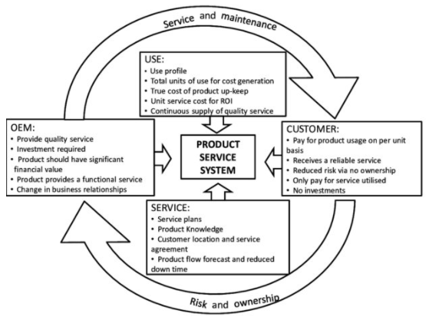
Product as a service
A PSS model incorporates a combination between a physical product and a service element.
[1] Conway, Paul; West, Andrew; Product life cycle information management in the electronics supply chain. August 2012. Web: https://www.researchgate.net/publication/273138281_Product_life_cycle_information_management_in_the_electronics_supply_chain/figures?lo=1

Slide 37
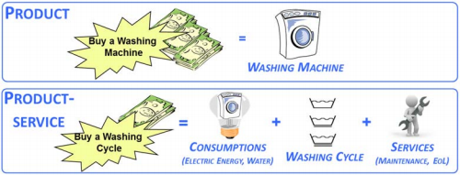
Product as a service (cont.)
Example of “washing machine” product and “washing cycle” product-service.
[2] : Favi, Claudio; Peruzzini, Margherita; Germani, Michele. A Lifecycle design approach to analyze the Eco-sustainability of industrial products and product-service systems (2012).
Example of “washing machine” product and “washing cycle” product-service [2]

Slide 38
Product as a service (cont.)
A Product Service System (PSS) can follow different approaches that can focus more on the physical product or on the service componente and separated into three main variants: product-oriented, user-oriented, and result-oriented PSS models.
• Product-oriented product service systems comprehends the inclusion of additional after-sales service in the value proposition but companies continue to produce and sell products in a conventional way. This model services can include maintenance contracts and repair offerings through extended product warranties or take back agreements.
• User-oriented product service system models aims for a more balanced weight between products and services. Clients pay for a temporary use of a good, usually through a lease agreement, and the service provider keeps full ownership of the good. Clients only pay for a product when they really need it, avoiding upfront and ongoing costs of ownership.
• Result-oriented PSS models are focused at the service end of the PSS spectrum. Firms do not market the products in the traditional way, instead firms market the services or outcomes associated with these products. Contracts between suppliers and clients represent a specific outcome, not having to specify how it is achieved.

Slide 39
Product as a service (cont.)
Advantages
A PSS can represent several benefits for the customer and the producer/supplier.
• On the customer side, a PSS is seen to provide value through more customisation and higher quality. The PSS tends to remove administrative or monitoring tasks from the customer. There is also the advantage of a higher productivity due to a better utilisation of the product’s performance and a longer operation. The customer receives value in a form close to its real needs.
• Companies will benefit from an improved strategic positioning due to the added value perceived by clients as a result of the PSS freeing the client from the costs and problems associated in the acquisition, use, maintenance and disposal of equipment and products. This improved strategic positioning can be related to:
New market development | A differentiated offer of a new product-service mix providing added value to consumers.
Increased flexibility | Fast response to the changing consumer market, due to new outsourcing relationships.
Longer-term client relationships | Relationships that lead to stronger company/customer connection and, consequently, customer loyalty.
Improved corporate identity | Company capacity to communicate ‘responsible and transparent’ position, by showing its environmental and social benefits.
Improved market and strategic positioning | Response to existing and future environmental legislative requirements or restrictions, such as extended producer responsibility and environmental performance.

Slide 40
Product as a service (cont.)
Challenges
• Notwithstanding the increased potential for value generation, the implementation of the Product as a Service model faces limitations. Changing from selling a product to selling a service is fundamental in a company’s value proposition but introduces several complexities.
• The “servitization” of a product can involve the design, planning, and overcome needed multiple additional capabilities, such as customer-service desks and account managers, to the collection and reverse logistics systems.
• The main barrier to implement the PSS in developed countries was identified as the necessary cultural shift from owning a product to value the fulfilment of the final need itself.

Slide 41
Synergies with other methodologies
The synergies of CE and two other methodologies - Lean manufacturing and Industrial Ecology - are described.
Lean manufacturing is a methodology aiming at minimizing waste in production processes by using tools such as value stream map, root-cause analysis, zero defects etc.
Industrial ecology is concerned with the study of resources flows and the interaction between industrial and environmental systems aiming at shifting the flows from linear to circular.

Slide 42
Synergies with other methodologies
Lean Manufacturing - Concept
• As a concept, lean manufacturing is described as a systematic method for eliminating or minimizing waste from a manufacturing system, or value chain, while avoiding a negative effect on productivity.
• Companies can create a system that sustainably creates more value and less waste applying lean manufacturing with its focus on process design and flow
• In the Lean concept, the term “value” is defined as an action or process that a customer would be willing to pay for and ”waste” is defined as anything that doesn’t add value to a product, or have a cost without a benefit.

Slide 43
Synergies with other methodologies
Lean Manufacturing - Wastes
Commonly identified 7 wastes of Lean:
Overproduction: producing more, sooner, or faster than is required by the next process or customer
Waiting: operators standing idle while machines cycle, equipment fails, parts delay, etc.
Transport (or conveyance): movement of parts and products beyond the absolute minimum necessary.
Overprocessing: unnecessary or incorrect processing.
Inventory: keeping more than the minimum stock of raw materials, parts, work in process (WIP), and finished goods necessary.
Motion: movements made by operators or machines beyond what is necessary.
Defects: time and effort spent correcting and inspecting rework and scrap.
The “unutilized talent” waste

Slide 44
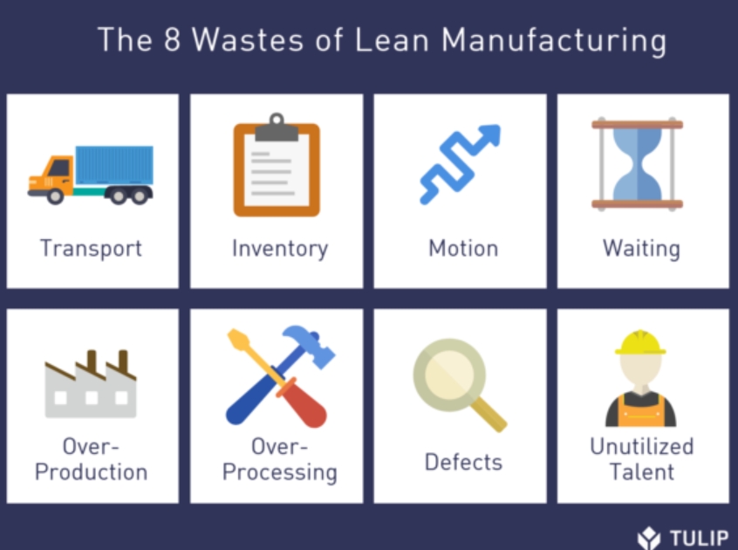
Synergies with other methodologies
Lean Manufacturing - Wastes
The 8 wastes of Lean Manufacturing:
[1] The Complete Lean Manufacturing Guide - Learn how manufacturers are using new Industry 4.0 technologies to augment traditional lean manufacturing practices. Tulip.co E-book. Web: https://tulip.co/ebooks/lean-manufacturing/#chapter-two-history-of-lean

Slide 45
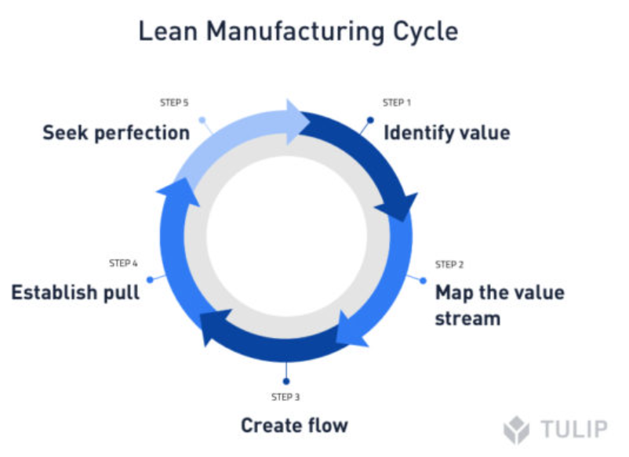
Synergies with other methodologies
Lean Manufacturing - principles
The lean concept considers five major principles as a recipe for improving workplace efficiency, namely the following:
Identifying value;
Mapping the value stream;
Creating flow;
Establishing pull;
Seeking perfection.
[2] The Complete Lean Manufacturing Guide - Learn how manufacturers are using new Industry 4.0 technologies to augment traditional lean manufacturing practices. Tulip.co E-book. Web: https://tulip.co/ebooks/lean-manufacturing/#chapter-two-history-of-lean

Slide 46
Synergies with other methodologies
Industrial Ecology - Concept
• IE is a concept in which the ecosystem is seen as an example for the design of industrial systems with the purpose of decreasing their impact on the environment by closing energy and resource loops.
“Industrial ecology conceptualises industry as a man-made ecosystem that operates in a similar way to natural ecosystems, where the waste or byproduct of one process is used as an input into another process. Industrial ecology interacts with natural ecosystems and attempts to move from a linear to cyclical or closed loop system. Like natural ecosystems, industrial ecology is in a continual state of flux”

Slide 47
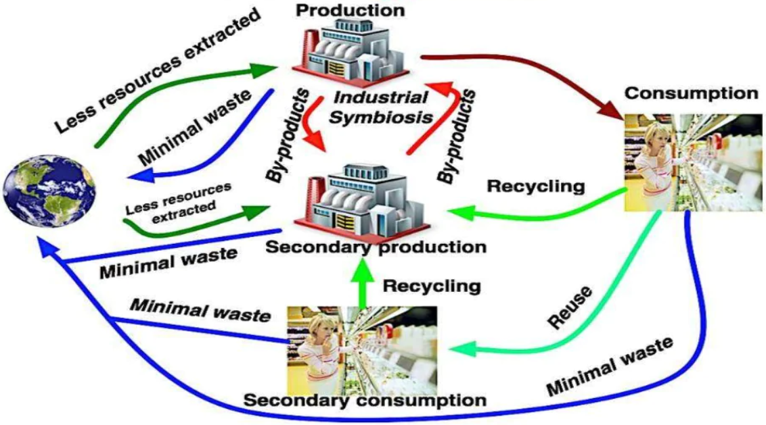
Synergies with other methodologies
Industrial Ecology - Processes
According to the IE concept, one industry utilises the surpluses (wastes & by products) of other industries as inputs into its own processes while interacting with nature. IE follows an hybrid system between industrial and natural ecosystems and considers sustainability concepts and tools such as material flow analysis, design for disassembly, environmentally friendly technologies and dematerialisation.
Industrial Ecology Processes [3]
[3] Introduction to industrial ecology and industrial metabolismo. Greek-Albanian cross border cooperation in Biomass Exploration. Available online: https://slideplayer.com/slide/13338089/

Slide 48
Synergies with other methodologies
Industrial Ecology - Principles
Develop industrial ecosystems - see waste as a resource; close loops; make partnerships with other industries to trade by-products which are used as inputs to other processes.
Dematerialise industrial output - use less virgin materials and energy by becoming more resource efficient; reuse materials or replace with more environmentally friendly materials; do more with less.
Balance industrial inputs and outputs to natural levels - manage the environmental-industrial interface; increase knowledge of ecosystem behaviour, recovery time and capacity; increase knowledge of how and when industry can interact with natural ecosystems and the limitations.
Improve the efficiency of industrial processes - redesign products, processes, equipment; reuse materials to conserve resources.
Energy use - incorporate energy supply within the industrial ecology; use alternative sources of energy that have less impact on the environment.
Align policies with the industrial ecology concept - incorporate environment and economics into organisational, national and international policies; internalize the externalities; use economic instruments to encourage a move towards industrial ecology; use a more appropriate discount rate; use a more comprehensive index to measure a nation's wealth rather than GNP.

Slide 49
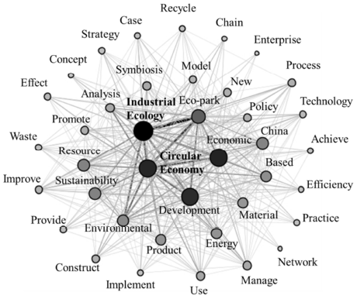
Synergies with other methodologies
Industrial Ecology & Circular Economy
[4] Saavedra, Yovana; Iritani, Diego; Pavan, Ana; Ometto, Aldo; Theoretical contribution of industrial ecology to circular economy. Received 8 September 2016, Revised 17 September 2017, Accepted 17 September 2017, Available online 30 September 2017. Web: https://www.sciencedirect.com/science/article/abs/pii/S0959652617321728
Word co-occurrance network for CE and IE literature [4]

Slide 50
Synergies with other methodologies
Industrial Ecology & Circular Economy
Contribution of IE | CE Principles based on Ellen McArthur Foundation
• Study the material and energy flows and their application. • Introduce the principles of the biological ecosystem in the industrial ecosystem • Transform the linear and semicircular flows to circular or close flows. • Eliminate the dependence on the finite stocks and reuse the waste generated into the system. • Provide material flow analysis in a complex system. | • Preserve and enhance natural capital by controlling finite stocks and balancing renewable resources flows.
• Use IS and EIPs. • Use waste as by-products. • Use strategies such as: reuse, recycling, repair and remanufacturing. • Extended the life cycle of products. • Do more with less (dematerialization) • Develop more services than products (PSS). • Use the Design for Environment or Ecodesign. • Implement Cleaner Production in the companies. | • Optimize resource yields by circulating products, components and materials in use at the highest utility at all time in both technical and biological cycles.
• Use the indicators to monitor the system effectiveness. • Research aimed at developing new ways for CE transition. • Implement national and international economic development policies. | • Foster system effectiveness by revealing and designing out negative externalities.
Contributions of IE to CE

Slide 51
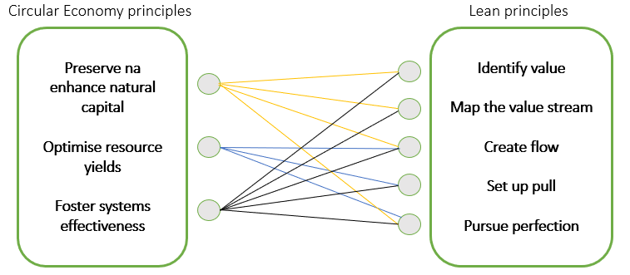
Synergies with other methodologies
Industrial Ecology & Circular Economy
Interrelations between Circular Economy and Lean principles
[5] Saavedra, Yovana; Iritani, Diego; Pavan, Ana; Ometto, Aldo; Theoretical contribution of industrial ecology to circular economy. Received 8 September 2016, Revised 17 September 2017, Accepted 17 September 2017, Available online 30 September 2017. Web: https://www.sciencedirect.com/science/article/abs/pii/S0959652617321728
Word co-occurrance network for CE and IE literature [5]

Slide 52
Synergies with other methodologies
Industrial Ecology & Circular Economy
Different approaches of LM and CE to the elements of Waste and Value
 | Lean approach | CE approach
Element Waste | • The minimum quantity of equipment, materials, parts, space and time are absolutely essential to add value to the product; • Is an activity that does not add value to costumers; • Is inefficiency and is measured by KPI’s. | • Waste = raw material; • Is seen in 4 dimensions: Wasted resources, wasted lifecycles, wasted capability, wasted embedded values.
Element Value | • Value is perceived from customer’s perspective; • Costumer’s requirement. | • Reduce waste by recycling and source from waste; • Prevent resources from exiting the economy; • Four dimensions: Cost reduction, revenue generation, resiliency, legitimacy and image.
[6] Nadeem, Simonª; Garza-Reyes, Joseª; Anosike, Anthonyª; Kumar, Vikas^{b}; ªCentre for Supply Chain Improvement, University of Derby, Derby, U.K.; ^{b}Bristol Business School, University of the West of England, Bristol, U.K.; Coalescing the Lean and Circular Economy, 2019. Web: http://ieomsociety.org/ieom2019/papers/279.pdf
Different approaches of LM and CE to the elements of Waste and Value [6]

Slide 53
Assessment
Task
Watch the video below and answer to the following questions:
What is the difference between the linear and a circular economy model?
In how far does circular economy affect you as a company owner and what benefits come with it in comparison to the linear economy model?
Comment on the following statement: Local and regional governments have a critical role to play
https://www.youtube.com/watch?v=__0Spwj8DkM

Slide 54
Further readings
Developing new circular products or services
European Comission, Sustainable Product Policy and Ecodesign. https://ec.europa.eu/growth/industry/sustainability/product-policy-and-ecodesign_en
European Comission, Ecodesign and Energy Labelling, Directive 2009/125/EC and Regulation (EU) 2017&1369. https://ec.europa.eu/growth/single-market/european-standards/harmonised-standards/ecodesign_en
European Comission, Ecodesign your future – How ecodesign can help the environment by making products smarter, Report, https://op.europa.eu/pt/publication-detail/-/publication/4d42d597-4f92-4498-8e1d-857cc157e6db

Slide 55
Further readings
Developing new circular products or services (cont.)
ISO/TR 14062—Environmental management—Integrating environmental aspects into product design and development, Tech. Rep. 2002 (2002)
E.D. Reiskin, A.L. White, J.K. Johnson, T.J. Votta, Servicizing the Chemical Supply Chain, J. Ind. Ecol. 3 (1999) 19–31. https://doi.org/10.1162/108819899569520
I.C. De los Rios, F.J.S. Charnley, Skills and capabilities for a sustainable and circular economy: The changing role of design, J. Cleaner Production 160 (2017) 109-122 https://www.sciencedirect.com/science/article/pii/S0959652616317619?via%3Dihub

Slide 56
Further readings
Circular Suplies
Roos G. Business model innovation to create and capture resource value in future circular material chains, Resources 3 (2014) 248-274, https://doi.org/10.3390/resources3010248
D. Benton, J. Hazell, Resource Resilient UK – A report from the Circular Economy Task Force, Green Alliance 2013. Available at: https://greenalliance.org.uk/resources/Resource%20resilient%20UK.pdf

Slide 57
Further readings
Recycle, reuse, and share
OECD publications (2019): Business Models for the Circular Economy-Opportunities and Challenges for Policy. Available at: https://www.oecd-ilibrary.org/sites/e59f8dd6 en/index.html?itemId=/content/component/e59f8dd6-en Waste to Wealth: The Circular Economy Advantage (2015): Lacy, Peter, Rutqvist, Jakob
Ellen McArthur Foundation, Upstream Innovation: a guide to packaging solutions, Available at: https://emf.thirdlight.com/link/xgfhlc17d1oc-qtv2v7/@/preview/3
S.W. Short, N.M.P. Bocken, C.Y. Barlow, M.R. Chertow, From Refining Sugar to Growing Tomatoes, J. Ind. Ecol. (2014), https://doi.org/10.1111/jiec.12171

Slide 58
Further readings
Extending products' life
Carra, Guglielmo (Arup) and Magdani, Nitesh, (BAM) (2016) Circular Business Models for the Built Environment, https://www.ellenmacarthurfoundation.org/assets/downloads/ce100/CE100-CoPro-BE_Business-Models-Interactive.pdf, last access 13.11.2020.
European Commission (16.01.2018), Communication from the Commission to the European Parliament, the Council, the European Economic and Social Committee and the Committee of the Regions on a monitoring framework for the Circular Economy, https://ec.europa.eu/environment/circular-economy/pdf/monitoring-framework.pdf, last access 03.11.2020.
Design and business model considerations for heavy machinery remanufacturing – Caterpillar. Ellen Macarthur Foundation. Web: https://www.ellenmacarthurfoundation.org/case-studies/design-and-business-model-considerations-for-heavy-machinery-remanufacturing, last access 04.08.2021.

Slide 59
Further readings
Extending products' life (cont.)
Keeping clothing in use - save money and reduce waste – thredUP. Ellen Macarthur Foundation. Web: https://www.ellenmacarthurfoundation.org/case-studies/keeping-clothing-in-use-save-money-and-reduce-waste, last access 04.08.2021.
GROWTH WITHIN: A CIRCULAR ECONOMY VISION FOR A COMPETITIVE EUROPE. Ellen Macarthur Foundation. Web: https://www.ellenmacarthurfoundation.org/assets/downloads/publications/EllenMacArthurFoundation_Growth-Within_July15.pdf , last access 04.08.2021.
Guglielmo Carra, Arup; Nitesh Magdani, BAM. CIRCULAR BUSINESS MODELS - FOR THE BUILT ENVIRONMENT. Circular Economy 100 (CE100) programme. Web: https://www.arup.com/perspectives/publications/research/section/circular-business-models-for-the-built-environment , last access 04.08.2021.

Slide 60
Further readings
Sharing Platforms
Circular knowledge networks and platforms Available online: https://kenniskaarten.hetgroenebrein.nl/en/knowledge-map-circular-economy/circular-knowledge-networks-platforms/ .
Schwanholz, J.; Leipold, S. Sharing for a circular economy? an analysis of digital sharing platforms’ principles and business models. J. Clean. Prod. 2020.

Slide 61
Further readings
Product as a service
Carra, Guglielmo (Arup) and Magdani, Nitesh, (BAM) (2016) Circular Business Models for the Built Environment, https://www.ellenmacarthurfoundation.org/assets/downloads/ce100/CE100-CoPro-BE_Business-Models-Interactive.pdf , last access 13.11.2020.
European Commission (16.01.2018), Communication from the Commission to the European Parliament, the Council, the European Economic and Social Committee and the Committee of the Regions on a monitoring framework for the Circular Economy, https://ec.europa.eu/environment/circular-economy/pdf/monitoring-framework.pdf , last access 03.11.2020.
Vezzoli, Carlo; Kohtala, Cindy; and Srinivasan, Amrit with Diehl, JC; Fusakul, Sompit, Xin, Liu and Sateesh, Deepta. Product-Service System Design for Sustainability (2014); LeNS project - Learning Network on Sustainability https://re.public.polimi.it/retrieve/handle/11311/828725/24772/Product-Service%20System%20Design%20for%20Sustainability_PART%20I.pdf , last access 03.08.2021.

Slide 62
Further readings
Product as a service (cont.)
Bringing office furniture full circle – Ahrend. Furniture as a service (FAAS). Ellen Macarthur Foundation. Web: https://www.ellenmacarthurfoundation.org/case-studies/bringing-office-furniture-full-circle, last access 04.08.2021.
GROWTH WITHIN: A CIRCULAR ECONOMY VISION FOR A COMPETITIVE EUROPE. Ellen Macarthur Foundation. Web: https://www.ellenmacarthurfoundation.org/assets/downloads/publications/EllenMacArthurFoundation_Growth-Within_July15.pdf, last access 04.08.2021.
Guglielmo Carra, Arup; Nitesh Magdani, BAM. CIRCULAR BUSINESS MODELS - FOR THE BUILT ENVIRONMENT. Circular Economy 100 (CE100) programme. Web: https://www.arup.com/perspectives/publications/research/section/circular-business-models-for-the-built-environment, last access 04.08.2021.

Slide 63
Further readings
Synergies with other methodologies
Carra, Guglielmo (Arup) and Magdani, Nitesh, (BAM) (2016) Circular Business Models for the Built Environment, https://www.ellenmacarthurfoundation.org/assets/downloads/ce100/CE100-CoPro-BE_Business-Models-Interactive.pdf , last access 13.11.2020.
European Commission (16.01.2018), Communication from the Commission to the European Parliament, the Council, the European Economic and Social Committee and the Committee of the Regions on a monitoring framework for the Circular Economy, https://ec.europa.eu/environment/circular-economy/pdf/monitoring-framework.pdf , last access 03.11.2020.
PRINCIPLES OF LEAN; Lean Enterprise Institute; Web: https://www.lean.org/WhatsLean/Principles.cfm

Slide 64
Further readings
Synergies with other methodologies (cont.)
O'Rourke, Dara; Connelly, Lloyd; Koshland, Catherine; INDUSTRIAL ECOLOGY: A CRITICAL REVIEW; International Journal of Environment and Pollution, Vol. 6, Nos. 2/3, pp. 89-112, 1996. Web: https://www.researchgate.net/publication/255598523_Industrial_Ecology_A_Critical_Review
Robert U. Ayres; Leslie W. Ayres; A Handbook of Industrial Ecology; Published by Edward Elgar Publishing Limited; 2001. Web: http://pustaka.unp.ac.id/file/abstrak_kki/EBOOKS/A%20Handbook%20of%20Industrial%20Ecology.pdf
Magnusson, T., Andersson, H., Ottosson, M., (2019), Industrial ecology and the boundaries of the manufacturing firm, Journal of Industrial Ecology, 23(5), 1211-1225. Web: https://doi.org/10.1111/jiec.12864

Slide 65
BUSINESS MODELS
Thank
you!
environmental concept tree and money by sompong_tom in https://www.freepik.com/premium-photo/environmental-concept-tree-money_26734080.htm#query=green%20money&position=33&from_view=search&track=ais

