Slide 1
BUSINESS MODELLING FOR CIRCULAR ECONOMY BUSINESSES

Slide 2
02
2.1 Circular economy and its principles

Slide 3
Main objectives
Linear model of production and consumption
CE Principles as opposed to the Linear Model
CE Indicators
CE policies and legislative framework

Slide 4
Linear model of production and consumption
An overview of the linear model of production and consumption explaining. under a historical perspective, how the linear model was favoured in order to achieve economic growth.
The implications (e.g., climate change, pollution) of the linear model are realized through evidence of the environmental degradation that contributed to the linear model.

Slide 5
The Linear Economy
The wording, which could best describe the Linear Economy, is a "disposal society". The roots of this wasteful behavior can be found in the dawn of industrialization more than 150 years ago. At that time, people started massively processing raw materials. The process starts with the extraction of raw materials, their transformation into specific products, and the usage/exploitation of those products by the end users (consumers). Once the products are no longer needed, they are being disposed of. As a result, large quantities of valuable materials are still lost today.
Source: Wautelt, 2018

Slide 6
The Linear Economy (cont.)
The linear model creates an economy that is heavily dependent on energy consumption and other resources to provide products and services.
Current production processes are energy-intensive and extraction of raw materials generates huge amounts of waste and are responsible for a relevant consumption of water and energy.
Both renewable and non-renewable resources undergo several stages of processing in order to serve their purpose in the economy.

Slide 7
The Linear Economy (cont.)
The first stage is called primary processing where pure materials are separated from the mixed form in which they usually exist in the environment. The materials that are the result of the primary processing are then used by the different manufacturing industries transforming them into finished products. The finished products then reach the consumer (either individual consumers/households or the tertiary economic sector such as distributors, retailers, and various service providers). Each step of the production process has its negative impact on the environment.
The primary sector has the most negative impact as it generates a big quantity of residual waste as well as requires a big input of energy.

Slide 8
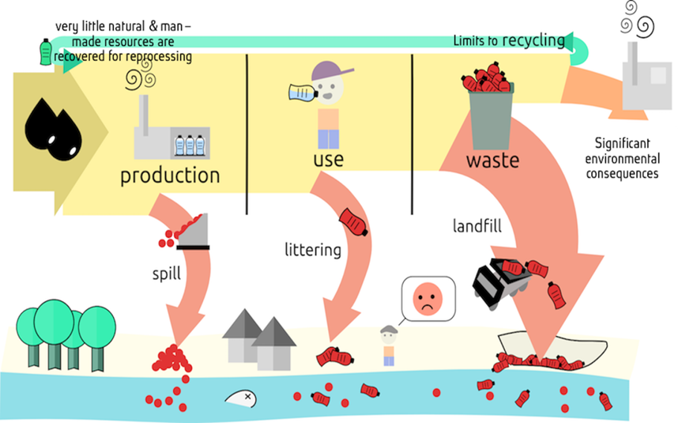
The limits of the linear model
There is uneven consumption of resources, the main part of which is directed to highly developed countries at the expense of developing ones.
2. There is a huge accumulation of different types of waste which are not recycled after being disposed of.
3. Negative effect on the environment - as a result of the extraction and consumption of raw materials, energy consumption and greenhouse gas emissions are increasing.
Source: https://www.circulareconomyasia.org/circular-economy/

Slide 9
Shoe production in the linear economy example
Elements | Characteristic
Cotton | Cotton production is the cause of ¼ of the consumption of pesticides in the world; it requires large quantities of water and artificial fertilizers; the seeds are treated with fungicides and insecticides and are of genetically modified varieties; when collecting cotton, herbicides that remove the leaves are used, to make harvesting easier; the mono-cultural nature of cotton production causes soil loss; it is dependent on a variety of potentially dangerous chemicals (washing, bleaching, and more).
Leather | Only in 2009, leather production in China has contributed nearly to 250 million tons of waste water; untreated water from tanneries often contains high levels of heavy metals.
Rubber | During World War II, there was a need for an alternative source of tires; today almost 70% of the rubber we use is synthetic; synthetic rubber is produced from oil; it is cheaper compared to the natural one, but is of lower quality.
Glues | All types of chemical glue pollute air; they are dangerous for human health and other living beings; a study conducted among Chinese shoemakers found high levels of benzene, toluene and other toxic solvents contained in various adhesives; toxic substances cause aplastic anemia, leukemia and other diseases; most organic solvents are neurotoxic, causing the so called “shoemaker’s paralysis; in some developing countries, the shoemaker industry employs a large number of children (17.5 million in India in 2005), with the health risk for them being higher; typically, the task of children-shoemakers is to put the soles, thus they are in direct contact with toxic substances.
Characteristic features of the main elements in the production of a shoe, Adapted to http://www.lessonsfromnature.org/bg/index.php?option=com_content&view=article&id=104&Itemid=114

Slide 10
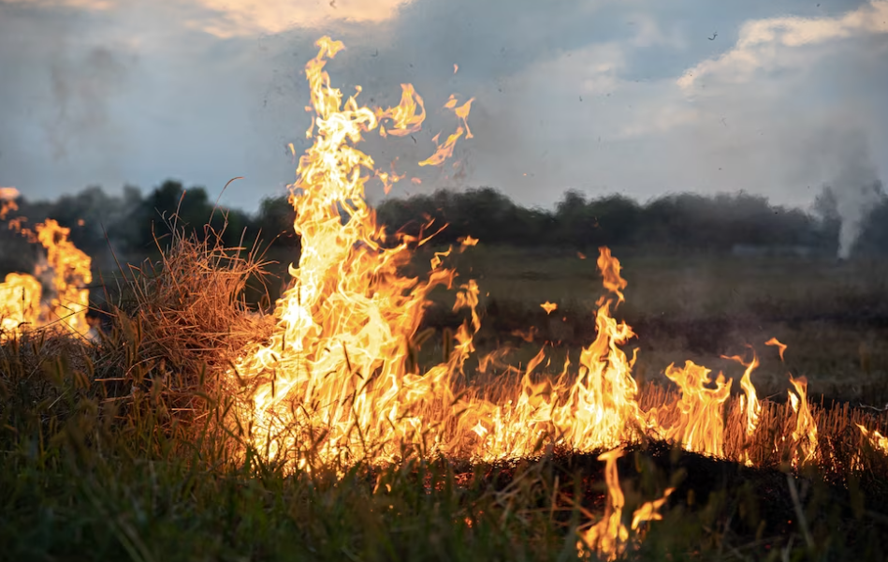
The negative effects on the environment
The linear economy is considered to be a non-viable form of economic model, as long-term planetary borders will reach an unsustainable level of maintenance. Humanity is already experiencing the disparity of the linear economy with the growing scarcity of resources, increased pollution and vulnerability of people and the environment caused by this pollution.
The negative effect of climate change:
Increase in the average global temperature
Wildfires and drought
Fresh water availability
Floods
Rise in sea level
Climate change poses various types of challenges – it affects different economic sectors (energy, agriculture and forestry, construction and infrastructure, tourism, etc.) and poses environmental, social, and territorial challenges.
fire in the steppe by pvproductions
in https://www.freepik.com/free-photo/fire-steppe-grass-is-burning-destroying-everything-its-path_18629392.htm#query=country%20fire&position=6&from_view=search&track=ais

Slide 11
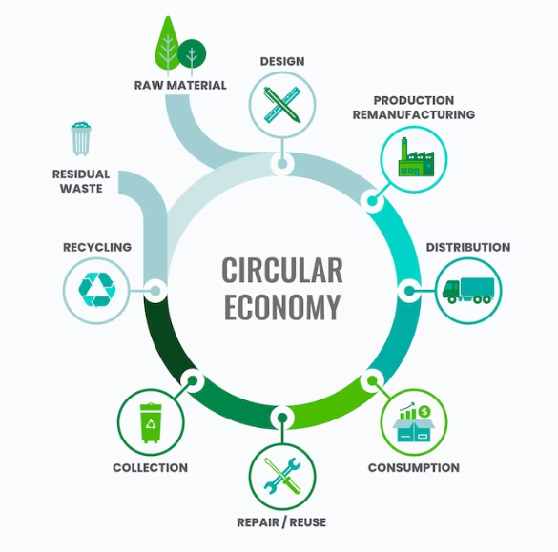
New model is needed…
It is obvious to all participants in the traditional linear model of production and consumption that through it the economy cannot continue in the future. In a number of countries there are already approaches to rethinking and reducing resource consumption.
“The system we have constructed to satisfy our needs has led us astray: an economy profligate of material resources, an environment degraded by material emissions, and lives overburdened by material concerns. From within the darkness of this position appears the light of a new conception: a society which addresses itself anew to the complex question of satisfying needs; an economy which does not degrade the environment in which it must survive” - Tim Jackson
There is already a concept of such an economic model and it refers to the Circular Economy.
circular economy infographic by freepik in https://www.freepik.com/free-vector/flat-design-circular-economy-infographic_21095200.htm#query=circular%20economy&position=4&from_view=search&track=ais

Slide 12
CE Principles as Opposed to the Linear Model
Information on the essence of the circular economy and the main principles that govern it.
The differences between the two economic models – the linear and the circular one are discussed and the benefits of the transition to circular economy are pointed out.

Slide 13
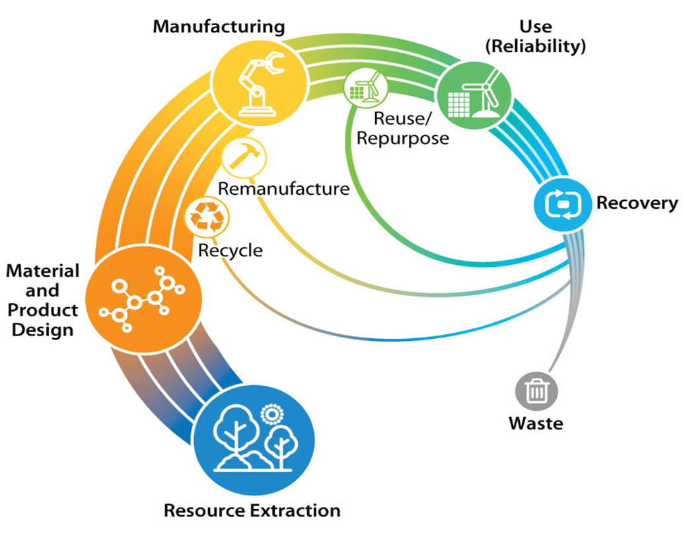
CIRCULAR ECONOMY
“The circular industrial economy manages stocks of manufactured assets, such as infrastructure, buildings, vehicles, equipment and consumer goods, to maintain their value and utility as high as possible for as long as possible; and stocks of resources at their highest purity and value”
The circular economy aims at long-term resilience, sustainability, benefits for the society and environment and generating business and economic opportunities. The goal of the circular economy is to rethink growth, putting the focus on societal benefits while distinguishing the consumption of finite resources from economic activity and preventing waste and pollution.
Circular economy (Source: NREL)

Slide 14
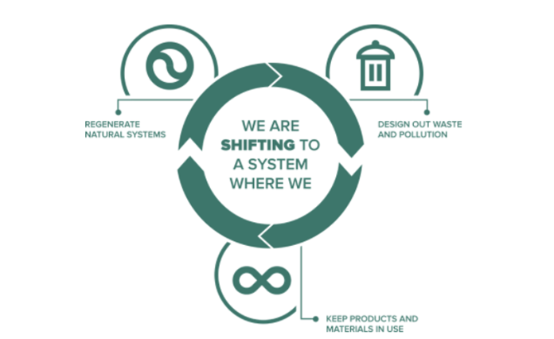
CE Principles as opposed to the Linear Model
Looking beyond the "Take, Make, Use, Dispose" linear industrial model, the model of the circular economy can be described as "Reduce – Reuse – Recycle".
The transition from a linear to a circular economy is based on three main principles[1]:
• Design out waste and pollution - In the circular economy the design stage of the product is the most important – circular products are designed in such a way so they can be reused / recovered later on and minimum or no waste is created
• Keep products and materials in use - products’ life extension and the possibility for them to be reused, repaired, and remanufactured
• Regenerate natural systems - opportunities for improving our environment
CE principles (Source [1]: https://planetark.org/)

Slide 15
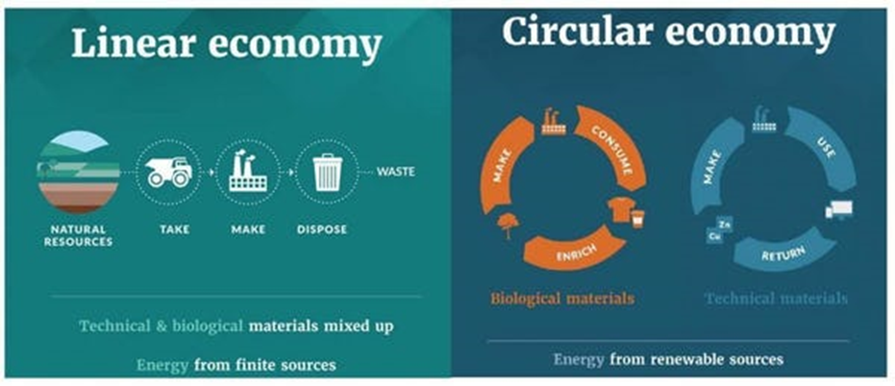
Differences between the Linear and the Circular Economy
The Circular and the Linear Economy are fundamentally different. In contrast to what is happening in a linear economy, the circular economy makes optimal use of raw materials and resources. This means that these materials and resources continue to be applied in a way that generates the highest economic value and the least environmental damage. Closing the cycles of raw materials in the circular economy is associated with different ways of creating value, new business models application and sustainability.
Source: Ellen MacArthur Foundation

Slide 16
Differences between the Linear and the Circular Economy (CONT.)
The Linear and the Circular Economy differ in terms of how value is created, in how they treat waste and view sustainability, in terms of job creation and liability and in business models. Major differences are presented on the table:
 | Linear Economy | Circular Economy
Economic model | Economy of scale / Ends at the point of sale | Open-ended
Value | Creates value added | Maintains value
Waste | Waste management | Waste prevention
Sustainability | Care for one’s own belongings | Caring for environment and society / Sharing
Tax | Tax on resources | Tax on labour
Job creation | Jobs on a global scale related to mass production | Enables local job creation and new jobs
Liability | Lies with the user/owner of goods | Extended producer liability
Business models | Focus on products | Focus on services

Slide 17
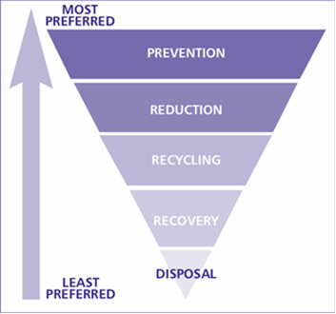
Waste in the Circular Economy
Another major point of difference between the circular and the linear economy is in the way they treat waste. In the circular economy model, waste prevention is a fundamental and shared value.
The Hierarchy of Waste Requirements is a priority order that includes:
Prevention of waste;
Preparing products for reuse;
Recycling products where possible;
Utilization of energy;
Disposal of products.
The waste management hierarchy Source: United Nations Environment Program, UNEP (2011)

Slide 18
Shoe production in the circular economy example
Main elements | Characteristics
Eco leather | It is produced without the use of hazardous chemicals (chromium, dyes); the tanning is done with plant products; the leather can be completely replaced with hemp, wool or jute.
Bio-cotton | Organic cotton production does not use seeds of genetically-modified varieties; no pesticides, herbicides and other chemicals and fertilizers are used; picking is manual; cotton can be completely replaced with bamboo or jute.
Hemp | A very adaptive plant; it grows in different climatic zones; no pesticides and chemicals are required; one of the sturdiest and most breathable materials.
Bamboo | One of the fastest growing plants; it contains antimicrobial properties; no chemicals and fertilizers needed.
Recycled rubber | 6 pairs of shoe soles are produced from one recycled car tire.
Natural rubber | It is extracted from the resin of trees; production techniques preserve tropical forests; it removes the need for huge plantations with mono-cultural plantations; it replaces toxic processes in the manufacture of synthetic rubber.
Recycled PET | It is obtained from the recycling of plastics (plastic bottles); it is an ethylene vinyl acetate (EVA) substitute.
Nettle | An abundant textile product; it does not fight for agricultural area with food crops; it grows quickly without the need for chemicals and pesticides and can be very easily picked and converted into fabric.
Silkworm | It creates a unique pupa with its saliva, which protects the future butterfly; the hard shell is gradually covered with tiny but very strong and durable silk fibres; it contains anti-bacterial and antifungal substances; the industry can produce 1 t per year of silk fibres.
Adhesives | They are water-based.
Characteristics of the main elements in the production of a shoe in a circular economy Adapted to http://www.lessonsfromnature.org/bg/index.php?option=com_content&view=article&id=104&Itemid=114

Slide 19
Circular Economy benefits - Economy
Circular economy brings economic, environmental, and social benefits:
Decoupling economic growth from raw materials’ consumption, would lead to more effective use of resources;
By implementing new circular activities, the companies would increase their turnover while the new types of activities related to the circular economy would lead to creation of new jobs;
The cooperation among various actors and sectors of the Circular Economy would result in innovative and sustainable products and services.
hands cupping plant by rawpixel.com in
https://www.freepik.com/free-photo/hands-cupping-plant-business-investment_15669196.htm#query=plant%20hand&position=1&from_view=search&track=ais

Slide 20
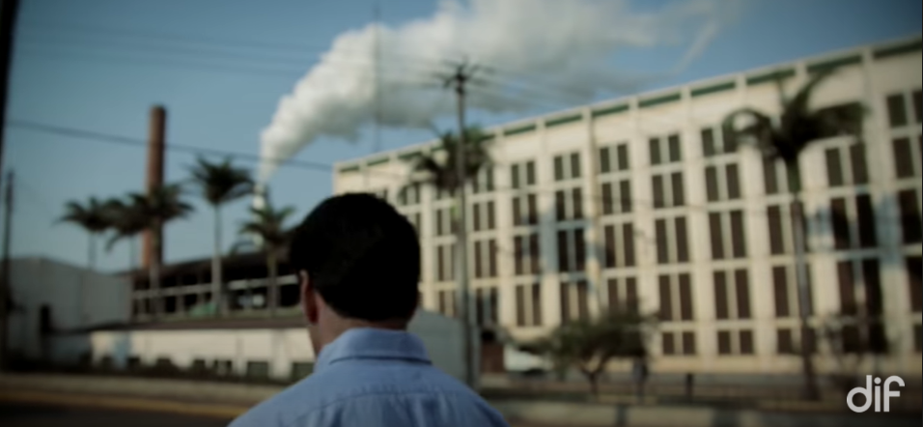
Circular Economy benefits - Environment
Circular economy brings economic, environmental, and social benefits
Environmental benefits of the CE
Reduction of greenhouse gas emissions due to decrease in extraction and processing of raw materials;
Circular Economy practices such as Regenerative Agriculture improve natural ecosystems that would lead to cleaner soils, water, and air e.g.
Video
Source: Balbo - UNICA
Source: Balbo - UNICA

Slide 21
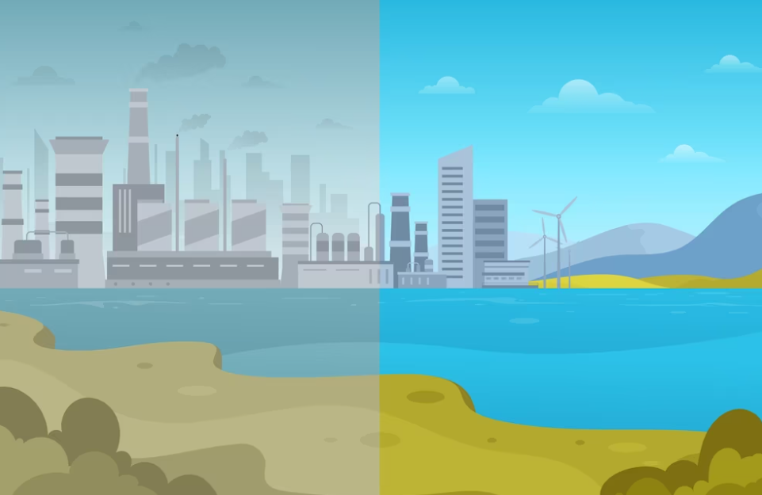
Circular Economy benefits - Society
Circular economy brings economic, environmental, and social benefits
Reduced unemployment due to new jobs / local jobs creation;
Improved quality of life related to energy-efficiency, sustainable transport and infrastructure, sustainable food, and pollution reduction;
More efficient use of resources through the sharing economy
environmental effects by freepik in
https://www.freepik.com/free-vector/environmental-effects-coronavirus-concept_7886905.htm#query=polution%20city%20before%20and%20after&position=4&from_view=search&track=ais

Slide 22
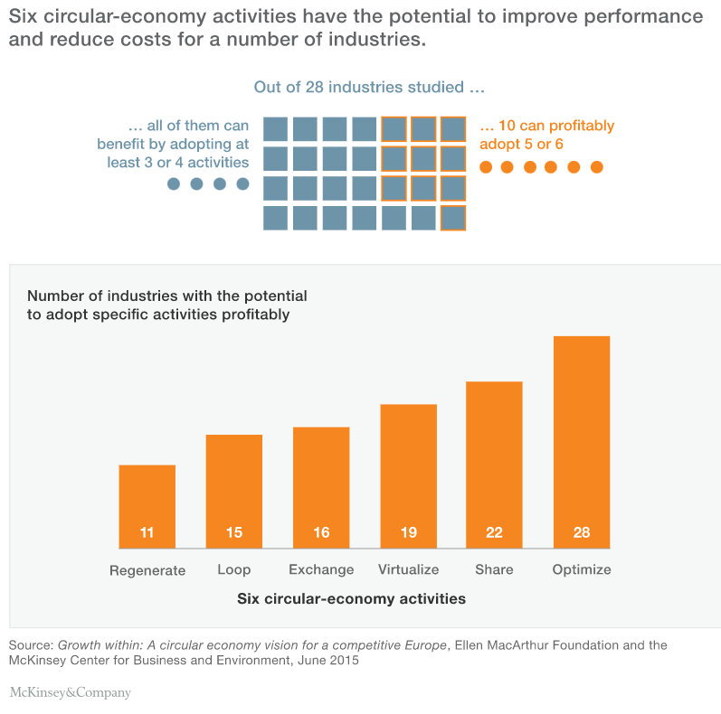
Circular Economy benefits for the business
In 2015, a joint research of Ellen MacArthur Foundation and the Mc Kinsey Center for Business and Environment, showed that most business across Europe could improve their financial performance by adopting circular economy activities. The study was performed among 28 industries in regards to 6 circular economy activities:

Slide 23
CE Indicators
Indicators for the Circular Economy as well as the Material circularity indicator.

Slide 24
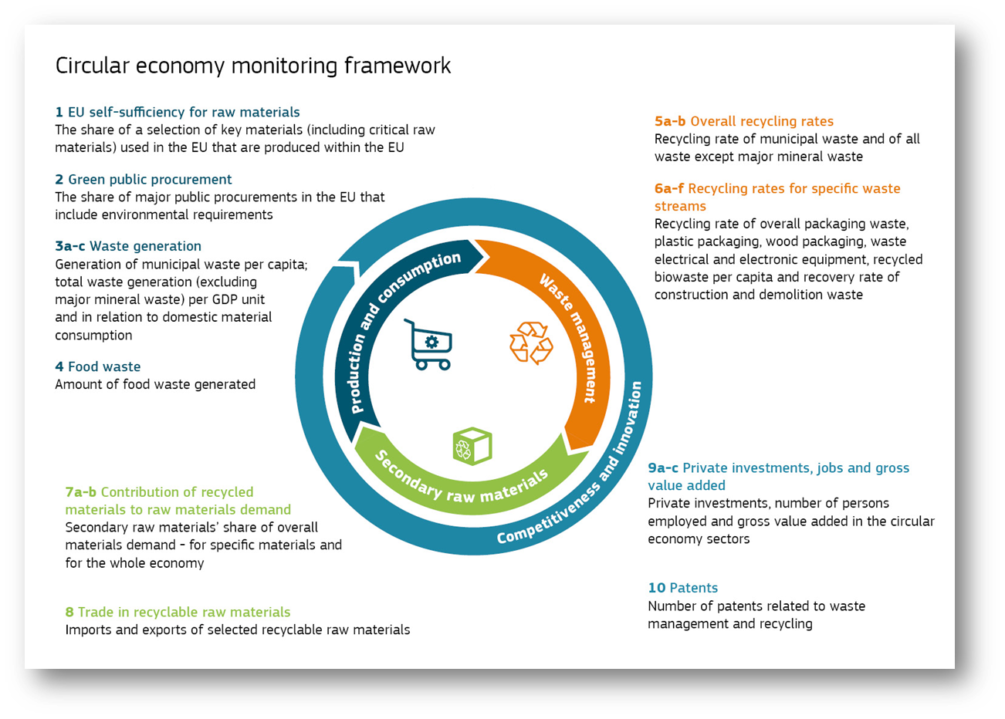
CE Monitoring framework
In order to monitor key trends of the transition to circular economy, the European Commission set up a Monitoring framework, consisting of 10 indicators grouped in 4 categories. The list of indicators uses available data from Eurostat, JRC, DG GROW, and the European Patent office.
Source: European Union, 2018

Slide 25
CE Indicators (1)
№ | Indicator | Importance | EU levers (examples)
Production and consumption
1 | Self-sufficiency of raw materials for production in the EU | The circular economy should help address the risks associated with the supply of raw materials, especially critical raw materials. | Raw Materials Initiative; Resource Efficiency Roadmap
2 | Green public procurement (as an indicator for financing aspects) | Public procurement takes up a large share of consumption and can drive the circular economy. | Public procurement strategy; support schemes and voluntary green public procurement criteria
3 | Waste generation (as an indicator for consumption aspects) | In the circular economy, waste generation is minimised. | Waste Framework Directive; directives on specific waste streams; Plastics Strategy
4 | Food waste | Food disposal has negative impacts on the environment, climate and the economy. | General Food Law Regulation; Waste Framework Directive; various initiatives (such as the EU Platform on Food Loss and Food Waste)
Waste management
5 | Recycling rates (the share of waste which is recycled) | Increasing recycling rates is part of the transition to a circular economy. | Waste Framework Directive
6 | Specific waste streams (packaging waste, biowaste, e-waste, etc.) | Reflects progress in recycling the most important waste streams. | Waste Framework Directive; Landfill Directive; directives on specific waste streams.

Slide 26
(cont.)
Secondary raw materials
7 | Contribution of recycled materials to raw materials demand | In the circular economy, recycled materials are regularly used to produce new products. | Waste Framework Directive; Ecodesign Directive; the EU Ecolabel; REACH Regulation; Plastics Strategy; quality standards for secondary raw materials.
8 | Trade of recyclable raw materials between the EU Member States and with the rest of the world | Trade in recyclable raw materials reflects the importance of the internal market and global participation in the circular economy. | Internal market policy; Waste Shipments Regulation; trade policy.
Competitiveness and innovation
9 | Private investments, jobs and gross value added | Reflects the contribution of the circular economy to job creation and growth. | Investment Plan for Europe; Structural and Investment Funds; InnovFin program; Platform for financial support of the circular economy; Sustainable finance strategy; Green Jobs Initiative; A new European Skills Agenda; internal market policy
10 | Patents related to recycling and secondary raw materials as a proxy for innovation | Innovative circular economy technologies increase the EU's global competitiveness. | Horizon Europe

Slide 27
CE Indicators (2)
While the previous slide presents the CE Indicators coming from the Circular Economy Monitoring Framework, in the following slide we present another set of indicators, again of the EC – DG Environment and the Eco-innovation action plan.
There are 3 major categories:
Sustainable Resource Management
Societal Behavior
Business Operations
Data comes mainly from Eurostat, but also from Deloitte, Ecopreneur, EEA, Flash Eurobarometer 441, Community Innovation Survey 2014 and EU Ecolabel.

Slide 28
CE Indicators (3)
Group | Indicators
Sustainable resource management — measure performance on transformation to CE in terms of resource demand and pressure on the environment | Material footprint Resource productivity of Member States Trends in the repair sector Extended producer responsibility Trends in the recycling market
Societal behavior - measure citizens' awareness and involvement in the circular economy | Citizens Who have chosen alternatives to buying new products Coverage of the CE topic in media Turnover in repair of computers and personal goods NP of enterprises and employees in repair
Business operations — indicators related to business models for circular economy, reuse, remanufacturing, recycling Indicators | Difficulties in implementing circular economy activities experienced by companies Financing sources for CE activities; Availability of information on access to finance for CE related activities; Share of enterprises that facilitate recycling of products after use; Enterprises that extend product life through more durable products; Enterprises that recycle waste, water, or materials for own use or sale; Number of eco-labeled products or services
Source: https://ec.europa.eu/environment/ecoap/indicators/circular-economy-indicators_en

Slide 29
The material circularity indicator (MCI)
The possible values of the material circularity indicator are from 0 to 1:
MCI = 1: In order to obtain rating 1, all used raw materials should come from recycled components or recycled materials without any losses during recycling
MCI = 0.1: A product with a score of 0.1 has fully linear material flows in which all raw materials come from untreated material and are not reused or recycled as waste. To achieve a value below 0.1, the product should have a shorter life cycle or lower intensity of use than that of the average industrial product.
MCI> 0.1: For a product with fully linear material flows, but with a higher benefit than the average industrial product, there will be an MCI> 0.1.
The material circularity is an expression of the compatibility of a product with the principles of the circular economy. The material circularity indicator (MCI) reveals the degree of circularity of the material flow on a scale from 0 to 1.
The results show that the higher the value, the more "circular" the product is.

Slide 30
CE Policies and Legislative Framework
The legal framework in the field of the circular economy in Europe.
It gives an overview of potential policy instruments affecting product circularity throughout the product life cycle.

Slide 31
CE Policies and legislative framework
The successful transition to circular economy requires the adoption and implementation of new measures and actions with focus on the efficient use of natural resources and products’ life span extension while carefully considering each stage of the product chain – from extraction of raw materials, planning and design of products, and production to consumption and waste management.
In March 2020, the European Commission adopted the New Circular Economy Action Plan – Europe’s new agenda for sustainable growth and one of the main blocks of the European Green Deal. The New Action Plan announces initiatives along the entire life cycle of products such as products’ design, circular economy processes, sustainable consumption, and waste. It focuses on sectors that are resource demanding and have a high potential for circularity such as electronics and ICT, batteries and vehicles, packaging, plastics, textiles, construction, and food.

Slide 32
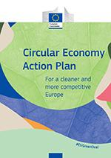
(Cont.)
The document introduces legislative and non-legislative measures targeting areas where action at EU level could bring real added value. Some of the measures are to:
Make sustainable products the norm in the EU;
Empower consumers and public buyers;
Ensure less waste;
Make circularity work for people, regions, and cities;
Lead efforts on the circular economy on a global scale.
Source: https://op.europa.eu/

Slide 33
EU and the Circular Economy
With the EP resolution of 10 February 2021 on the New circular economy action plan, the EP called for additional measures to achieve environmental sustainability and carbon neutrality by 2050. Some of the additional recommendations relate to:
tightening recycling requirements;
binding targets on the “ecological footprint” of materials;
support of the EU Ecolabel as a benchmark for environmental stability;
strengthening the role of green public tenders;
integration of CE principles into the national recovery plans of the Member States.
“the EU Ecolabel is a label of environmental excellence that is awarded to products and services meeting high environmental standards throughout their life-cycle: from raw material extraction, to production, distribution and disposal. The EU Ecolabel promotes the circular economy by encouraging producers to generate less waste and CO2 during the manufacturing process. The EU Ecolabel criteria also encourages companies to develop products that are durable, easy to repair and recycle”.
Source: European Commission

Slide 34
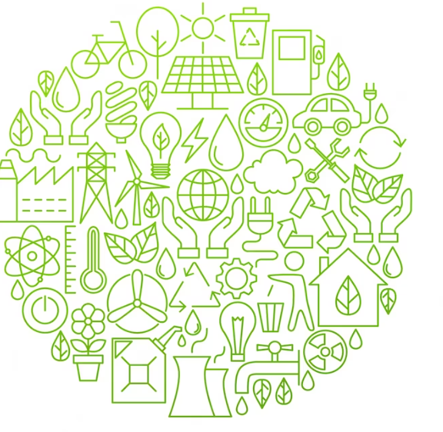
National CE Policies, Strategies, Plans, and Measures
Germany
Cyprus
Croatia
Austria
Ireland
Romania
Greece
Bulgaria
Portugal
ecology line icon circle design by anya_leni in
https://www.freepik.com/premium-vector/ecology-line-icon-circle-design-vector-illustration-green-power-environment-objects_19679860.htm#query=environmental%20icns&position=18&from_view=search&track=ais

Slide 35
9. PORTUGAL
The Circular Economy Action Plan (PAEC), 2017 | https://eco.nomia.pt/contents/ficheiros/paec-pt.pdf
Resolution of the Council of Ministers n. º 108/2019, of 2 July | Promotes the Action Plan for the Circular Economy in Portugal approved by Resolution of the Council of Ministers n. º 190-A/2017, of 11 December.
Decree-Law No. 86-C/2016, of December 29 | Creates the Fund for Innovation, Technology, and Circular Economy, with Ordinance No. 258/ 2017 approved the Management Regulation of this Fund.
The Roadmap Carbon neutrality (RNC2050) | Defines the path to carbon neutrality in Portugal, establishing the main guidelines and identifies cost-effective options to achieve this end in different socio-economic development scenarios.
The National Strategy for Green Procurement | Analyses the integration of criteria in Public Procurement, promoting resource circularity in the list of priority goods and services established in the National Strategy for Green Public Procurement (ENCPE 2020).
The Waste Management National Plan (PNGR 2020) | Aims to promote the prevention and management of waste integrated in the life cycle of products, centered on a tending circular economy and ensuring greater efficiency in the use of natural resources, and is based on two strategic objectives.
Ordinance No. 241-B/2019, of 31 July | Approves PERSU 2020+, which is an adjustment to the measures defined in the Strategic Plan for Urban Waste (PERSU 2020).
Resolution of the Council of Ministers no. 141/2018, of 26 October | Promotes a more sustainable use of resources in Public Administration by reducing the consumption of paper and plastic products.
Notice No. 2436/2018, of February 21st | Introduces the program “DURe – Repensar os plásticos na economia” (Rethinking plastics in the economy), to drive a new approach to plastics in the economy.
Law No. 77/2019, of 2 September | Promotes a framework of alternatives to the use of ultra-light plastic bags at points of sale for bread, fruit and vegetables.
Law No. 76/2019, of 2 September | Determines the non-use and non-availability of single-use plastic tableware in the activities of the restaurant and/or beverage sector and in the retail.
Ordinance No. 202/2019, of July 3 | Defines the terms and criteria applicable to the pilot project to be adopted within the scope of the consumer incentive system for the return of non-reusable plastic beverage packaging.
Law No. 69/2018, of December 26 | This law institutes a system to encourage the return of non-reusable plastic beverage packaging and the deposit of beverage packaging in plastic, glass, ferrous metals and aluminium, changing the Decree-Law No. 152-D/2017, of December 11th.

Slide 36
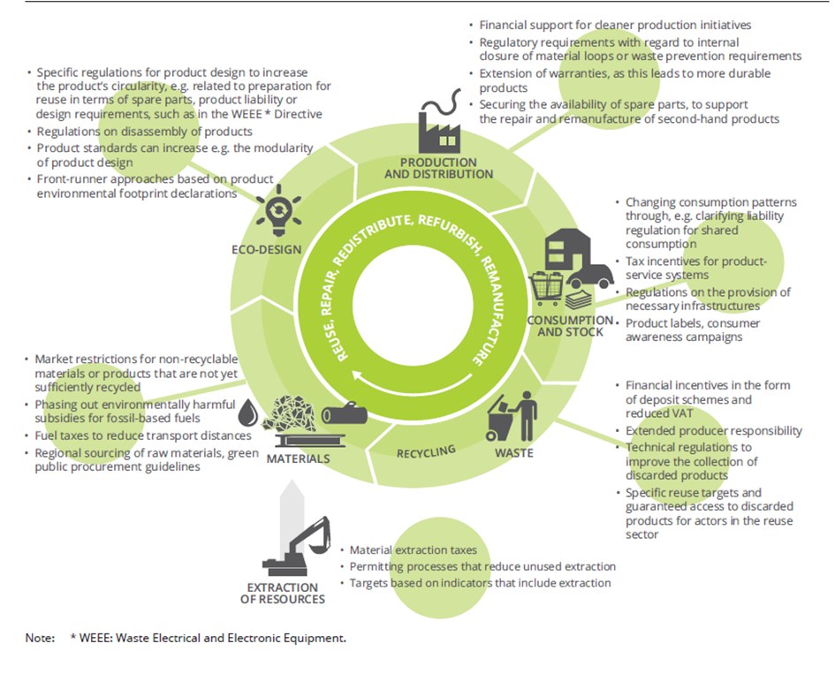
Potential policy instruments affecting product circularity
“Streamlining policy measures is a significant challenge, not only because different policy actors are responsible for different stages in a product's life‑cycle, but also because it is difficult to predict all the possible impacts of a policy before it is implemented. This highlights the need to use a systemic monitoring framework allowing the identification of systemic impacts of policy action, and appropriate adaptations”
Source: https://circulareconomy.europa.eu/platform/sites/default/files/circular_by_design_-_products_in_the_circular_economy.pdf

Slide 37
Assessment
Task
Build a one-page case for a business that uses the linear economy model.
Mind the following questions:
What are the negatives effects of this business case on the environment?
What will you propose to change in this business model to reducing resource consumption or negative impact on environment?

Slide 38
Further readings
Linear model of production and consumption
Books, papers, guides, thesis, others
Material Concerns: Pollution, Profit and Quality of Life (1996): Jackson, Tim. Routledge Publishing
Planned obsolescence: Exploring the issue, Briefing, May 2016, https://www.europarl.europa.eu/RegData/etudes/BRIE/2016/581999/EPRS_BRI%282016%29581999_EN.pdf
Websites & platforms
European Commission website on Adaptation to climate change, how will we be affected? Available at: https://ec.europa.eu/clima/policies/adaptation/how_en
CE projects
http://www.lessonsfromnature.org/

Slide 39
CE Principles as Opposed to the Linear Model
Books, papers, guides, thesis, others
Walter R. Stahel, Routledge & CRC Press, 2019, The Circular Economy: A User’s Guide
EEA Report No 6/2017 Circular by design Products in the circular economy REUSE, REPAIR, EDISTRIBUTE, REFURBISH, REMANUFACTURE, ISSN 1977-8449, Available at: https://circulareconomy.europa.eu/platform/sites/default/files/circular_by_design_-_products_in_the_circular_economy.pdf
Websites & platforms
Circular Economy Concept, Ellen McArthur Foundation. Available at: https://www.ellenmacarthurfoundation.org/circular-economy/concept
Effects of the Circular Economy on Jobs. Available at: https://www.iisd.org/system/files/2020-12/circular-economy-jobs.pdf
https://kenniskaarten.hetgroenebrein.nl/en/
Videos
Is this the Future of Global Food Systems? Available at: https://www.youtube.com/watch?v=G-pr0cYzuDQ

Slide 40
CE Indicators
Websites & platforms
Eurostat circular economy monitoring framework. Available at: https://ec.europa.eu/eurostat/web/circular-economy/indicators/monitoring-framework
Eurostat circular economy indicators information. Available at: https://ec.europa.eu/eurostat/web/circular-economy/indicators
Circular economy indicators, European Commission, Available at: https://ec.europa.eu/environment/ecoap/indicators/circular-economy-indicators_en
Material circularity indicator, Ellen MacArthur Foundation, Available at: https://ellenmacarthurfoundation.org/material-circularity-indicator

Slide 41
CE Policies and Legislative Framework
Books, papers, guides, thesis, others
A new Circular Economy Action Plan For a cleaner and more competitive Europe (2020). Available at: https://eur-lex.europa.eu/legal-content/EN/TXT/?qid=1583933814386&uri=COM:2020:98:FIN
European Parliament Resolution on the new circular economy plan (2020/2077 (INI)), Available at: https://www.europarl.europa.eu/doceo/document/TA-9-2021-0040_EN.html
Circular by design – Products in the circular economy, EEA Report I N 6/2017, Available at: https://circulareconomy.europa.eu/platform/sites/default/files/circular_by_design_-_products_in_the_circular_economy.pdf
More from less – materials resource efficiency in Europe, EEA Report I N 10/2016, Available at: http://www.sepa.gov.rs/download/publikacije/MoreFromLess_MaterialResourceEfficiencyEurope.pdf
Websites & platforms
EU Ecolabel, Available at: https://ec.europa.eu/environment/ecolabel/

Slide 42
Circular economy and its principles
Thank
you!
circular economy infographic by freepik in https://www.freepik.com/free-vector/flat-design-circular-economy-infographic_21095200.htm#query=circular%20economy&position=4&from_view=search&track=ais

