Slide 1
Green entrepreneurship and business

Slide 2
01
02
About me
What i do
03
04
My experience
My work
My name is ….
And I work at …
During this course I thought of a green business in …
My main abilities are …

Slide 3
01
Green entrepreneurship

Slide 4
Conceptual framework
The environmental goods and services industry consists of activities which produce goods and services to measure, prevent, limit, minimize or correct environmental damage to water, air and soil, as well as problems related to waste, noise and eco-systems. This includes cleaner technologies, products and services that reduce environmental risk and minimize pollution and resource use.

Slide 5
What is green entrepreneurship and why is it important?
Development that meets the needs of the present
Without compromising the ability of future generations to meet their own needs
Green entrepreneurship

Slide 6
What is green entrepreneurship and why is it important?
As shown here, a sustainable business strives to balance the economic (financial), social (people), and environmental (biodiversity, ecosystems) benefits of the business as part of its core business objective.
Sustainability
Social
Environmental
Economic

Slide 7
What is green entrepreneurship and why is it important?
Write down an example of green entrepreneurship that you can think of.
After that, present your choice to the class, and get feedback.

Slide 8
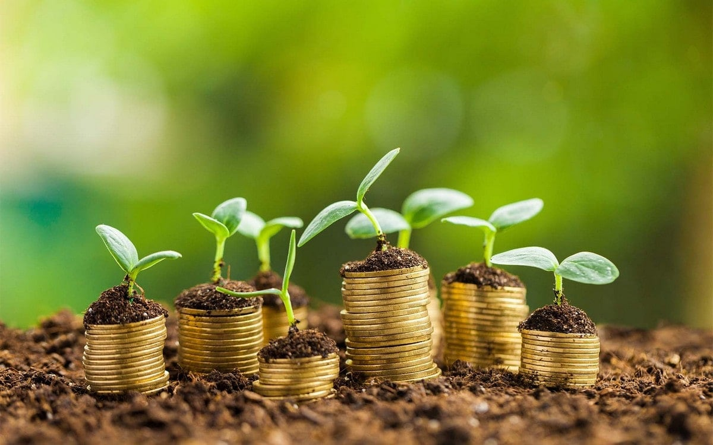
So, what is a green business?
Incorporate principles of sustainability into its business
Pay staff a fair wage for the work they do
Distribute benefits equitably across the value chain
Maximise the social benefits of the business
Supply environmentally-friendly and/or local products and services
Help community become more sustainable
Make efforts to reduce resource
Make an enduring commitment to environmental principles in your business operations
These will often be detailed in a publicly available and regularly updated Sustainability or Environmental Policy

Slide 9
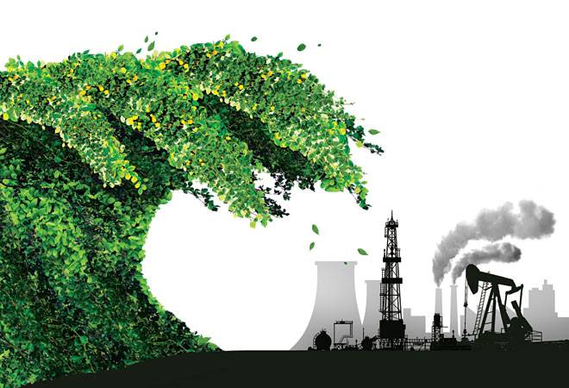
The Concept of Green Entrepreneurship
Facts:
60 percent of businesses today are measuring efficiency through green programmes out of which 78 percent of them achieve power efficiency
two-thirds indicate heating/cooling and paper savings
60 percent are cutting costs on water consumptions
about 69 percent indicate that they are already exploring green in their different endeavours

Slide 10
The Concept of Creative Green Entrepreneur
Green creative entrepreneurship is viewed as an entrepreneur’s ability to obtain stakeholders’ approval for his ideas, takes control of the value chains and gets rewarded for his ingenuity to solve environmental problems.
The entrepreneurs’ ability to attract investors for their creative ideas defines the level of success attained through innovative efforts.

Slide 11
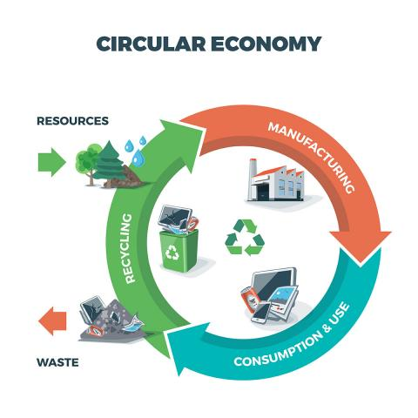
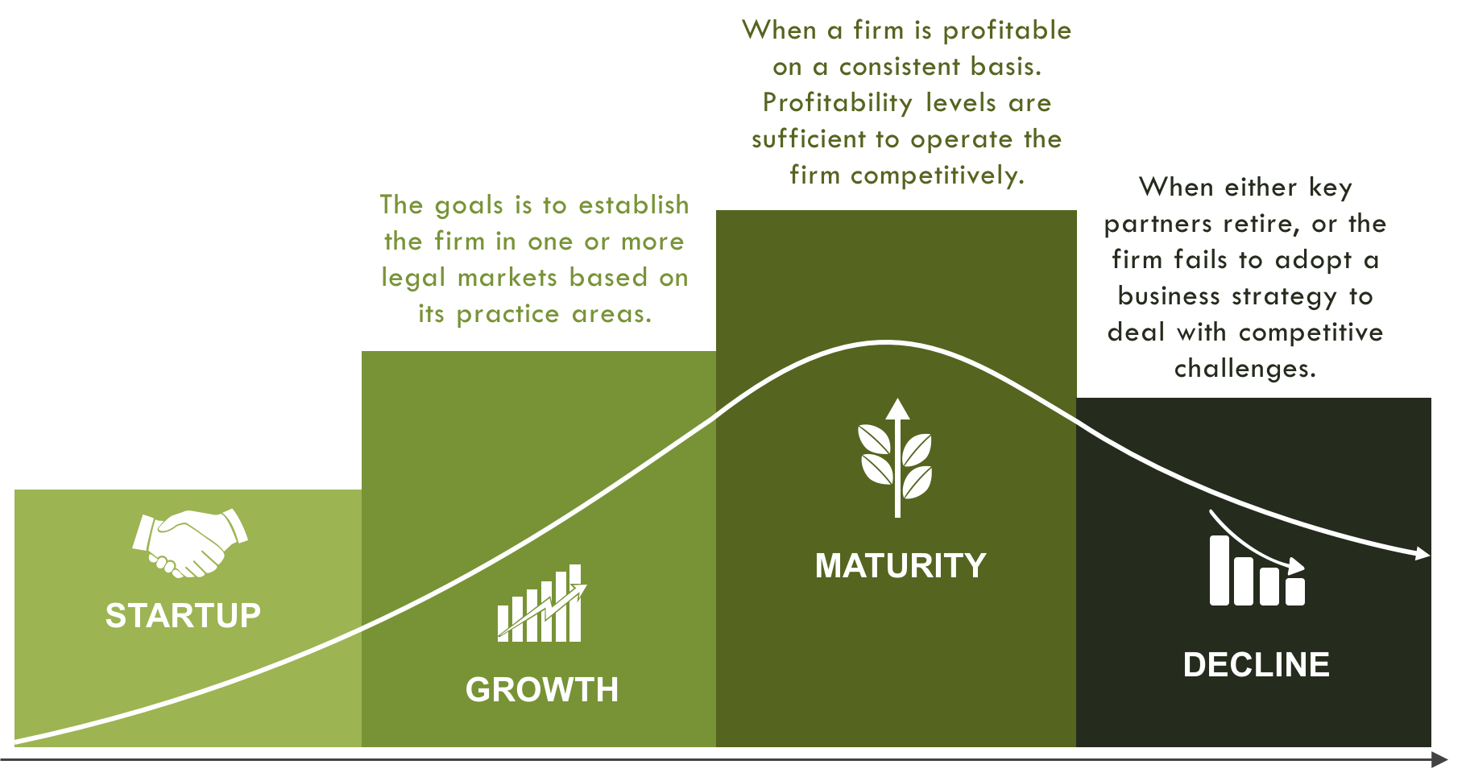
The Concept of Firm’s Life Cycle in Green Entrepreneurship
Firm’s life cycle is the progression of a firm from the time the it was launched in the business world to as long as it can survive within the environment.

Slide 12
The Concept of Institutional Structure in Green Entrepreneurship
Green entrepreneurship can exist in two ways namely; ‘already established’ firms that migrate into greening and new ‘born green’ firms.
Practical Exercise –Please, discuss with your team colleagues and find arguments about which one of the two types of green entrepreneurship mentioned above is more efficient and why.

Slide 13
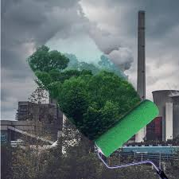
The Concept of Greenwashing in Green Entrepreneurship
What is greenwashing?
Nature-friendly words such as “eco”, “bio”, and “organic” sustainability are being used rhetorically by some unscrupulous firms just to deceive unsuspecting consumers to believe that these firms are being conscious of the environment in their business operations.
It has been observed that firms are deliberate in their choice of “greenwashing” habit which literally means to mislead the public through marketing campaigns.

Slide 14
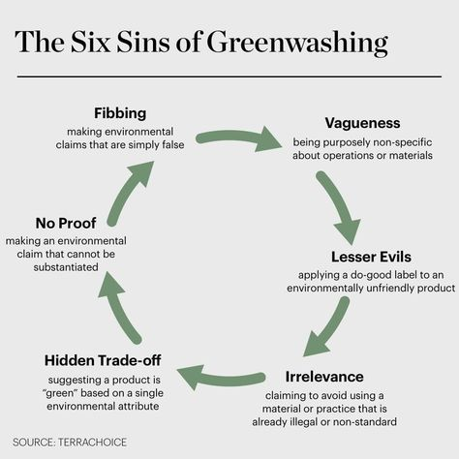
The Concept of Greenwashing in Green Entrepreneurship
The Six Sins of Greenwashing
Practical exercise
Please watch the following video and identify companies that practice Greenwashing.
After that, discuss with the group the effects that the actions of the companies you identified have.
https://www.youtube.com/watch?v=5cEl-esdjpU

Slide 15
How can you tell if you’re dealing with greenwashing?
1. Do you see an awesome green claim? Double check it. Go to their website. Is there a lot of information? Or do you see a lot of ambiguity? If it’s really vague and unspecific – it’s greenwashing.
2. Is the ad diverting you from the big picture? Sure BP helped clean up cuddly little ducks. It pulled on your heart strings. How adorable! But, if it weren’t for gross negligence on their part, those little ducks wouldn’t have been covered in oil in the first place. That’s greenwashing.

Slide 16
How can you tell if you’re dealing with greenwashing?
3. Are the words misleading? Are they saying a whole bunch of nothing? Is there any substantial information? Are their sources for their claims like actual certifications or provable facts?
4. What about the graphics? Are the graphics all green? Do they depict beautiful nature scenes? Are they trying to make you feel like the product is natural when it might be anything but?

Slide 17
How can you tell if you’re dealing with greenwashing?
5. Does the claim feel too good to be true? Are they overstating intention? Do you really think the company can follow through with their claims?
6. What’s your gut reaction? I’m pretty sure we all know not to take advertisements at face value. There’s always an ulterior motive to get to your pocket book. Trust yourself.
7. When in doubt google it. The great thing about the internet is the history is all there.

Slide 18
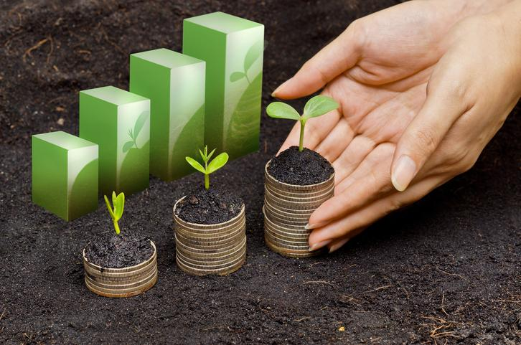
The benefits of doing Green Entrepreneurship
Green marketing awareness
Easy implementation of environmental legislation
Attainment of green investments and acquisition of loans with better terms
New trade opportunities
Reduction of operational costs

Slide 19
Tips for Green Entrepreneurs
Be ready to changing your initial idea!
Know yourself… and your limits!
Can I launch and run my business alone?
Be a Green Entrepreneur
Think big!
Set up a good team
Identify the stakeholders
Involve customers and stakeholders
Look at international market opportunities!
Think economic sustainability!
Have a unique value proposition!
Partner with your supply chain
Communicate wisely
Alleviating startup capital
Be aware of new business models!
Don’t be frightened of failure!
Must I be rich to set up a green business?
Try hard to convince financing institutions!
Stay connected!

Slide 20
Conclusions
Reduction of environmental impact
Greening the business process, products and services
Business becomes greener
Make green thinking a part of the company

Slide 21
Assessment – green business canvas
Practical exercise
After discussing the tips for green entrepreneurs, please fill in a GREEN BUSINESS CANVAS, taking into consideration the indications in the shown example.

Slide 22
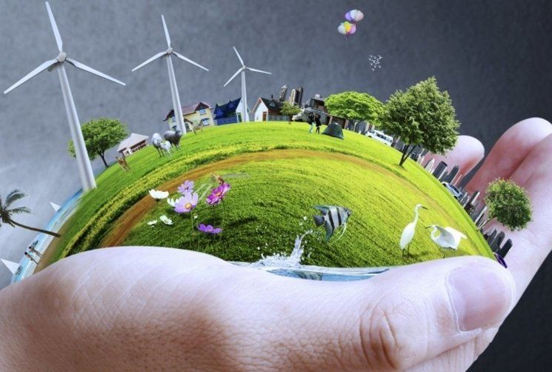
Green entrepreneurship and business
Thank
you!

