Slide 1
GREENentrecomp

Slide 2
01
02
GreenEntrecomp
“Greenning”
03
04
How to use?
How to motivate…
What is it?
What “greening the competences” means?
How to use greener skills and competences?
… your trainees.

Slide 3
01
What is greenEntreComp?

Slide 4
The importance of entrepreneurship
Entrepreneurs are frequently thought of as national assets to be cultivated, motivated, and remunerated to the greatest possible extent.
Great entrepreneurs can change the way we live and work. If successful, their innovations can improve standards of living, create wealth and jobs and contribute to a growing economy.

Slide 5
The existing entrecomp
EntreComp was developed to become a reference de facto for any initiative aiming to foster entrepreneurial capacity of European citizens.

Slide 6
The existing entrecomp
It consists of 3 interrelated and interconnected competence areas:
‘Ideas and opportunities’,
‘Resources’,
‘Into action’.

Slide 7
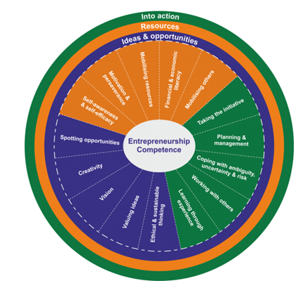
The existing entrecomp
Each of the areas is made up of 5 competences, which together constitute the building blocks of entrepreneurship as a competence.

Slide 8
Greenentrecomp
In response to climate change, there has been a growing interest in the development of a ‘green’ or ‘low carbon’ economy as a means of reconciling economic development and the environment.
Why do it?

Slide 9
Greenentrecomp – why?
Research on green entrepreneurs to date has focused on individual green entrepreneurs, neglecting wider economic and social contexts within which they operate.

Slide 10
Greenentrecomp – why?
Green entrepreneurship movement is often presented as a non-profit motivated business sector that belongs to the ‘social entrepreneurship stable’.

Slide 11
Greenentrecomp – why?
Although green entrepreneurship was brought into sharp focus, it is still seen and regarded by many as an add-on to the market economy comprising business ventures that address and satiate the consumer habits of environmentalists and green activists.

Slide 12
Greenentrecomp
Therefore, EntreComp framework needs to be reconsidered - it needs to incorporate and reflect the green objectives of our time.
Why do it?

Slide 13
Greenentrecomp
It is not sufficient to have some green entrepreneurs - rather every entrepreneur needs to incorporate environmental and ecological factors into their business from the very beginning.
Why do it?

Slide 14
Greenentrecomp
While influenced by carbon taxation and other policy measures, the emphasis for Vocational Education and Training should be firmly placed on “greening” the entrepreneurship actions of next generation entrepreneurs.
How to do it?

Slide 15
Greenentrecomp
Greening EntreComp, as the key benchmark for entrepreneurship education is now an essential first step.
How to do it?

Slide 16
02
“greening” the entrecomp

Slide 17
The European “green deal”
The European Green Deal sets ambitious targets for Europe up to 2050 as a strategic framework aimed at making Europe the first carbon neutral continent.
It is not just more entrepreneurs that countries need but more green and sustainable entrepreneurs that will drive the transition towards a circular economy.

Slide 18
The European “green deal”
The greening of EntreComp and the clarification of new Circular Business Models represents a further and significant strengthening of key competences in iVET and cVET.

Slide 19
activity
Interpret and describe in your own words the benefits and importance of the GreenEntreComp.
60 minutes

Slide 20
03
how to use greenentrecomp?

Slide 21
THE EXAMPLES OF “GREENING” THE ENTReCOMP
Original descriptor:
Initiate processes that create value. Take up challenges. Act and work independently to achieve goals, stick to intentions and carry out planned tasks.
“Green” descriptor:
Initiate processes that create value and positive societal impact. Take up challenges. Act and work independently to achieve sustainable goals, stick to intentions and carry out planned tasks.

Slide 22
activity
Create new “greener” descriptors and competences using the existing ones form EntreComp.
30 minutes

Slide 23
04
How to motivate your trainees?

Slide 24
How to motivate
The human race is facing a number of systemic ecological challenges: climatic instability, food security, depleted oceans, build-up of toxic waste, and exhaustion of natural resources.
Explain the importance

Slide 25
How to motivate
Instead of thinking about reducing human beings’ negative footprint as much as possible, why not design a positive footprint?
The new way of thinking

Slide 26
How to motivate
Green entrepreneurs can find new niches by applying
new thinking and new technological approaches to current practices.
New way of thinking

Slide 27
How to motivate
Green creative entrepreneurship is about seeing one’s main activities as a force for good, wanting to change the world and having maximum social impact.
The way forward

