Slide 1
What is entrecomp?

Slide 2
01
02
About me
What i do
03
04
My experience
My work
My name is ….
And I work at …
During this course I thought of a green business in …
My main abilities are …

Slide 3
01
What is EntreComp?

Slide 4
Policy context
The Entrepreneurship Competence study (EntreComp) was launched by the JRC on behalf of the Directorate General for Employment, Social Affairs and Inclusion (DG EMPL) in January 2015. One of the key objectives of EntreComp was to develop a common conceptual approach, which could support the development of entrepreneurship competence at European level.

Slide 5
Understanding EntreComp
Case study
Watch the following video
https://www.youtube.com/watch?v=ijpVICWGIdc
Then, write down 3 characteristics that you think best defines EntreComp.
After that, present your choices to the class, and get feedback.

Slide 6
Understanding EntreComp
EntreComp is a framework of 15 entrepreneurship competences, broken down further into threads that describe what the particular competence really means in practical terms. These are clearly defined through learning outcomes (442 in total) – what a learner knows, understands and can do. The learning outcomes are mapped across 8 different levels of progression, from beginner to expert.

Slide 7
Understanding EntreComp
There are 5 key building blocks to understanding EntreComp:
Definition
Areas
Competences
Threads
Progression levels

Slide 8
definition
EntreComp defines entrepreneurship as:
The capacity to act upon opportunities and ideas, and transform them into value for others. The value that is created can be financial, cultural or social.

Slide 9
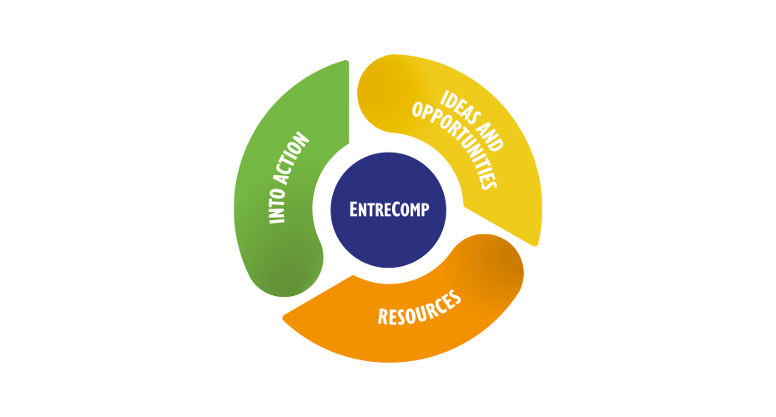
Areas
EntreComp identifies 3 competence areas:

Slide 10
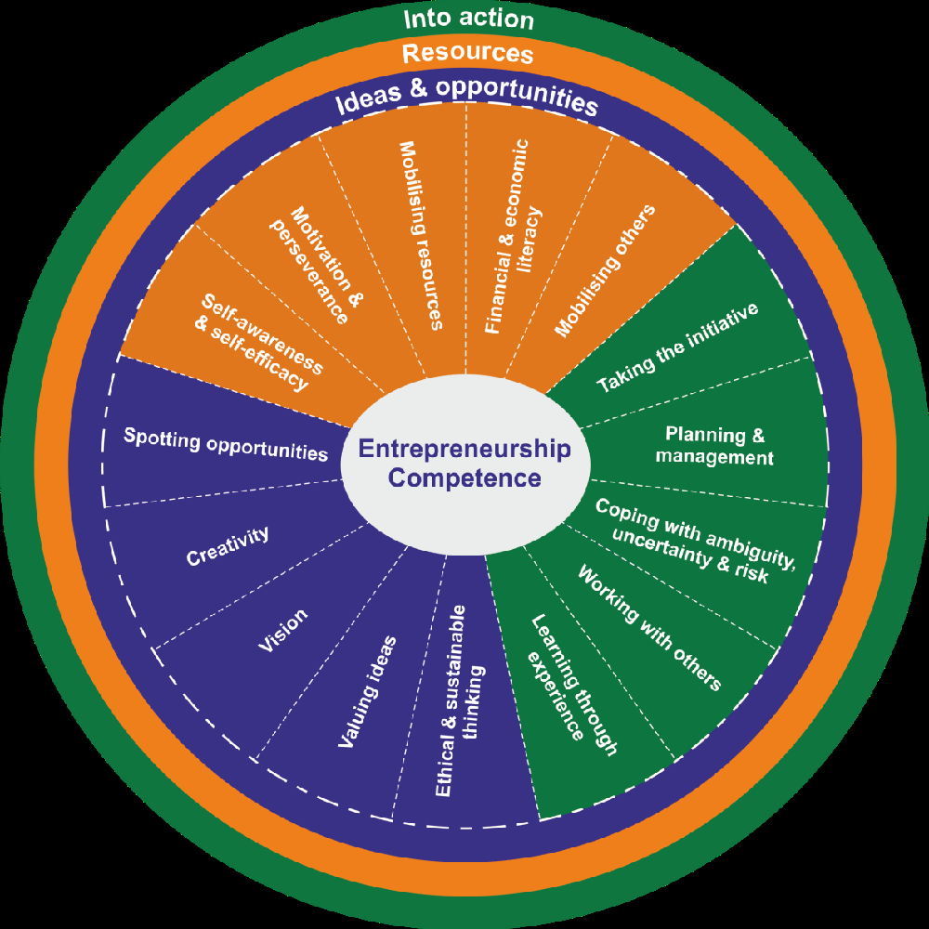
Competences
Each area contains 5 competences, and together these make up the
15 competences that create an entrepreneurial mindset:

Slide 11
IDEAS & OPPORTUNITIES
Competence | Hint
Spotting opportunities | Use your imagination and abilities to identify opportunities for creating value
Creativity | Develop creative and purposeful ideas
Vision | Work towards your vision of the future
Valuing ideas | Make the most of ideas and opportunities
Ethical and sustainable thinking | Assess the consequences and impact of ideas, opportunities and actions

Slide 12
RESOURCES
Competence | Hint
Self-awareness & self-efficacy | Believe in yourself and keep developing
Motivation & perseverance | Stay focused and don’t give up
Mobilising resources | Gather and manage the resources you need
Financial & economic literacy | Develop financial and economic know-how
Mobilising others | Inspire, enthuse and get others on board

Slide 13
INTO ACTION
Competence | Hint
Taking the initiative | Go for it
Planning & management | Prioritise, organise and follow up
Coping with uncertainty, ambiguity & risk | Make decisions dealing with uncertainty, ambiguity and risk
Working with others | Team up, collaborate and network
Learning through experience | Learn by doing

Slide 14
02
The EntreComp Progression Model

Slide 15
The EntreComp Progression Model
Entrepreneurship as a competence is developed through action by individuals or collective entities to create value for others.
The progression in entrepreneurial learning is made up of two aspects:
Developing increasing autonomy and responsibility in acting upon ideas and opportunities to create value;
2. Developing the capacity to generate value from simple and predictable contexts up to complex, constantly changing environments.

Slide 16
03
Who is EntreComp for?

Slide 17
Using EntreComp to achieve goals
mobilise interest in entrepreneurship andinspire action
create value by adapting the framework to specific contexts
appraise & assess levels of entrepreneurship competence
implement entrepreneurial ideas and projects
recognise entrepreneurship skills
EntreComp has been applied in different ways and has proved to be useful in helping projects and organizations to achieve a number of goals.
Goals

Slide 18
Who is EntreComp for?
If you are working in and influencing policy you may use EntreComp to:
Develop a shared understanding and common language with all parties involved
Inform policies linked to education, economic, employment or community development
Define entrepreneurship impact indicators

Slide 19
Who is EntreComp for?
If you are working in education and training you may use EntreComp to:
Tailor entrepreneurial learning outcomes to a specific context
Create new or enhance existing teaching and learning activities to develop entrepreneurial
competences
Design assessment of entrepreneurial learning

Slide 20
Who is EntreComp for?
If you are working with young people outside of formale ducation you may use EntreComp to:
Design activities that provide practical entrepreneurial experiences
Help young people understand how entrepreneurial they are
Recognise your own entrepreneurial competences

Slide 21
Who is EntreComp for?
If you are working with start-ups and entrepreneurs, you may use EntreComp to:
Understand how existing activities contribute to entrepreneurial competences
Help entrepreneurs map their own entrepreneurial competences
Design new training to support business creation or business growth mapped to EntreComp competences

Slide 22
Who is EntreComp for?
If you are involved in recruiting and managing human resources you may use EntreComp to:
Help define job-specific competency requirements
Plan organisational learning and development strategies and activities
Build entrepreneurial teams

Slide 23
04
Top tips for getting started with EntreComp

Slide 24
Top tips for getting started with EntreComp
Create shared understanding
Use the visuals
Find the right level
Find the right competences
Understand your starting point
Adapt if you need to
Understand the starting point of your learners

Slide 25
Top tips for getting started with EntreComp
Refine or evaluate learningstrategies
Identify the learning outcomesthat suit your activity
Self-assessment
Demonstrate value
Map against your existingactivity
Provide an evidence base

Slide 26
Case study
Divide in groups, and using the information provided in the slides above, brainstorm to develop a plan for applying EntreComp in your current activity.
After that, present your plan to the class, and get feedback.

Slide 27
For more information, please visit:
Thank you!
The European Entrepreneurship Competence Framework (https://ec.europa.eu/social/main.jsp?catId=1317&langId=en)

