Slide 1
BUSINESS MODELLING FOR CIRCULAR ECONOMY BUSINESSES

Slide 2
02
2.3 Greening your Business

Slide 3
Main objectives
Benefits and barriers in implementing CE models in SMEs
Company Benefits
Consumer Benefits
Benefits for other stakeholders
Environmental benefits following the CE transition

Slide 4
Company benefits of ce
An overview of the company benefits of implementing Circular Economy practices. The 4 main areas of the presented benefits are Finance and funding, Market and value chain, Human resources and Resilience. An insight into the main barriers for SMEs related to Circular Economy.

Slide 5
Company Benefits of CE
Why should SMEs go circular?
They are the backbone of the economy
Lower level of hierarchy
Simpler organizational structure
Flexibility
Existing practices without labelling „circular”/”green”
The TOP 3 reasons why European SMEs adopt CE practices
Saving material costs
Creating competitive advantages
Creating new markets

Slide 6
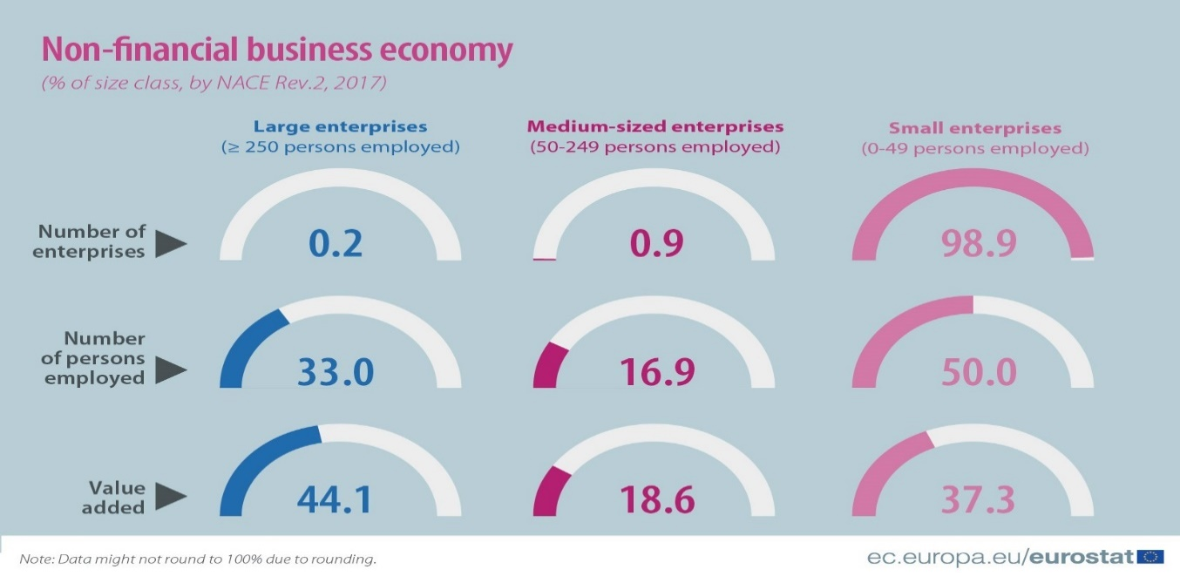
No one is too small to make a difference
Medium-sized enterprises
(50-249 persons employed)
Small enterprises
(50-249 persons employed)
Large enterprises
>250
Number of
enterprises
Number of
persons
employed
Value added

Slide 7
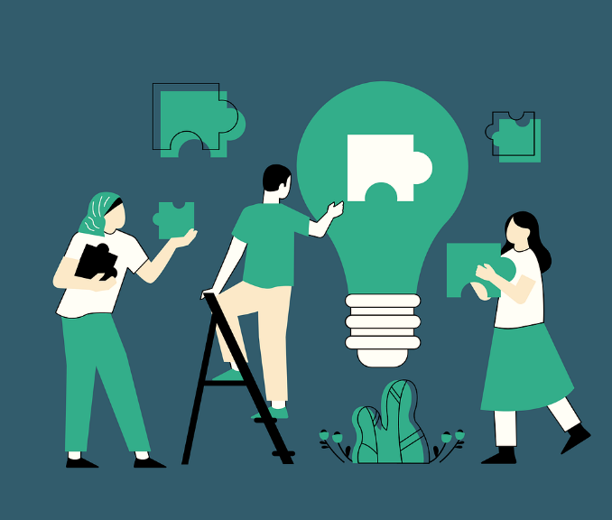
Resilience – CE, the key for recovery
Am I ready for Circular Economy?
Revise your company values
Hold a pitch/workshop on CE to boost the commitment of your SME
Collect feedback and brainstorm to develop new ideas
Map the potential benefits and barriers/risks of your CE ideas
Make your decision on which ideas are worth implementing
Step 1 - Understand who you want to influence.
Step 2 - Describe the context
Step 3 - Define your circular economy idea
3. Figure Steps of CE pitch according to Ellen MacArthur Foundation Source: [4]

Slide 8
Finance and funding
Save costs
Get funding
Use less primary raw material to lower the level of exposure to price fluctuations.
Get to know the different type of financial products: public equity funds, bonds, private market funds and banking..
Maximize the retained value from existing capital assets.
Check the website of the EU to get information on funding programmes, such as Horizon Europe, or LIFE programme.
Rent equipment instead of buying.

Slide 9
Market and value chain
Remanufacturing
Remarketing
Repairing
The need for service-based solutions is evolving,
selling a good product is not enough anymore to satisfy the customers.
Expand your business activities, enter new markets with CE business models, such as…
Sharing
Reselling
Upgrading

Slide 10
competitive advantage through CE
Price volatility
A circular supply chain is more decentralized, diversified, shorter and more local suppliers are involved.
Geopolitical conflicts, natural disasters
Build a circular supply chain to mitigate the risk of…
Supply chain disruption
High demand for raw materials

Slide 11
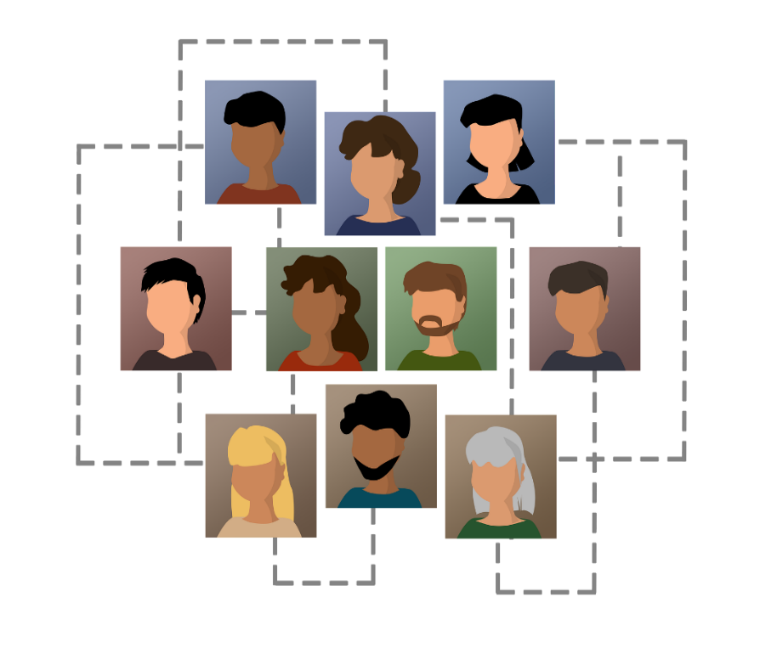
Exploiting the job creatin potencial of CE
Improve your employer image
Develop and exploit ‚circular’ skills and knowledge of the employees
Attract talents with ‚green’ mindset
Create new, circular jobs, positions
Retain commited employees

Slide 12
Resilience – CE, the key for recovery
-Higher level of social integration
-New market/revenue channel potential
Social and economic resilience
Deepened inequalities
Increased demographic imbalances and poverty
Accelerated automation
Unemployment in service sector
-Safer, diversified supply chain -Lower need for primary raw materials
Geopolitical resilience
The EU's over-reliance on third countries for critical raw materials crucial in key technologies to achieve a carbon-neutral and digital society
-High job creating potential
-Resource-efficient, green technologies
Green resilience
A shift to a greener economy could create 24 million new jobs globally and its impact in the recovery from the COVID-19 crisis could be significantly larger than previously thought
- The concept of CE incorporate the need for disruptive technologies, innovative solutions
Digital resilience
Hyper-connectivity and the integration of new technologies affecting the human condition and the way we live
7. Figure The 4 types of resilience and relevant challenges (adapted from [11])
8. Figure Resilience related benefits of CE

Slide 13
Barriers of SMEs
Environmental culture
The management of the SME may lack 'green' attitude
Financial barrier
SMEs are more sensitive to additional financial costs
SMEs, especially start-ups are considered to be financially risky
Lack of government support and effective legislation
Most tools for environmental management are suitable for large companies
Several concepts of CE related EU legislation are not clear enough
Lack of information
SMEs are not aware of the financial gains from improving their resource efficiency
They consider resource efficiency practices to be costly
Administrative burden
SMEs often lack the specific knowledge and capacity to comply with administrative requirements
The monitoring and reporting of environmental data is often a complex process for an SME
Lack of technical skills
SMEs often lack the technical capacity to identify, assess and implement more advanced, cutting-edge technologies
Lack of support from the supply and demand network
SMEs have little influence on their suppliers’ and their customers' engagement in sustainable activities

Slide 14
Consumer Benefits
An overview of what sustainable consumption is, investigates consumer behaviour in terms of how do customers intentions correlate with their actions, and gives a summary of the most important dimensions of the CE benefits from the perspective of the customers.

Slide 15
Consumer Benefits
A topic that has been kept silent about by the researchers
Thus far, Circular Economy has been almost exclusively investigated from the perspective of businesses and technology, emphasising the benefits of CE to businesses
The value proposition of circular economy to customers/consumers have been extremely neglected
Just like in case of any innovation, it is a must to understand customer value from the perspective of the customer - this is the key to the successful commercialization of CE products and solutions

Slide 16
What is sustainable consumption?
Sustainable consumption
Has various dimensions:
Environmental sustainability (e.g. impacts on the environment)
Social sustainability (e.g. living conditions of local communities)
Economic sustainability
What is sustainable consumption?
‘the use of goods and services that respond to basic needs and bring a better quality of life, while minimising the use of natural resources, toxic materials and emissions of waste and pollutants over the life cycle, so as not to jeopardise the needs of future generations'.
(1994 Oslo Symposium on Sustainable Consumption)

Slide 17
Intention-Action Gap
The majority of customers are aware of the negative impact of their consumption habits on the environment
Despite their awareness, their purchasing habits are not in line with their good intentions
This gap occurs due to the fact that consumers are led not just by sustainability factors, but many other factors as well, such as: price, availability, habits, values, social norms, peer-pressure, self-concept, emotional appeal etc.
% of population

Slide 18
How to close the Intention-Action Gap?
2. Increasing customers’ benefits
Personal/immediate benefits
decreased amount of toxins in a product – e.g. clean cosmetics, organic food
eco-savings – e.g. less packaging
positive self-image - Individuals desire to maintain positive self-views and can reaffirm the positivity of the self-concept through consumption
social credit for using/purchasing a sustainable product
Distant benefits:
positive impact on climate change mitigation
fewer plastics in the oceans
better labor and living conditions for workers
Decreasing customers’ efforts
(e.g. by making sustainable products/solutions easily accessible, making recycling easier)
STEP 02
Increase the benefits customers will experience when opting for sustainable products/solutions
STEP 01
Closing the Intention-Action Gap
Miminize/decrease the efforts the customers have to make for choosing sustainable products/solutions
TIP:
Conduct a customer segmentation to choose the right benefits for the right groups when communicating with them

Slide 19
Costumer value of ce
Economic Values
Direct monetary benefits (savings)
Indirect monetary savings due to reduced costs associated with waste management, processing, material etc.
Indirect financial savings from time costs, psychological/emotional costs
Indirect earnings from the improved brand value (in case of business customers)
Excellent quality/price ratio of reused/recycled materials/products
01
FunctionalValues
02
Reduced amount of waste
Improved processes and functions
Easy to use/fit with practices
Expansion of variety and options with new, trendy characteristics
Better understanding of resource efficiency
Innovativeness and creativity
Emotional Values
Pride in behaving in a sustainable way
Relief by not causing harm
Feeling of belonging to a community sharing the same values
Excitement caused by choosing recycled/reused products
Satisfaction related to daily activities (e.g. greater satisfaction when working in a sustainable way)
Sometimes negative feelings might be present(e.g. Fear of bad quality)
03
Esteem/Symbolic Values
Positioning your company as a sustainable company (in case of business customers)
Identifying yourself as someone respecting sustainability principles
Involvement with others
Sharing similar values
Possibility to create new jobs
Contributing to sustainable growth
04

Slide 20
Benefits for other stakeholders
An overview on benefits for stakeholders excluding the companies and consumers.
These stakeholders include the government, municipalities, education institutions and the society at large meaning, and
gives a summary of the most important dimension of the CE benefits from the perspective of these groups.

Slide 21
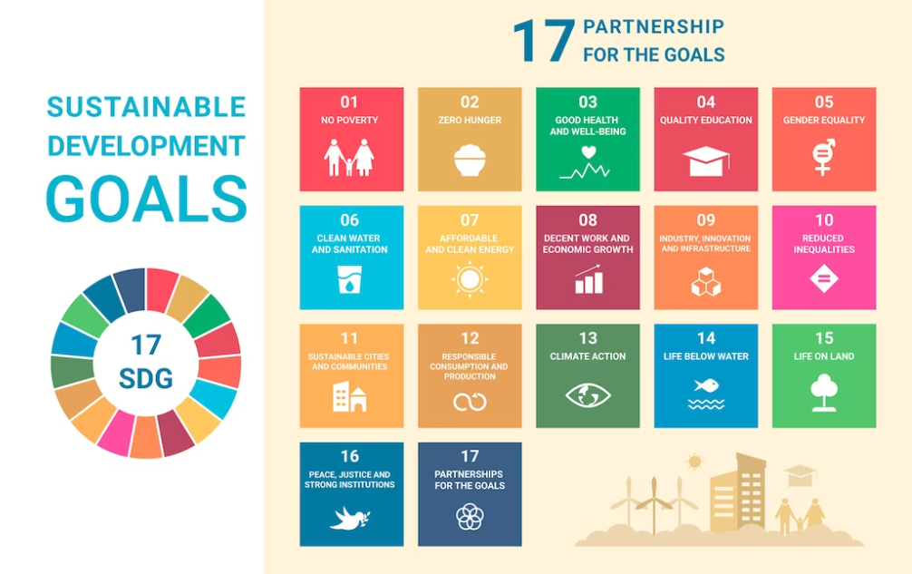
Benefits for other stakeholders
Who are they?
government
municipalities
education institutions and
the whole society
Sustainable Development Goals in Europe
cooperation of science and business
the local, regional and state authorities
The European Green Deal
sdg infographic by freepik in https://www.freepik.com/free-vector/hand-drawn-sdg-infographic-infographic_29830257.htm#query=sustainable%20development%20goals&position=1&from_view=search&track=ais

Slide 22
Benefits for other stakeholders
Education for Sustainable Development
lifelong learning
integral part of quality education
higher level of knowledge acquisition
empowers people of all genders, ages, respects cultural diversity

Slide 23
Benefits for other stakeholders
Universities and Research centres
projects
teaching programmes
research work
international network
knowledge exchanges between business and higher education

Slide 24
Benefits for other stakeholders
Governments and municipalities
outstanding responsibility
job creation
reducing unemployment
local jobs
the fastest growing sectors
decrease of employment in the extractive industries

Slide 25
Benefits for other stakeholders
Value creation in the society
includes each part of the society
long-term relationship with stakeholders
building up the social capital contributes to rising of living standards through:
- good education
- jobs
- health and wellbeing,
- democracy
- inclusion
- social justice and
- reduced inequality

Slide 26
Benefits for other stakeholders
Travel and transportation
largest share of greenhouse gas emissions
benefits of travelling by train
adopting new transport habits
benefits of innovations
real costs of transport:
- sustainable transport: convenient, environmentally-friendly and NOT expensive
International cooperation
investments domestically and abroad
supply chains at regional level

Slide 27
Environmental benefits
Key environmental benefits that follow a transition of a Small and Medium Enterprise from Linear to Circular Economy

Slide 28
INtroduction
With the growing world population and increasing material consumption, the pressure on the environment is far from being sustainable.
Circular Economy origins are mainly rooted in ecological and environmental economics and industrial ecology. The initial goal of the circular economy is to have a positive impact on the ecological systems.
Circular economy is one concept suggesting that it is possible to reduce the pressure on the environment without limiting the economy.

Slide 29
Ce and biodiversity
Biodiversity is the variety of life on Earth. Rates of biodiversity are typically the measure of variation at the genetic, species and ecosystem level.
All species, including humans, are dependent on this complexity and its intricate balance of natural life in ecosystems — micro to macro-level — for their survival.
People are becoming increasingly aware of the wide range of goods and services that nature gives them for free, as well as the imperative need to protect it. We depend on many of these services for our lives.

Slide 30
Ce and biodiversity
Βiodiversity loss describes the decline in the number, genetic variability, and variety of species, and the biological communities in a given area.
Biodiversity is being lost at an unprecedented rate and the wasteful, and polluting linear economy is increasingly recognised as one of the main underlying causes of this crisis. Today, more than 90% of biodiversity loss is due to the extraction and processing of natural resources.
The circular economy aims to reduce the overall level of resource consumption and waste output by getting more value from the resources we use and keeping that value in the economy for as long as possible through designing out waste and shifting from owning products to using services.

Slide 31
Ce and biodiversity
When products and materials are circulated in the economy, the need for production from virgin materials is reduced. This leaves more space for other uses, including the preservation of wilderness areas.
In a circular economy, driven by design, waste and pollution are eradicated so these direct threats to biodiversity are reduced. As an example, eliminating unnecessary plastics and re-designing plastic products to have value post-use (for reuse, recycling or composting) means they can be reused in the economy rather than being wasted and polluting the environment.
Additionally, economic activity have to actively rebuild biodiversity.

Slide 32
Ce and biodiversity
Construction Industry: designing buildings to make use of reusable modular concrete components reduces demand for sand – the extraction of which harms local wildlife populations and is occurring at rates beyond those that can be naturally replenished.
Plastic Packaging: eliminating non-essential packaging items such as ‘tear-offs’, using innovative materials that are edible, or redesigning products and business models so they no longer need packaging – all these design interventions help to avoid plastic waste from being generated in the first place.
Food Production: designing food products with a diverse range of regeneratively produced ingredients promotes biodiversity by supporting farming systems that grow food in ways that, for example, build soil health, enhance carbon sequestration, improve air and water quality, and eliminate the need for harmful synthetic inputs.

Slide 33
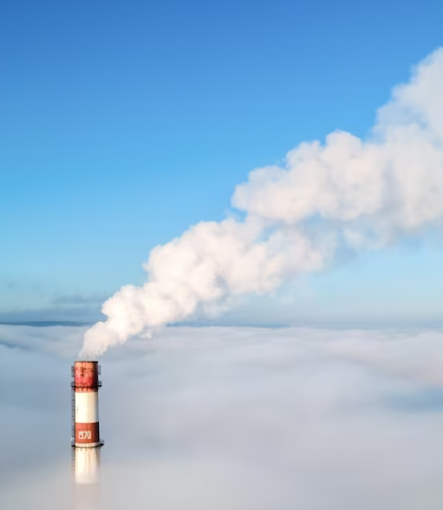
Ce and climate change
The Intergovernmental Panel on Climate Change (IPCC), which includes more than 1,300 scientists, forecasts a temperature rise of 2.5 to 10 degrees Fahrenheit over the next century.
The world can maximise chances of avoiding dangerous climate change by moving to a circular economy, thereby allowing societies to meet the goals of the Paris Agreement on Climate Action.
The transition to renewable energy is vital if we are to tackle climate change. Yet, with existing technologies, that transition would only address 55% of global greenhouse gas emissions.
These emissions come from the electricity and heat we use in buildings, from our energy system more broadly, and from transport. The remaining 45% of emissions come from industry, agriculture, and land use.
aerial drone byfrimufilms in
https://www.freepik.com/free-photo/aerial-drone-view-thermal-station-s-tube-visible-clouds-with-smoke-coming-out-blue-clear-sky_12875360.htm#query=chimney&position=19&from_view=search&track=sph
aerial drone view of thermal station's by frimufilmse o nr da licença…

Slide 34
Ce and climate change
By eliminating waste and pollution. The circular economy is a framework for preventing negative impacts of economic activity that lead to the loss of valuable resources and damage to human health and natural systems. GHG emissions is one of these negative effects designed out of the system.
By keeping products and materials in use. The circular economy favours activities that preserve value in the form of energy, labour, and materials. This means employing reuse, remanufacturing, and recycling to keep products, components, and materials circulating in the economy.
By regenerating natural systems. The circular economy favours the use of renewable resources and aims to enhance natural systems by returning valuable nutrients to the soil. This regenerative approach offers opportunities for carbon sequestration.

Slide 35
Example from the Construction Sector
Improving circularity and efficiency
Materials management, including the production, consumption and disposal of materials, products and infrastructure, contributes a major share of global greenhouse gas emissions — up to two thirds by some accounts.
extending product lifetimes
reducing material losses
recirculating materials and products
preventing downcycling
substituting greenhouse gas-intensive materials with those with lower emissions

Slide 36
Plastic Pollution and Circular Economy
Approximately 11 million tonnes of plastic are dumped into the world’s oceans each year - an amount expected to nearly triple by 2040 - affecting at least 267 species.
Many of these products, such as plastic bags and food wrappers, have a lifespan of mere minutes to hours, yet they may persist in the environment for hundreds of years.
Every minute of every day the equivalent of the contents of a garbage truck full of plastic reaches the oceans; by 2050 this is expected to grow to four per minute.

Slide 37
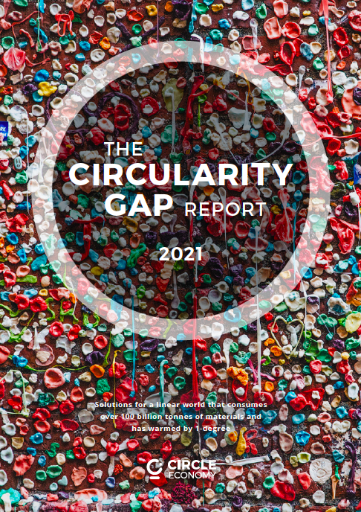
Plastic Pollution and Circular Economy
On January 22, at the annual World Economic Forum in Davos, Switzerland, Circle Economy revealed a report about the benefits of a circular economy. This paper focuses on how much the world could benefit from transitioning to a circular economy, especially from a Greenhouse Gases and climate change point of view.
Circle Economy estimates around two-thirds of greenhouse gases (except those from forestry and land use) are released during the extraction, processing, and manufacturing of goods to serve societal demand. The remaining one-third of emissions happen when goods or services are transported or used. Another interesting insight is that society’s needs for housing, nutrition, and mobility account for over 80% of our total current material footprint.

Slide 38
Plastic Pollution and Circular Economy
Six key points to reverse Plastic Pollution
All plastic packaging is 100% reusable and recyclable
Where possible, reuse models are applied
Redesign new delivery packaging models
Finite resources are used instead of plastics
All plastic packaging is reused, recycled or composted
Plastic packaging is free of hazardous chemicals

Slide 39
Assessment
What do the 3Rs stand for?
A. Reuse, Repair and Recycling
B. Reuse, Repair and Reduce
C. Recycling, Repair and Reduce
D. Reuse, Recycling and Reduce
Comment on the following question:
In how far does Circular economy imply the reduction of waste at minimum.

Slide 40
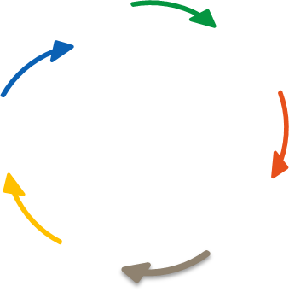
Assessment
Task
Choose a product of your choice and draw a circular diagram with the single parts of it.

Slide 41
Further readings
Companies benefits
5 BENEFITS OF A CIRCULAR ECONOMY https://tontoton.com/5-benefits-of-a-circular-economy/
Circular Economy - What are the benefits for businesses? https://kenniskaarten.hetgroenebrein.nl/en/knowledge-map-circular-economy/ce-benefits-for-businesses/
The benefits of circular economy – Veolia https://www.youtube.com/watch?v=iXusHn804hc
The Benefits of a Circular Economy for Achieving Climate Objectives and Recovering Better https://www.youtube.com/watch?v=4cr8sSeeh0g
CIRCULAR ECONOMY - Benefits and opportunities for businesses, https://www.youtube.com/watch?v=can-1BB9gz8
Circular Economy: 6 benefits to business https://www.youtube.com/watch?v=OLIYDK34UNA

Slide 42
Further readings
Comsumer benefits
Books, papers, guides, thesis, others
European Commission, Circular Economy Action Plan For a cleaner and a more competitive Europe, https://ec.europa.eu/environment/pdf/circular-economy/new_circular_economy_action_plan.pdf, last access 06.01.2022.
Aarikka-Stenroos, L.; Welathanthri, M.D.; Ranta, V. What Is the Customer Value of the Circular Economy? Cross-Industry Exploration of Diverse Values Perceived by Consumers and Business Customers. Sustainability 2021, 13, 13764.https://www.mdpi.com/2071-1050/13/24/13764 last access: 18/01/2022
Macartur Foundation, Ellen, (2013), Towards the Circular Economy, vol 1. https://emf.thirdlight.com/link/x8ay372a3r11-k6775n/@/preview/1?o last access: 13.01.2022.
Šajn, Nikolina, European Parliament, Sustainable Consumption – Helping consumers make eco-friendly choices, https://www.europarl.europa.eu/RegData/etudes/BRIE/2020/659295/EPRS_BRI(2020)659295_EN.pdf?fbclid=IwAR03UfonxFQwRB30wMV7lYjABiY9U8ZB_oUfJXL6yivnb2N-be_iQM1VC2s , last access 06.01.2022.
CE websites & platforms
European Circular Economy Stakeholder Platform, https://circulareconomy.europa.eu/platform/en , last access: 20/01/2022
CE projects (especially other Erasmus+ projects)
Girls go Circular, Digital and Entrepreneurial Skills for the Circular Economy, https://eit-girlsgocircular.eu
Last access: 25/01/2022

Slide 43
Further readings
Stakeholders benefits
Books, papers, guides, thesis, others
European Commission (14 July 2021) The European Commission adopted a set of proposals to make the EU's climate, energy, transport and taxation policies fit for reducing net greenhouse gas emissions, European Green Deal, Striving to be the first climate-neutral continent https://ec.europa.eu/info/strategy/priorities-2019-2024/european-green-deal_en
European Commission (16 September 2021) the Climate Pact is part of the European Green Deal and is helping the EU to meet its goal to be the first climate-neutral continent in the world by 2050, article: On the move with the Climate Pact https://europa.eu/climate-pact/news/move-climate-pact-2021-09-16_en
OECD (2020), Competition in Labour Markets http://www.oecd.org/daf/competition/competition-concerns-in-labour-markets.htm
P63_Stahel_Sustainable_Taxation_10 Oct2011.pdf. [Accessed: 07-May-2020]. The Ex’ Tax project et al., “New era. New plan. Europe. A fiscal strategy for an inclusive, circular economy,” Ex’ Tax Proj., 2016
United NationsEducational, Scientific andCultural Organization (2012) Education for sustainable development sourcebook https://unesdoc.unesco.org/ark:/48223/pf0000216383
W. R. Stahel, “The Virtuous Circle? Sustainable Economics andTaxation in a Time of Austerity,” Chartered Insurance Institute (CII) Thinkpiece, 2011. Online Available: https://www.cii.co.uk/media/854301/T
CE websites & platforms
Ellen Macarthur Foundation, Let's build a circular economy https://ellenmacarthurfoundation.org/ last access on 22/05/2022

Slide 44
Further readings
Environmental benefits following the CE transition
Ellen Macarthur Foundation, How the circular economy tackles climate change, https://emf.thirdlight.com/link/w750u7vysuy1-5a5i6n/@/preview/1?o
Ellen Macarthur Foundation, The Nature Imperative: How the circular economy tackles biodiversity loss, https://emf.thirdlight.com/link/bqgxl2mlprld-v7i2m6/@/preview/1?o
Carra, Guglielmo (Arup) and Magdani, Nitesh, (BAM) (2016) Circular Business Models for the Built Environment, https://www.ellenmacarthurfoundation.org/assets/downloads/ce100/CE100-CoPro-BE_Business-Models-Interactive.pdf, last access 13.11.2020.
European Commission (16.01.2018), Communication from the Commission to the European Parliament, the Council, the European Economic and Social Committee and the Committee of the Regions on a monitoring framework for the Circular Economy, https://ec.europa.eu/environment/circular-economy/pdf/monitoring-framework.pdf, last access 03.11.2020.
John N. Hahladakis, Eleni Iacovidou, Spyridoula Gerassimidou, Chapter 19 - Plastic waste in a circular economy, https://www.sciencedirect.com/science/article/pii/B9780128178805000190
Ellen Macarthur Foundation, Plastics and the Circular Economy, https://archive.ellenmacarthurfoundation.org/explore/plastics-and-the-circular-economy
EU SCIENCE HUB, Waste and Circular Economy https://ec.europa.eu/jrc/en/research-topic/waste-and-recycling
CIRCLE ECONOMY, A CIRCULAR WORLD IS BIODIVERSE. BUT DOES BIODIVERSITY NEED THE CIRCULAR ECONOMY?, https://www.circle-economy.com/blogs/a-circular-world-is-biodiverse-but-does-biodiversity-need-the-circular-economy

Slide 45
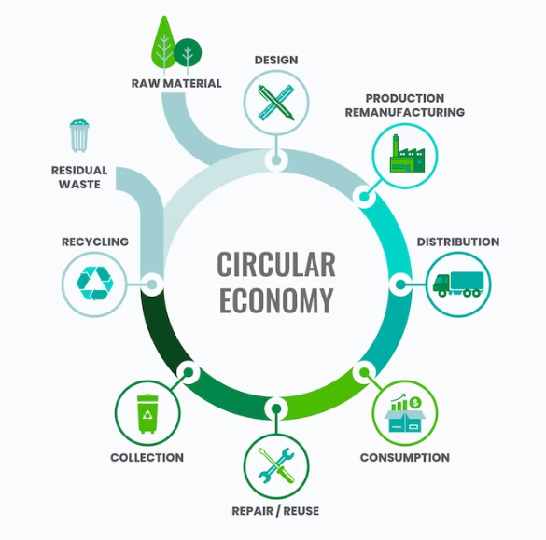
Greening your Business
Thank
you!
circular economy infographic by freepik in https://www.freepik.com/free-vector/flat-design-circular-economy-infographic_21095200.htm#query=circular%20economy&position=4&from_view=search&track=ais

