Slide 1
Business Modelling for Circular Economy Businesses

Slide 2
THE SUSTAINABLE CONSUMPTION

Slide 3
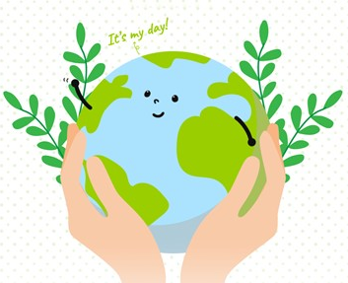
Aim of the Masterclass
Sustainable Consumption is the Holy Grail of environmental sustainability. Sustainable consumption simply put, is to expand the decision-making process of consumers when deciding to buy a product or a service, other than price, quality etc., to include sustainability, however this is defined.
The aim of this Masterclass is to explain the concept of Sustainable Consumption, make it more practical with hands-on activities and provide strategies on how we can achieve a more sustainable future.

Slide 4
Structure of the Masterclass – sustainable consumption
1. What is sustainable consumption
2. How can i achieve sustainable consumption
3. Conclusions and further actions
Explanation of the concept
Activities
Further steps

Slide 5
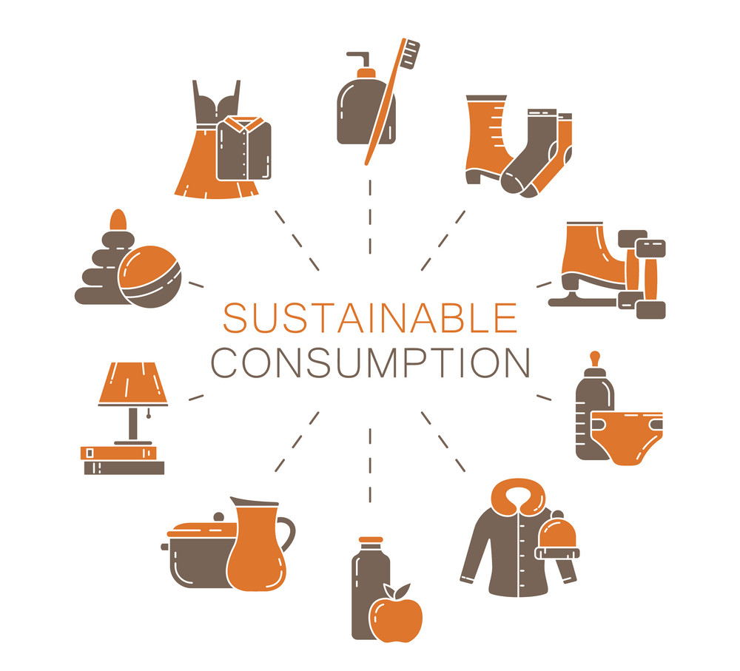
What is sustainable consumption?
“the use of services and related products, which respond to basic needs and bring a better quality of life while minimizing the use of natural resources and toxic materials as well as the emissions of waste and pollutants over the life cycle of the service or product so as not to jeopardize the needs of future generations”

Slide 6
My work - project 2
Facts and figures
Venus has a beautiful name and is the second planet from the Sun
Each year, an estimated one third of all food produced – equivalent to 1.3 billion tonnes worth around $1 trillion – ends up rotting in the bins of consumers and retailers or spoiling due to poor transportation and harvesting practices.
If people worldwide switched to energy efficient light bulbs the world would save US$120 billion annually.
Should the global population reach 9.6 billion by 2050, the equivalent of almost three planets could be required to provide the natural resources needed to sustain current lifestyles.
“The European Commission’s support of this publication does not constitute an endorsement of the contents, which reflect the views only of the authors, and the Commission can not be held responsible for any use which may be made of the information therein.”

Slide 7
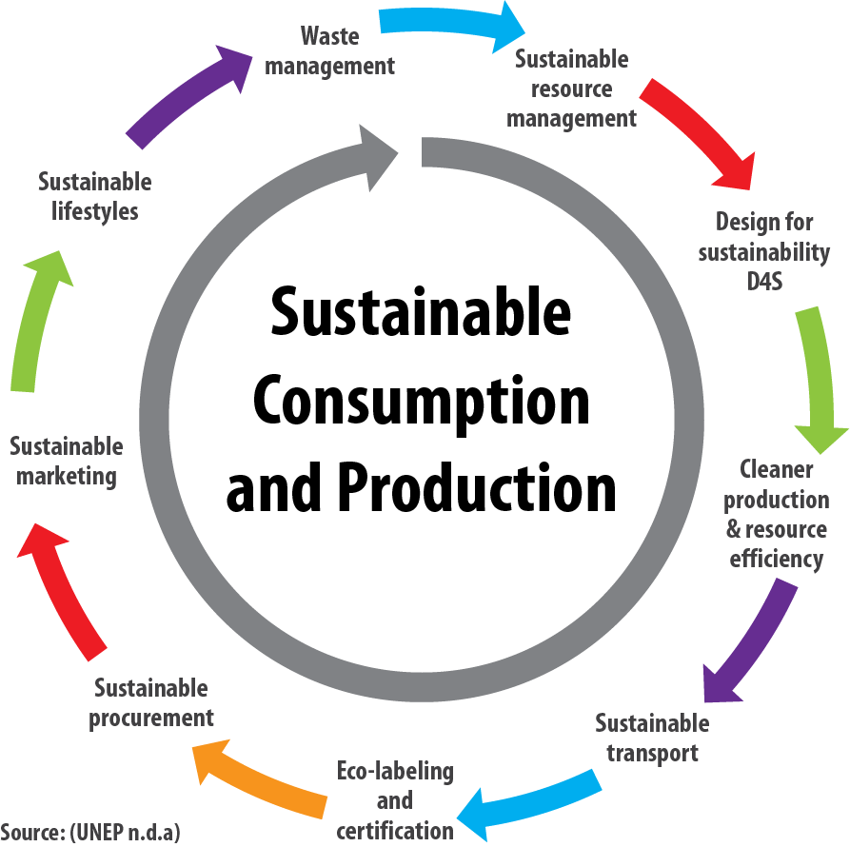
Sustainable development is based on three fundamental pillars: social, economic and environmental.

Slide 8
Decision-Model of Sustainable Consumption: Determinants and Motivations
Attempts to explain or change behaviour towards a more sustainable consumption must start off with the diverse and interdependent influence quantities of sustainable consumption.
Next picture gives an overview of a general decision-making model of sustainable consumption derived from different studies.
It implies that beliefs lead to attitudes, which in their turn derive intentions. Intentions determine the actual buying behaviour. Many different individual, social and situational factors influence this decision process

Slide 9
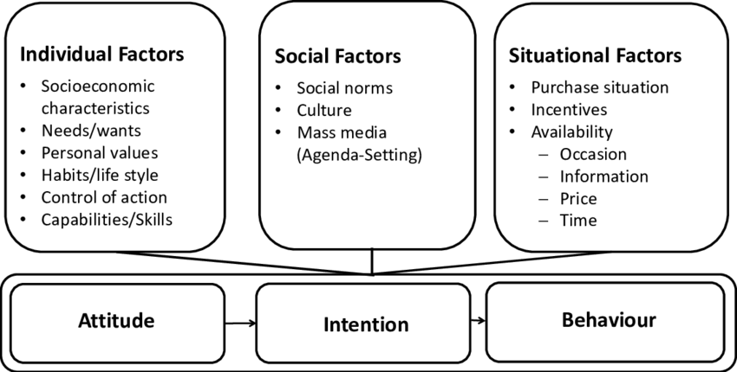
Decision-Model of Sustainable Consumption: Determinants and Motivations

Slide 10
What are the examples of sustainable consumption?
Strong sustainable consumption refers to participating in viable environmental activities, such as consuming renewable and efficient goods and services (such as electric locomotive, cycling, renewable energy).

Slide 11
What are the examples of sustainable consumption?
Sustainable consumption can be understood to include a range of changes in behaviour, such as greater efficiency in the consumption of energy and resources in the home, the minimisation of waste, and more environmentally sound purchasing habits of households.

Slide 12
ACTIVITY
How can I / we influence on these three fields to achieve more sustainable future?
WATER
ENERGY
FOOD

Slide 13
ACTIVITY
Group 1: Design a water saving system for your home / company:

Slide 14
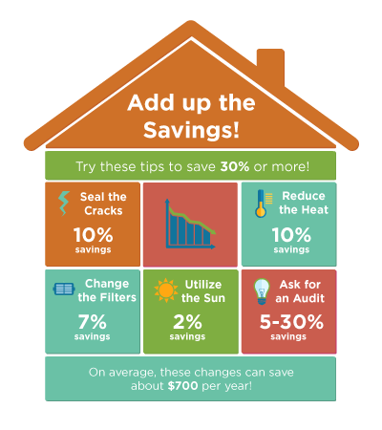
ACTIVITY
Group 1: Design an energy saving system for your home / company:

Slide 15
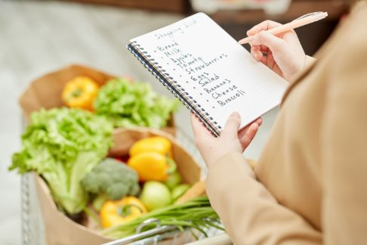
ACTIVITY
Group 1: Design a food saving system for your home / company:

Slide 16
ACTIVITY
Group 1: Design a food saving system for your home / company:

Slide 17
Conclusion
When it comes to sustainable consumption for businesses, here are some final conclusions for you to consider:
Sustainability should be integrated into all aspects of a business, including product design, sourcing, production, packaging, distribution, and end-of-life considerations
Move away from the traditional linear "take-make-dispose" model and embrace circular economy principles
Encourage customers to make sustainable choices by offering eco-friendly products and services
Foster a culture of innovation within your organization. Allocate resources to research and development efforts focused on sustainable technologies, materials, and processes

Slide 18
Conclusion
Join industry collaborations, partnerships, or initiatives focused on sustainability. By working together, businesses can address systemic challenges and drive industry-wide change.
Sustainability is an ongoing journey. Regularly evaluate and reassess your sustainability initiatives, learn from successes and failures, and adapt your strategies accordingly.
Engage in continuous improvement to drive positive environmental and social impacts.

Slide 19
Thank you
Any Questions?

