Slide 1
Business Modelling for Circular Economy Businesses

Slide 2
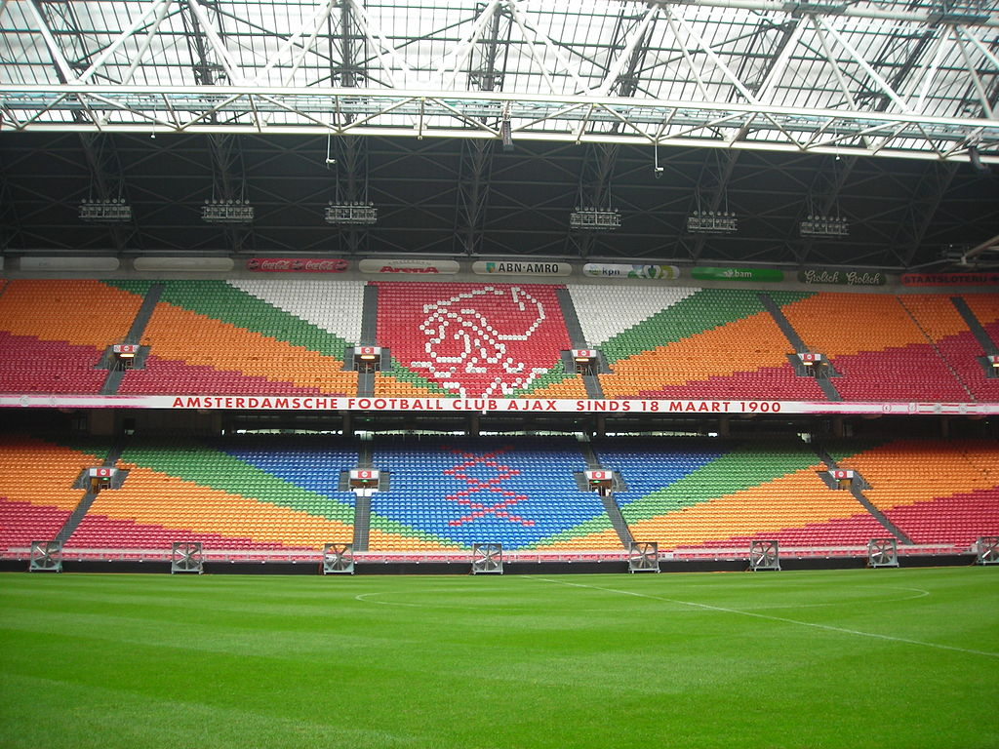
THE SECOND LIFE OF A STADIUM SEAT
AMSTERDAM ARENA: A CASE STUDY FOR REUSE AND RECYCLING OF DISCARDED STADIUM SEATS
CC BY-SA 4.0

Slide 3
Aim of the Masterclass
This Masterclass aims to deliver a recycling and reuse-based case study in the context of circular business models.
The trainees will have the opportunity to develop a Design Thinking Canvas and a Sustainable Business Model Canvas while deepening their knowledge in the concepts of:
• Circular Business Models
• Design Thinking
• Collaborative Recycling/Reuse
• Up-cycling

Slide 4
Structure of the Masterclass
TYPE OF ACTIVITY | • In-class activity
LEARNING OBJECTIVES | • Circular business models • Collaborative recycle/reuse • Design Thinking • Circular economy practices
TRAINING METHOD(S) | • PBL (Problem based learning), experiential learning
TIME/ DURATION | • Overall duration: 90 minutes (depending on the size of the group) • 20 minutes to share the THE SECOND LIFE OF A STADIUM SEAT case study. • 5 minutes to explain the Design Thinking Canvas exercise. • 25 minutes to develop the Design Thinking Canvas in small groups and to share the learnings and results with everyone. • 5 minutes to explain the Business Model Canvas exercise. • 25 minutes to develop the Business Model Canvas in small groups and to share the learnings and results with everyone. • 10 minutes for final discussion, wrap up and summary.
GROUP SIZE | • 20 people at most; the subgroups should not be more than five people

Slide 5
Structure of the Masterclass
SETUP (ENVIRONMENT) & NECESSARY TOOLS | • Flipcharts, markers, sheets to take notes, pens, exercises templates. All materials should consider the number of participants (must be prepared prior to the workshop).
DESCRIPTION | The trainer gives a general perspective of the masterclass structure and opens the circular economy subject with the Ellen Macarthur sentence. The trainer presents the case study highlighting the concepts of: Circular Business Models; Design Thinking; Recycle; Reuse; Up-cycling. The trainer explains the first proposed exercise for the trainees to develop in small groups. The trainees share their findings, and the trainer asks questions to explore their results and introduces the concept of collaborative recycle/reuse in the presentation. The trainer adds a twist and present a new exercise with a different problem to be solved using the Business Model Canvas exercise. The trainees share the findings and the trainer interfere to dynamize with questions and suggestions on the business model. The trainer closes the masterclass with an overview of the results achieved.
CONCERNS AND IMPLEMENTATION SUGGESTIONS | The trainer must prepare for the moderation of the group dynamics in advance considering the following: • Communication examples (good and bad) • Possible solutions • Twisting/complication factor
LEVELS & VARIATION | To adapt the exercise to the local, in-house situation if possible. Make sure to approach sensitive topics assertively.

Slide 6
“To solve big problems like climate change, waste, and pollution, we need a big idea.
It’s time to rethink how we design, make, and use the things we need, from the food we eat to the clothes we wear.
Together, we can create a better future for business, society and the natural world”.
Source: https://ellenmacarthurfoundation.org/

Slide 7
The Amsterdam ArenA CASE STUDY
The Amsterdam ArenA, named as Johan Cruyff Arena, is the stadium of the Ajax football club and a venue for concerts and events. In preparation for the hosting of the European Football Championship in 2020 (UEFA Euro 2020), the club replaced all stadium seats, but wished to reuse the old seats with a circular approach. They engaged the Urban Technology research programme expertise at the Amsterdam University of Applied Sciences (AUAS) in this project.
As a baseline scenario, it was assumed, that the stadium seats were to be treated as waste, meaning that the steel frames could be sold to metal manufacturers for recycling, while the seats could end up being partly ‘downcycled’ and partly incinerated by plastic recyclers.

Slide 8
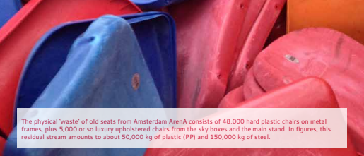
The Amsterdam ArenA CASE STUDY
With this starting point, three alternative scenarios were explored to give the stadium seats a second life:
• Scenario 1: Redistribution of seats for reuse in other stadiums
• Scenario 2: Upcycling of stadium seats to consumer chairs
• Scenario 3: Recycling the raw material of stadium seats for various applications
Source: https://www.hva.nl/binaries/content/assets/subsites/kc-techniek/second-life-of-a-stadium-seat.pdf?1541515706243

Slide 9
The Amsterdam ArenA CASE STUDY
Scenario 1: Redistribution of seats for reuse in other stadiums
In the first scenario, stadium seats, including the frames, are disassembled, transported and installed in other stadiums. The Amsterdam ArenA, distributed removed seats to amateur stadiums in various parts of the world. For example, 2500 seats were sent to Curaçao, 2700 to Surinam and 2000 seats were reserved to football fields in the Netherlands. This reuse scenario was helpful for amateur stadiums because of their limited means to build or upgrade their current galleries with new seats.

Slide 10
The Amsterdam ArenA CASE STUDY
Scenario 2: Upcycling of stadium seats to consumer chairs
In the scenario to explore the upcycling of the stadium seats, several options were identified, starting with the collection of chair designs and corresponding prototypes made with the original seats:
• Chair designs reusing the original steel frames
• Chair designs incorporating other, existing frames
• Chair designs with a customised frame
• Chair designs with a digitally produced frame

Slide 11
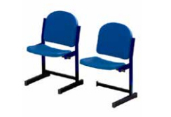
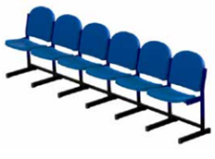
The Amsterdam ArenA CASE STUDY
Scenario 2: Upcycling of stadium seats to consumer chairs
Chair designs reusing the original steel frames
This option was probably the best from a circular economy perspective, as the aim was to reuse as much material as possible from the existing seats. Several furniture manufacturers and production companies were involved to consider this solution. The chosen chair is made of the existing frame and plastic parts of the original seat, mounted onto a newly built base.
Prototype of single chair connectable to others, made by Ahrend.
Source: https://www.hva.nl/binaries/content/assets/subsites/kc-techniek/second-life-of-a-stadium-seat.pdf?1541515706243

Slide 12
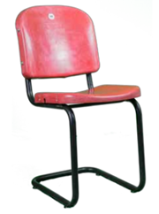
The Amsterdam ArenA CASE STUDY
Scenario 2: Upcycling of stadium seats to consumer chairs
Chair designs incorporating other, existing frames
This was the option of mounting the plastic stadium seats onto an existing, preferably reused, chair frame in an upcycling solution. Existing frames helps reduce the environmental impact and represents cost savings, as it was not necessary to produce new ones. Nonetheless, the geometry of the existing old seats is so specific that it proved hard to find suitable frames to perfectly fit and mount them on. The solution was to need to make further adjustments to the plastic parts, resulting in more labour and materials.
Prototype of chair with existing tube frame, made by AUAS.
Source: https://www.hva.nl/binaries/content/assets/subsites/kc-techniek/second-life-of-a-stadium-seat.pdf?1541515706243

Slide 13
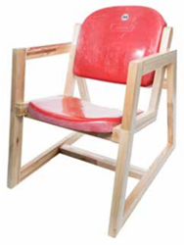
The Amsterdam ArenA CASE STUDY
Scenario 2: Upcycling of stadium seats to consumer chairs
Chair designs with a customised frame
The option of making a customised frame was also explored, in order to avoid the risk of a low availability of existing frames. Considering several solutions, the first new chair frame was produced by hand, using recycled wood from industrial pallets as raw material. Although being potentially a good solution, scaling up production to larger quantities would not be easy because of limitations related with the production method and the required labour.
Prototype with customized frame using reclaimed wood, designed by AUAS and made by Panter.
Source: https://www.hva.nl/binaries/content/assets/subsites/kc-techniek/second-life-of-a-stadium-seat.pdf?1541515706243

Slide 14
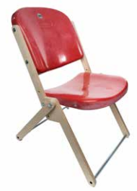
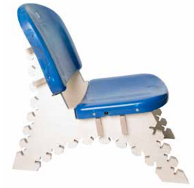
The Amsterdam ArenA CASE STUDY
Scenario 2: Upcycling of stadium seats to consumer chairs
Chair designs with a digitally produced frame
Digital production makes it easy to create complex shapes to fit the specific characteristics of the plastic seats.
One example was a set of separate flat wooden pieces that can be assembled by the costumer. It can be produced by CNC, milling a single standard wooden plate, perfectly suitable for packing and shipping to the final customer. With this same method, it was produced a folding chair as an alternative. 3D Printing was used to produce a plastic connector to interconnect standard tubular profiles into a suitable chair frame. This option could help to reduce transport costs due to the possible printing in different locations.
Prototype of foldable chair by AUAS
Design and prototypes by AUAS with digitally produced frame that can be easily costumised.
Source: https://www.hva.nl/binaries/content/assets/subsites/kc-techniek/second-life-of-a-stadium-seat.pdf?1541515706243

Slide 15
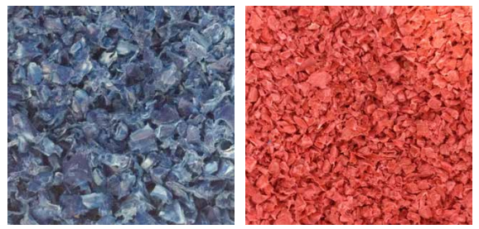
The Amsterdam ArenA CASE STUDY
Scenario 3: Recycling the raw material of stadium seats for various applications
Not all 50,000 stadium seats will be suitable for reuse through redistribution or upcycling because of broken, degraded seats. A recycling process was explored for these remaining plastic parts to use them as a ‘new’ raw material to make products.
Aiming to keep the raw material of the seats as close to the original as possible, it were tested different processing techniques, to determine possible applications, namely pressure and injection moulding, and 3D Printing.
Granulate fromold plastic seats.
Source: https://www.hva.nl/binaries/content/assets/subsites/kc-techniek/second-life-of-a-stadium-seat.pdf?1541515706243

Slide 16
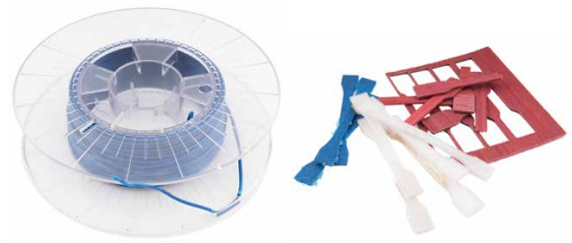
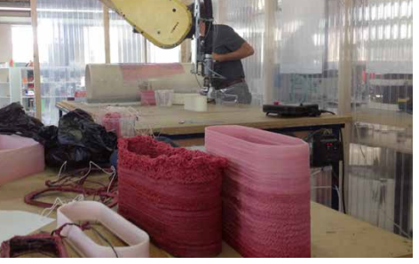
The Amsterdam ArenA CASE STUDY
Scenario 3: Recycling the raw material of stadium seats for
various applications
3D Printing filament and tensile test bars for material testing
After tests, the granulate of the seats proved as effective as virgin polypropylene. Tensile strength, elasticity and density showed promising results: they demonstrated good material performance, slightly inferior to virgin new material. (final application subject to more material analysis)
3D printing can promote circular economy with the use of recycled plastics and unlock a creative potential, a social connection and an environmentally positive impact that should be accessed.
Large scale 3D Printing with an industrial robotic arm.
Source: https://www.hva.nl/binaries/content/assets/subsites/kc-techniek/second-life-of-a-stadium-seat.pdf?1541515706243

Slide 17
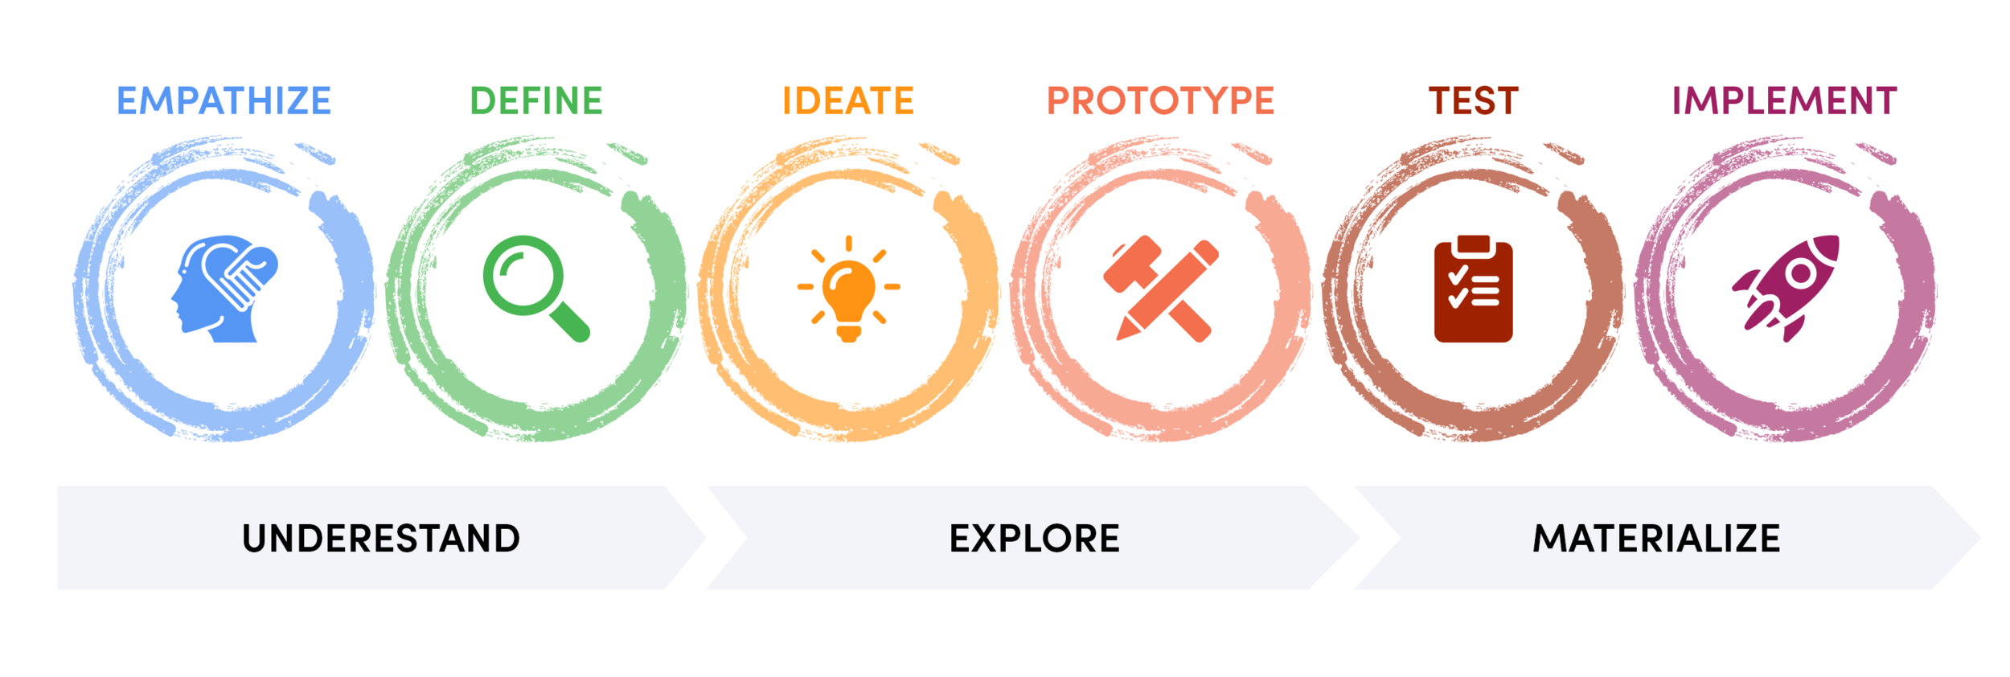
Exercise 1
Design thinking
Imagine that you have to find a solution to how these old plastic chairs could be transformed as a collaborative reuse/recycling action with other countries.
You are tasked with creating a Design Thinking Canvas as a structured approach to plan a design-led strategy and process.
Source: https://freshworks.io/design-thinking-process/

Slide 18
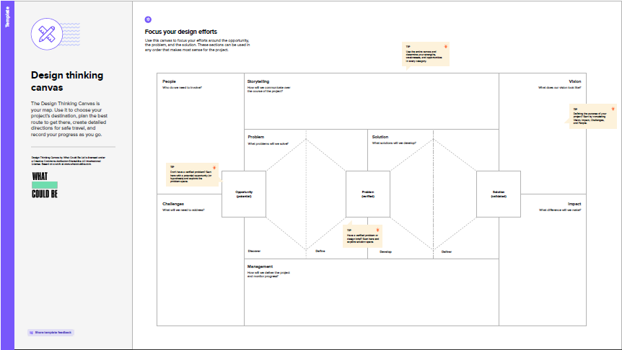
Exercise 1
Design Thinking Canvas
The Design Thinking Canvas is your map. Use it to choose your project destination, plan the best route to get there, create detailed directions for safe travel, and record your progress as you go.

Slide 19
Exercise 2
Business Model Canvas
Imagine that you are a plastic chair producer facing a major shortage in raw materials and you need to find a solution for your business following the circular economy principles. Use a Business Model Canvas to develop a new business model.

Slide 20
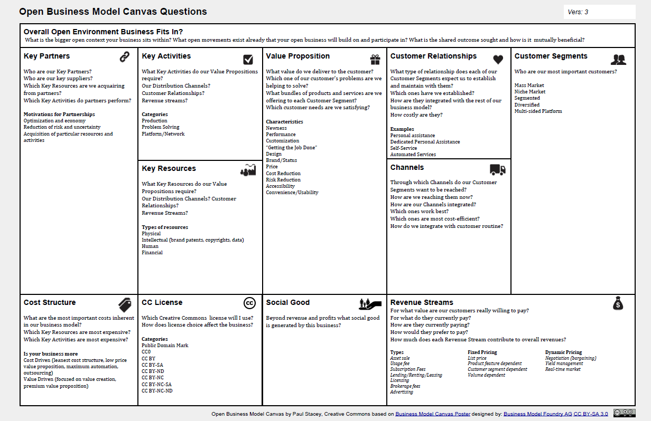
Exercise 2
Business Model Canvas
The business model canvas is a great tool to help you understand a business model in a straightforward and structured way. It will lead to insights about the customers you serve, what value propositions are offered through what channels, and how your company has profit.

Slide 21
Thank you
Wrap up and summary
• The second life of a stadium seat
• Circular Business Models
• Design Thinking
• Collaborative Recycling/Reuse
• Design thinking canvas
• Business model canvas

