Slide 1
Business Modelling for Circular Economy Businesses

Slide 2
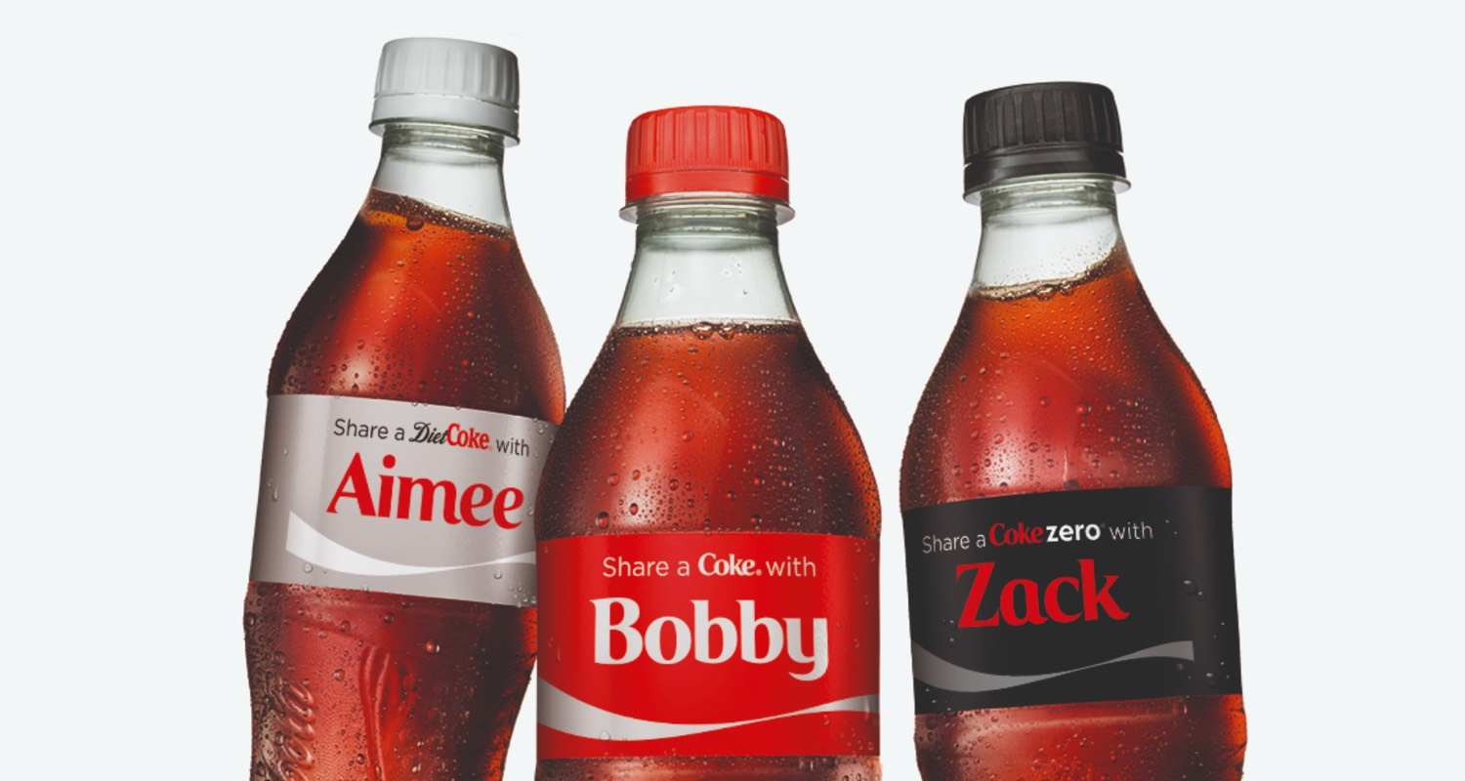
THE CO-CREATION OF PRODUCTS/SERVICES BUSINESS MODEL
The Co-creation of Products/Services model brings end-users closer to the design and manufacturing phases by identifying consumer preferences in order to customise the end-user requirements

Slide 3
Aim of the Masterclass
This Masterclass will focus on the Co-creation of Products / Services Business model
Main goal is that participants understand how co-creation works, why is it important, and how can it be achieved

Slide 4
Structure of the Masterclass
Co-creation explained
Case study
activity
Explanation of the term co-creation of the products / services.
Successful example of the Co-creation Business model.
Activity for participants to make co-creation business proposal.

Slide 5
What is co-creation of products / SERVICES?
Co-creation is the practice of collaborating with other stakeholders to guide the design process.
Participants with different roles align and offer diverse insights, usually in facilitated workshops. Designers can therefore get more holistic views of what a product or service should include.

Slide 6
My work - project 2
CUSTOMER CO-CREATION explained
Venus has a beautiful name and is the second planet from the Sun
Co-creation occurs, when firms involve customers as partners in the process of product development (Prahalad & Ramaswamy, 2004).
They interact with the aim to create joint value (Van Dijk, Antonides & Schillewaert, 2014).
By so doing, firms use inflows of knowledge to accelerate innovation (Pee, 2016).
So, besides co-creation, the terms open innovation or co-innovation are often used in a similar manner.
“The European Commission’s support of this publication does not constitute an endorsement of the contents, which reflect the views only of the authors, and the Commission can not be held responsible for any use which may be made of the information therein.”

Slide 7
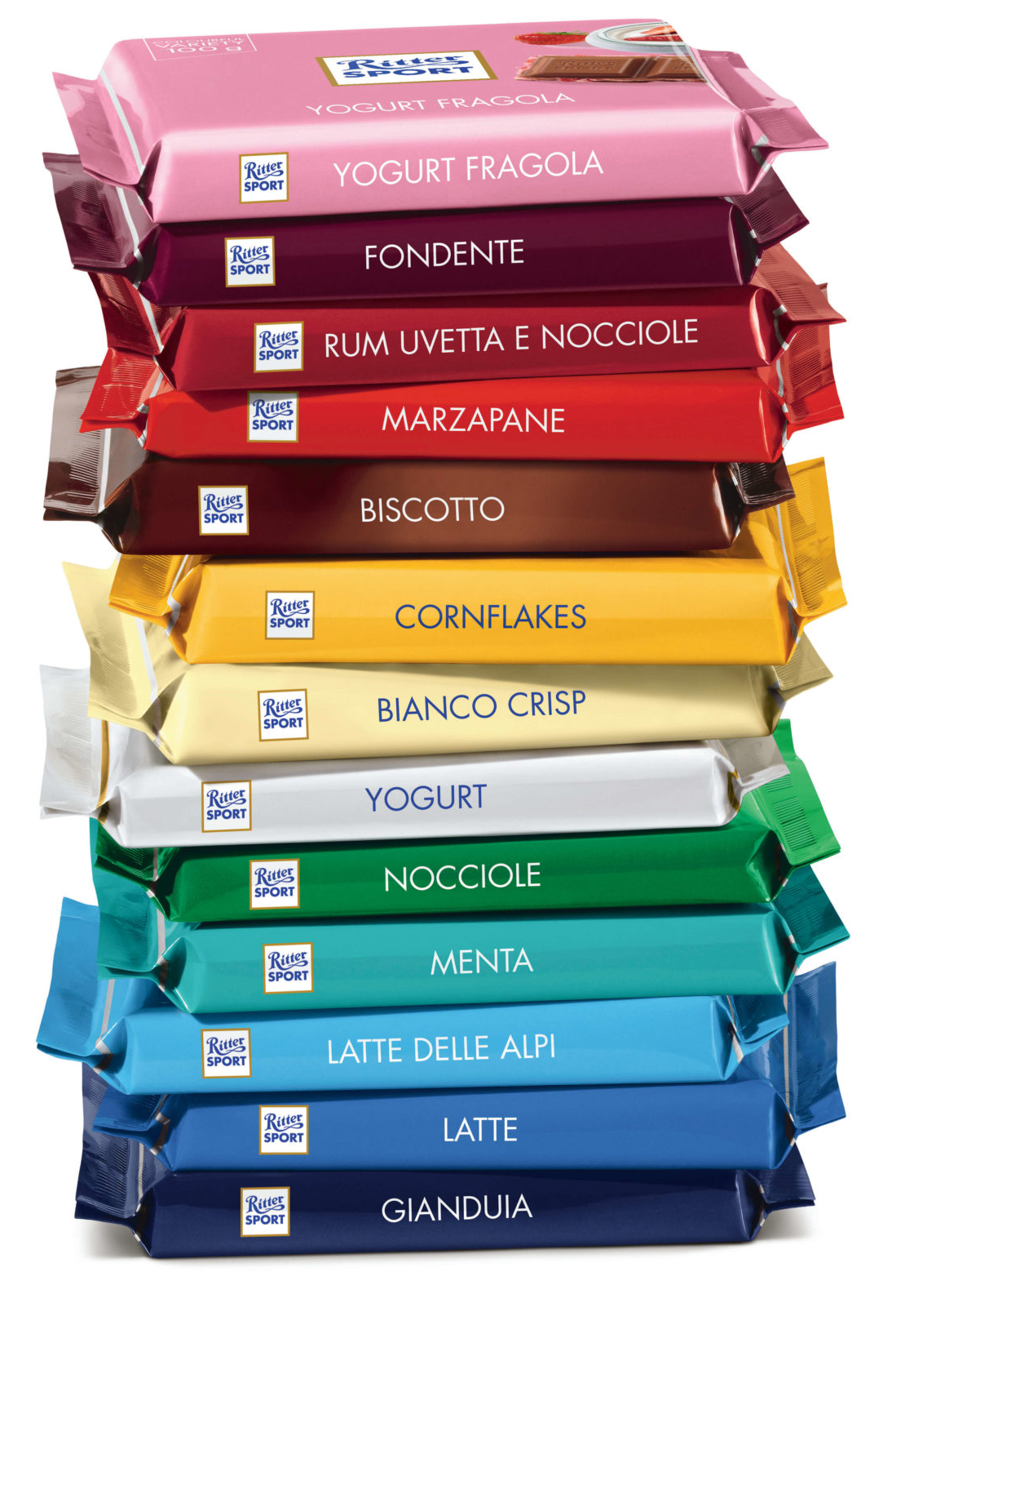
CASE STUDY
RITTER SPORT is one of the most popular confectionery brands in Germany and famous for its quadratic shape. The chocolate manufacturer has a turnover of € 470M and exports to more than a hundred countries (Ritter Sport, 2016).
Ritter Sport has an important online asset, which is an interactive webpage called Sortenkreation (translated: chocolate creation). The platform encourages customers to generate ideas for new products and, in this way, to participate in co-creation.
They can choose ingredients, add a description and create a design. Additionally, users can like, comment and share their own or other ideas with friends in social media.

Slide 8
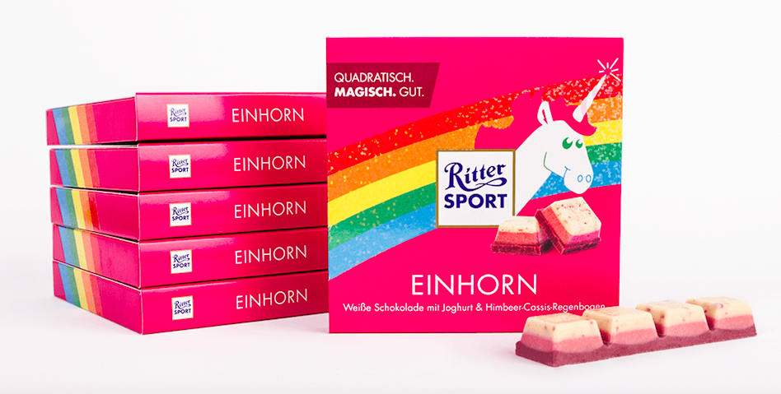
CASE STUDY
Lately, a chocolate with the logo of Ritter Sport and the given name ‘unicorn glitter’ has randomly made its way through social media. Users all over the web have immensely engaged with these unicorn chocolate posts. The chocolate was a fake, yet it helped Ritter Sport to measure and identify enormous potential for a co-creation with a unicorn theme.

Slide 9
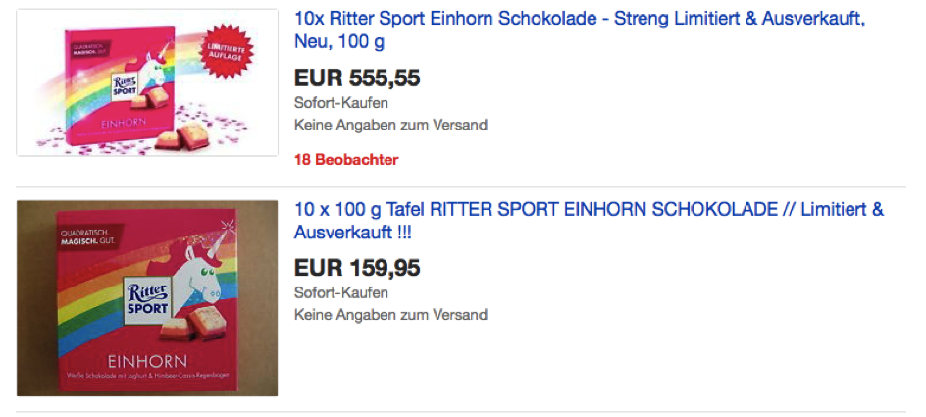
CASE STUDY
Ritter Sport manufactured the unicorn chocolate as a limited edition and announced its launch online in social media. Moreover, its communication agency worked with Influencers to spread the product awareness even more. The results are fabulous, like the unicorn. The chocolate bars were sold out within hours. The demand was so extreme that users, who successfully bought a unicorn chocolate bar, resold it on eBay for a price up to 333 times as high as the initial selling price of €1.99.

Slide 10
5 LESSONS THAT MAKE YOUR CO-CREATION A SUCCESS

Slide 11
5 LESSONS THAT MAKE YOUR CO-CREATION A SUCCESS
MOVE AWAY FROM THE TRADITIONAL MARKETING PERSPECTIVE
The first step is to acknowledge that modern marketing has only little in common with the traditional view you tremendously hold on to. The Internet, and in particular social media, are among the greatest inventions in the 20th century and change the way brand management and product development work. Nowadays, users fill various roles, from a retailer on eBay to a video-producer on YouTube (Hennig-Thurau et al., 2013) to a co-creator of the brand and new products or services. They are no longer passive absorbers (Gensler, Völckner, Lui-Thompinks & Wiertz, 2013).
Yet, co-creation does not work at a moment’s notice. You must challenge internal structures and beliefs first. Common barriers to successful co-creation are organizational or managerial learning procedures, such as inertia or preference (Woodruff, 1997). Sentences like ‘I like to do it this way’ or ‘This is how we do things’ have to be abandoned from your organisation’s vocabulary.

Slide 12
5 LESSONS THAT MAKE YOUR CO-CREATION A SUCCESS
2. IDENTIFY POSSIBILITIES FOR CO-CREATION THAT WORK WITH YOUR BRAND
Once you have successfully overcome the internal barriers, it is your turn to brainstorm possible ways, in which consumers can contribute to the co-creation process. This is important because of two reasons. First, customer co-creation should fit your brand, strategy and goals. Second, if you do not pay attention to customers’ ideas, they may develop negative sentiments (Gebauer, Füller & Pezzei, 2013), which, as a consequence, may also affect your brand.

Slide 13
5 LESSONS THAT MAKE YOUR CO-CREATION A SUCCESS
3. GIVE YOUR CUSTOMERS A VOICE AND LISTEN TO THEM
You can either collaborate with your customers in generating ideas for co-creation, in selecting ideas or in both. Idea generation collects valuable inflows of knowledge about current customer needs and wants. The selected idea, then, highlights what the collective finds most appealing. Therefore, co-creation enables you to develop innovative products that fit the consumption needs and sell better, respectively (Pee, 2016).

Slide 14
5 LESSONS THAT MAKE YOUR CO-CREATION A SUCCESS
4. USE A CO-CREATION TO ITS FULLEST POTENTIAL
Once the co-created product is about to be launched, full commitment and a well-planned marketing strategy can empower customers’ buying desire. Reconsider our case of Ritter Sport and the unicorn again. Shortly before the launch, Ritter Sport has made customers curious about an upcoming, extraordinary surprise with the help of various social media channels and the power of Influencers.

Slide 15
5 LESSONS THAT MAKE YOUR CO-CREATION A SUCCESS
5. BE PREPARED
Never forget to be well prepared for troubling situations, even though you won’t expect them. Indeed, the unicorn co-creation could have been more of a success for Ritter Sport. It was not the limited amount of unicorn chocolate bars that upset the customers, rather the web shop.

Slide 16
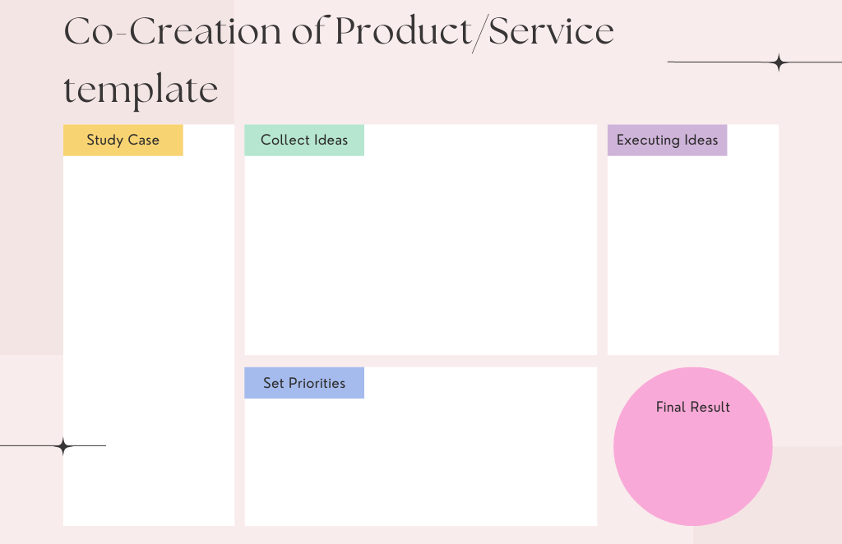
ACTIVITY
Use this template to create your Co-creation of product business model proposal:

Slide 17
Thank you
Any Questions?

